Slide 1



  Innovation Metrics:
  What You Measure is What You Get
  InnoLead / Wazoku Master Class
  10.11.23

Slide 2
  How mature is your approach to innovation metrics?
Non-Existent
Emerging / Taking Shape
Starting to Become Routinized & Reliable
Optimized & Accessible
Developing Innovation Metrics & Reports That Really Matter, March 2021

Slide 3
  Which financial metrics do you consistently use?
Developing Innovation Metrics & Reports That Really Matter, March 2021

Slide 4
  Which non-financial metrics do you consistently use?
Developing Innovation Metrics & Reports That Really Matter, March 2021

Slide 5
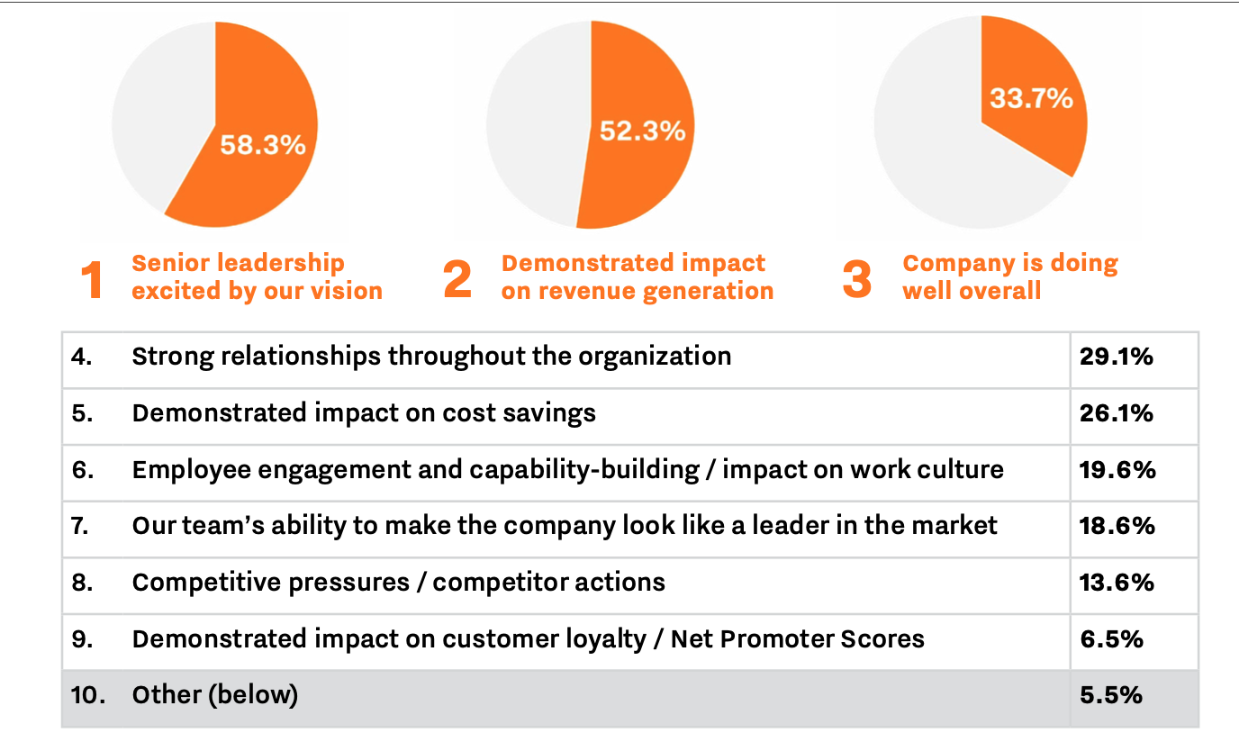
  What are the three most important factors that impact your ability to get additional human or financial resources to support innovation?
Benchmarking Innovation Impact 2023

Slide 6


  Coming soon…

Slide 7
  Webinar Polls

Slide 8
  How mature is your approach to innovation metrics?
  Webinar Poll Results
Non-Existent
Emerging / Taking Shape
Starting to Become Routinized & Reliable
Optimized & Accessible
InnoLead / Wazoku Webinar Poll, October 2023

Slide 9
  How mature is your approach to innovation metrics?
  Combined Results
Non-Existent
Emerging / Taking Shape
Starting to Become Routinized & Reliable
Optimized & Accessible
Developing Innovation Metrics & Reports That Really Matter, March 2021; InnoLead / Wazoku Webinar, October 2021

Slide 10
  How long has your most senior innovation leader been in his or her role?
  Webinar Poll Results
InnoLead / Wazoku Webinar Poll, October 2023

Slide 11
  How frequently does your innovation team report innovation metrics to corporate or business unit leadership?
  Webinar Poll Results
InnoLead / Wazoku Webinar Poll, October 2023

