Slide 1

InnoLead + High Alpha Innovation
WINNING WITH GEN AI IN 2024
11.14.2023

Slide 2
SURVEY //
MY ORGANIZATION IS EXPERIMENTING WITH GENERATIVE AI AT THE APPROPRIATE PACE
STRONGLY DISAGREE
STRONGLY AGREE

Slide 3

OODA LOOP //
OBSERVE
ORIENT
DECIDE
ACT
Notes:
OODA Loop - originally developed by an Air Force colonel for use in combat situations where troops wouldn’t have time to gather all of the information needed to make good decisions. It is useful in any situation where you’re dealing with uncertainty. The future is very uncertain! Going to talk today about how to apply the OODA loop to threats/opportunities related to generative AI.

Slide 4
OBSERVE / ORIENT //
GENERATIVE AI IS A CLASSICALLY DISRUPTIVE TECHNOLOGY
Makes the difficult/expensive accessible/affordable
Will create massive opportunities
GENERATIVE AI ALSO HAS CHARACTERISTICS THAT MAKE
IT UNIQUE
Improving exponentially
Corporations have advantages!
Notes:
The first thing to do is to understand the threat and opportunity that generative AI presents. Observe and orient. Innovation teams are in a good position to lead their companies in this effort.
First a definition. Generative AI is AI capable of generating text, images, or other media. LLMs are a form of Gen AI. Not all Gen AI is LLMs.
AI has been around for a long time.
Alan Turing was born a few years before WWI, when soldiers still charged into battle wielding swords. His love of mathematics led him to explore a number of challenging ideas, including the halting problem, the question of whether you could create an algorithm that could determine whether another algorithm would ever complete its operation. He introduced the idea of programmability and cracked open the notion that the only limit to what computers and programs could ultimately do would be the complexity of the devices. It became clear way back then that the human imagination might one day no longer be a rate limiter of scientific advancement and innovation. Turing invented the idea of the imitation game, proposing that a computer might one day be able to trick a human into thinking the computer was a human. That Turing Test as it became known has been passed.
Generative AI is a classically disruptive technology, in the Clayton Christensen definition of that term. It has the promise of making what was previously very difficult or expensive more accessible and affordable to a wider audience, particularly of today’s non-consumers. Generative AI will empower the masses by enabling access to technical capabilities like software coding that were once confined to experts. The science fiction write Arthur C Clarke once said that any sufficiently advanced technology is indistinguishable from magic. Generative AI is still very early in its development, but it already feels like magic. It is likely to move upmarket, perhaps quickly, to displace much more complicated solutions, and even companies, that are currently doing their best to serve their customers but leaving themselves open to low-end disruption.
Impact promises to be massive. Many are worried, I don’t think they should be. Highly recommend the website pessimistsarchive.org. The site chronicles the hysteria and technophobia that has greeted new technologies in the past, things like radios, bicycles, photocopiers, telegraphs, even teddy bears. We should be optimistic about the future of AI, for many reasons, not the least of which history tells us that the optimists are more often right. Pessimists sound smart. Optimists make money.
That said, it’s possible to be overly optimistic too. Vinod Khosla a successful VC who is much smarter than I am recently said that the need to work in society will disappear in 25 years for those countries that adopt AI technologies. He thinks that within a decade AI will be able to do 80% of 80% of all jobs today. I am convinced we will find ways to work and stay busy. Elon Musk recently said that digital super intelligence combined with robotics will essentially make goods and services close to free in the long term. On that point I think he’s actually right; another way to say it is that the world is about to get much richer. Exponentially richer.
Generative AI also has characteristics that make it unique from other disruptive technologies. It’s improving exponentially. NEXT SLIDE
Usually disruptive technologies present clear advantages to startups, but in the case of generative AI big corporations actually–for once–have significant advantages in their access to and control of unique data sets upon which to construct models. But there are lots of risks for corporations too, we’ll talk about that.

Slide 5
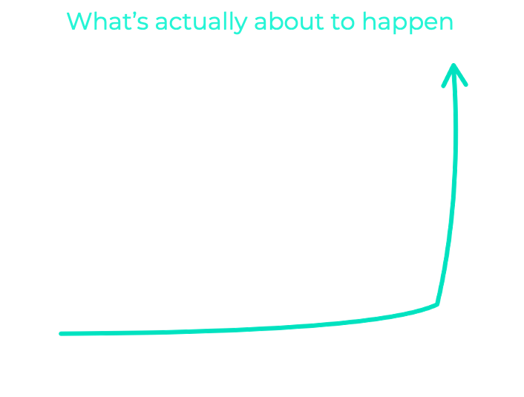
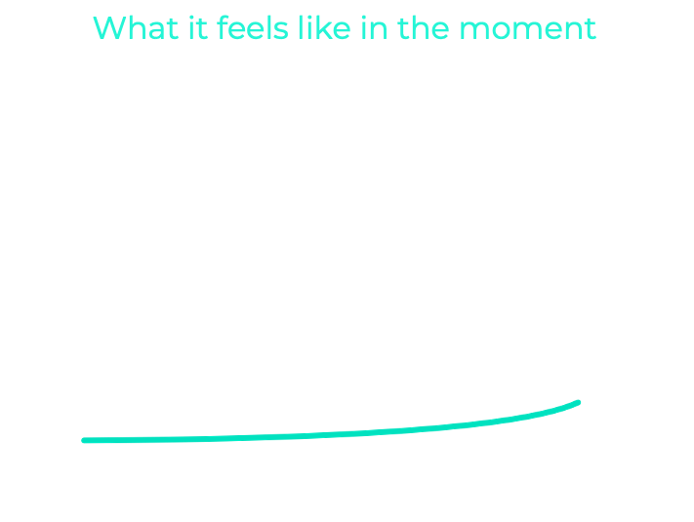
Source: @waitbutwhy
Notes:
Our brains have a hard time understanding exponential growth. When you’re in the middle of an exponential growth curve, it may not even feel that remarkable. But things are about to get crazy. Imagine that chips double in performance next year. LLMs also double in performance next year. Let’s imagine that investment scales capacity by 10x in the next year. That means that whatever you’re seeing now might be 40x better in a year, and another 20-40x better the year after. That’s 1000x better in the very near term. I don’t know what that looks like.

Slide 6
SURVEY //
IF YOUR ORGANIZATION HAS STARTED DEPLOYING GENERATIVE AI, WHAT ARE THE AREA(S) OF FOCUS?
OPTIMIZING OUR EXISTING OPERATIONS
IMPROVING THE EXPERIENCE FOR OUR CUSTOMERS
BUILDING NEW BUSINESSES
OTHER (PLEASE COMMENT IN THE CHAT)

Slide 7
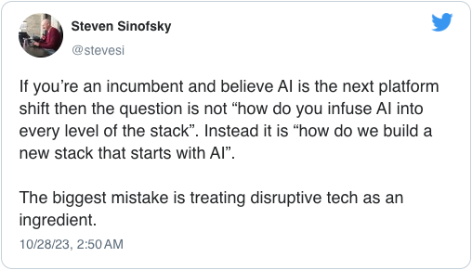
DECIDE //
Notes:
Once you’ve observed the opportunity and oriented yourself to it, the next step is to decide what to do about it. I love this tweet from former Microsoft exec Steven Sinofsky: IF you’re an incumbent and believe AI is the next platform shift then the question is not “how do you infuse AI into every level of the stack”. Instead it is “how do we build a new stack that starts with AI. The biggest mistake is treating disruptive tech as an ingredient.” Yes! So true, and true of every disruptive technology by the way.

Slide 8
WHERE TO APPLY GENERATIVE AI?
Optimize Operations
Improve Experiences
Build New Businesses
AUTOMATION: Efficiency
TRANSFORMATION: Growth
Notes:
Leaders should consider how AI-empowered tools can be used to 1) streamline existing operations, 2) improve customer interactions, and 3) create entirely new business models that do not yet exist. Leaders can begin by taking a look at their operations, products, and services, and asking, “What would a smarter version of this look like?” Once leaders know the answer to that question, they should not wait for someone else to build it. That smarter, AI-enabled version is coming if it is not already here, and if leaders are not asking the question and taking control of the solution, their company will not likely be the beneficiary. The first two columns on this chart here are ways to integrate AI into the existing stack. The last column is about creating entirely new stacks, enabling new businesses, around AI. Let me give you an example of how this applies. Consider a consumer clothing company. Using AI to optimize operations might look like putting in place inventory controls. Improving experiences might look like using AI to generate a virtual dressing room experience. Building entirely new businesses might look like empowering consumers to design new products using generative AI.
The first two columns are great and useful, and corporations should be exploring ways to use generative AI to complete these tasks. But the end result will be table stakes. Real opportunity exists in the third column. If you’re at a corporation, look for ways to leverage proprietary data to build entirely new business models. But beware that pursuing that path is not without risk, and there are right and wrong ways to go about it.
It’s so much easier than is used to be to get started. Until very recently, initiatives had to focus on use cases where structured data was readily available. Collecting, cleaning up, annotating, and syntehsizing heterogeneous data was super difficult. Generative AI can surface and use hidden data, or data stored unstructured in data lakehouses. But you need data infrastructure that is flexible and scalable. You need to be careful about IP and data protection. And you need to consider how what kinds of recommendations from generative AI will be warrantied or not. Negative effects of generative AI produced by scaled corporations are going to be very conspicuous and will erode trust. You should be concerned about inaccurate and unreliable outputs, and need to find ways to differentiate what users can and cannot rely on. The governance you have around your data and use of generative AI will determine how quickly and safely you can move ahead with the technology. The governance challenges related to AI exceed the capabilities of most large organizations currently. What do I mean by that? When you’re working with generative models that suck in and regurgitate all the data they’re exposed to, without regard for sensitivity or accuracy, organizations need to think about security and privacy very differently. Data grows exponentially when it is generated at low cost, and firms need to think about how to manage the growing data sources when much of the data is machine generated and may be of questionable quality. Organizations need to think carefully about bias in their data and models, copyright infringement, and security breaches.
So many organizations are rushing into generative AI without clearly understand the risks and without clear governance. Experiments are fantastic, but it’s important to move cautiously and to put in place appropriate rails.

Slide 9
SURVEY //
THE USE OF GENERATIVE AI IS OFFICIALLY APPROVED.
NEVER
RARELY
SOMETIMES
OFTEN
ALWAYS

Slide 10
ACT //
MORE EXPERIMENTS: FAST, CHEAP, AND WEIRD
Fast: Days, not months
Cheap: Capped/Leveraged where possible
Weird: Challenging existing beliefs
Action creates data, data creates knowledge, knowledge compounds.
SO MORE ACTION.
In the face of an unknown future, the best way to maximize returns and minimize risk is to run as many experiments as possible, at the lowest possible cost per experiment.
Notes:
Once you know where you want to apply generative AI, then ACT. In the face of an unknown future, the best way to maximize returns and minimize risk is to run as many experiments as possible, at the lowest possible cost per experiment. If you’re not already, you should be running a lot of experiments.
What’s an experiment? An experiment is an action you take where the outcome is unknown. YOu need to run a lot of experiments to learn what to do with generative AI, and you need to think about how to run those experiments as quickly and inexpensively as possible. The best experiments are the ones that lead to more experiments because they surface anomalies or surprises that challenge the status quo.
There is no data about the future, so you have to create it. You create data about the future by taking action. That data creates knowledge, and knowledge compounds, so you need to be taking a lot of action.
The good news with generative AI is that the costs are plummeting. You can build custom LLMs for very little money, and very quickly. You can even train those LLMs on your proprietary data, but make sure you understand ownership rights over that data and models once shared. Small, custom LLMs are less prone to hallucination than large models tainted by false information online. Scaled models are still expensive to create, but small models are not. Smaller models can be “good enough” for many applications.
Given some of the risks we already highlighted, and the challenges around governance, we believe that for many applications of generative AI, the best way to pursue those opportunities is through the creation of external startups, where costs and risks are capped, and where partners can inject capital and share in the pursuit. Building external startups–minority owned by the corporation–enables corporations to do more with less, putting a limit on downside risk but no ceiling on upside potential. The approach matches appropriate forms of capital investment to opportunities.
We’re building startups like this with many corporations. Let me tell you about a couple of them.

Slide 11
EXAMPLES //
ALPINE
STEALTHCO
Notes:
Alpine is a company we launched with a health system called OSF Heatlhcare, based in Illinois. Many large health systems have a problem with what they call complex discharges. This is where a person shows up to the hospital, is healed enough to be discharged, but for whom there is nowhere to go. These individuals sometimes stay at a hospital for days, weeks, or even months beyond when they were ready to be discharged. It’s a challenging problem in every healthcare system. What Alpine does is use proprietary data from the health system to predict when a person enters a hospital, with 80% plus accuracy, whether that person is going to be difficult to discharge. This knowledge enables the hospital to immediately begin working on discharge plans the moment a potentially challenging patient arrives the hospital. It has the potential to save costs and produce a far better expeirence for the patient, including improved care outcomes.
Why launch this venture externally? The health system is in the business of caring for patients, and while this technology helps improve patient outcomes, it’s adjacent to the health system’s strategy and know how. Plus, if it works, it’s a solution that many other health systems would be interested in using. That’s proving true. While Alpine was launched initially with a ML/AI model that has proven to be highly accurate, it’s not a leap to imagine how generative AI could one day move from diagnosing difficult discharge cases to actually producing the discharge plans and handling communication.
A few weeks ago we launched a new company, still in stealth mode, that is developing a generative AI tool to help pharma and other heavily regulated companies to generate marketing materials that fit within regulatory and brand guidelines. The pharma ads that you see on TV have likely passed through dozens of rounds of legal and regulatory review before they are shown publicly. Everything is scrutinized: the text, the images, the fonts, the colors. Any infraction can be incredibly expensive, so pharma companies are wisely very careful. What this new stealth company is working on is a tool that takes past, approved marketing materials, an understanding of known guidelines, and critiques marketing materials to help creators produce ads that fall within the rules. Initially the product is targeted at brands with a long operating history, and aims to reduce rounds of regulatory review significantly. At one company the estimated cost savings approach $100M annually. Why launch externally? A startup can move infinitely faster, and more cheaply, to build a solution. The risks are mitigated and confined to the startup in the initial testing and development. Once the tool works there is massive upside in providing the service to other businesses. So while it creates operational efficiency in the pharma company we developed it with, when shared with others it creates an entirely new business model, marketing review as an automated service. It won’t be long before critiques shift to suggestions, and generative AI is actually producing marketing content. This will be critical in a world where advertising is more customized, interactive, and generative.

Slide 12
THREE THINGS TO WIN WITH GEN AI IN 2024 //
01
OBSERVE / ORIENT:
UNDERSTAND AND ALIGN
02
DECIDE:
BUILD NEW BUSINESSES
03
ACT:
FAST, CHEAP, WEIRD EXPERIMENTS

Slide 13

ELLIOTT PARKER
CEO, HIGH ALPHA INNOVATION
@erparker // elliott@highalphainno.com

