Slide 1
GenAI Tournament Introduction Template
Guidelines for Participants
Date
Notes:
Ryan

Slide 2
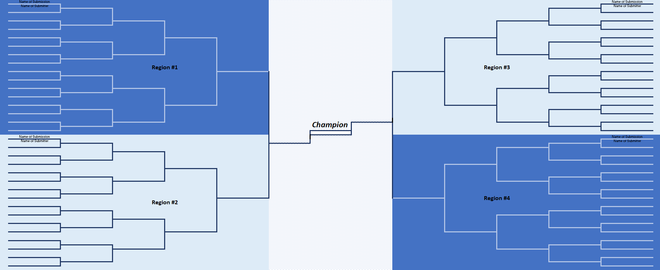
Objective
The objectives of this competition are:
Demonstrate practical business use cases for text-based generative AI (GenAI)
Identify priority concepts for further development and the resources needed to support them
Foster collaboration, knowledge sharing, awareness and understanding of generative AI
Encourage innovation and creativity
Identify and recognize talent
A global tournament to identify the best ideas
Notes:
Ryan

Slide 3
Navigating [GenAI Tool of Choice]
[This section should be for describing how your employees can access and use your GenAI tool of choice]
Notes:
Speaker: Tim W

Slide 4
Usage Guidelines & Restrictions
At this stage in the competition, you must use [Chosen GenAI Tool] [and we are not able to up-train the model on data]
  [This capability may be available at further stages in the competition.]
The data that generative AI uses may not be from a vetted and fact-based source. Therefore, its output could compromise fact-based decisions. These models can publish plausible-sounding answers that could be based on nonsensical, biased or incorrect data.
Use of [Chosen GenAI Tool] should comply with the “[Link to Your Generative AI Policy]” announced on [Date]. However, you can use [Company Name] sensitive information since its within our ecosystem.
  Questions on how the policy might impact your proposed use case can be directed to [Generative AI Contact within Your Company]
Notes:
Speaker: Steffanie Edwards

Slide 5
Details on Recording Your Demo
[This section should be for instructions on how to record a demo video using whatever means your company has]
Notes:
Speaker: Tim W

Slide 6
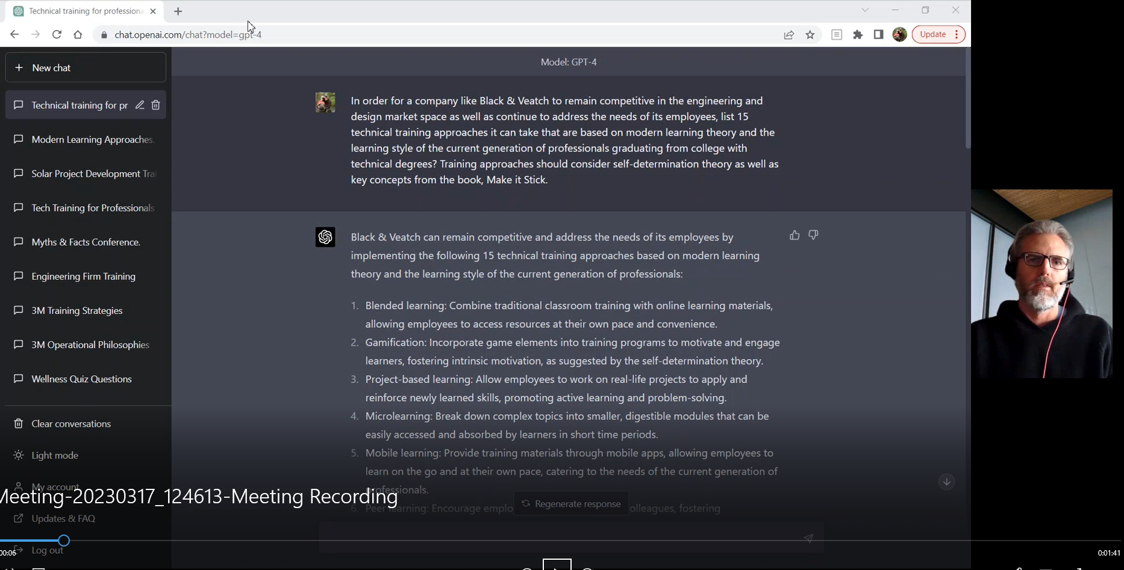
90 Second Video Examples
We have prepared some example videos to help guide you when making your own:
[Link to Example videos prepared by your team – Or we can provide]

Slide 7
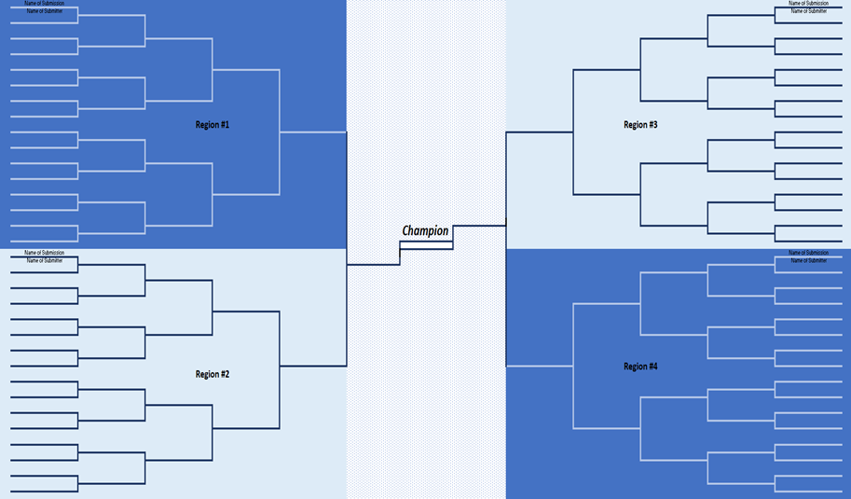
Tournament Overview
Prequal
Round 1 & 2
Round 3 & 4
Final 4
Round 3 & 4
Round 1 & 2
Prequal

Slide 8
Tournament Timeline (subject to change)
90sec Videos Due
5min Videos Due
Round 1 (64)
Round 2 (32)
Top 16 Announced
Round 3 (16)
Round 4 (8)
X/XX
X/XX through X/XX
X/XX
X/XX
X/XX through X/XX
Final Four Announced
Final Four
Championship
X/XX
X/XX
The first two rounds (64 & 32) will be based on your 90s video submissions
For the round of 16 & 8 you will create a longer video (5 minutes) with more time for explanation / demonstration
The final 4 and championship is tentatively scheduled to take place in person
Notes:
Speaker:

Slide 9
Competition Rules
Each submitter can have at most 2 use cases in the bracket
You will not be penalized for being slightly over or under 90 seconds
You must utilize [Chosen AI Tool] for your use case demonstration
Your video submission should have some form of demonstration using [Chosen AI Tool] . If your use case involves training the model, be creative.
Use cases must remain generally consistent throughout the competition. However, ideas can be expanded upon and become more sophisticated as the tournament proceeds from round-to-round.
Notes:
Speaker:

Slide 10
Judging Process and Criteria
Round 1 & 2 (64 →16)
90 sec pre-recorded videos will be matched against each other in 4 regional brackets
Round 3 & 4 (16 → 4)
Judging criteria:
Final 4
Judging criteria:
Judging criteria:
Business value
Scalability / expandability
Business value
Scalability / expandability
Business value
In-person competition
Each region will have a 90-minute Teams meeting for the matches
5 min pre-recorded videos will be matched against each other in 4 regional brackets
Each region will have a 45-minute Teams meeting for the matches
The same video used for rounds 1 and 2
The same video used for rounds 3 and 4
Creativity / fun
Format TBD
Considering a secondary process for great ideas knocked out too early

Slide 11
Prizes
1st place - $XXXX
2nd place - $XXXX
3rd place - $XXX
4th place - $XXX
In addition, the top-ranked competitors will be evaluated for further development, training and customization.
If a team is selected as a winner, the participants will decide how to split the prize.
Cash prizes will be provided on an after-tax basis.

Slide 12
Questions?
[Contact Email]

