Slide 1
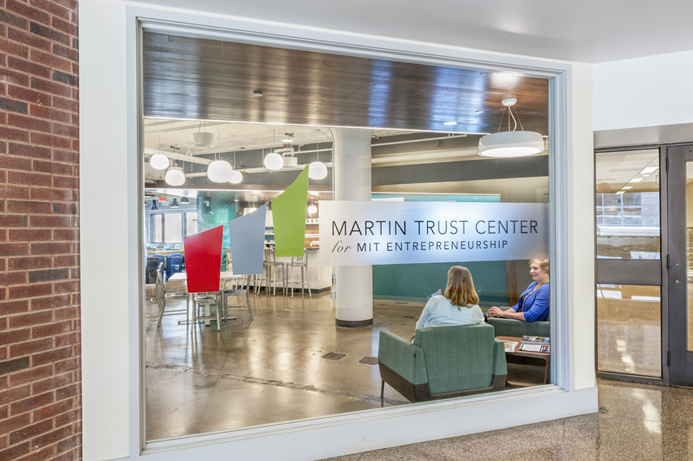


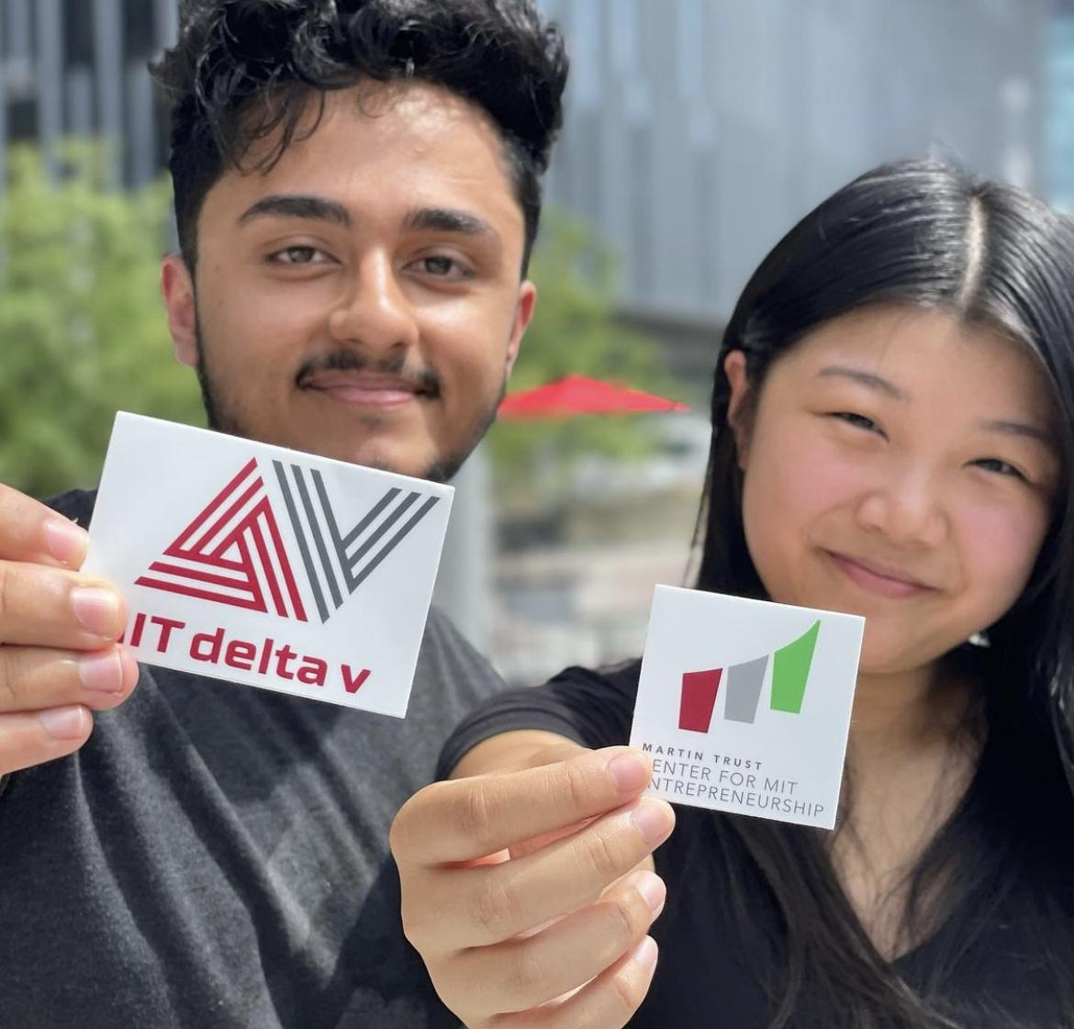
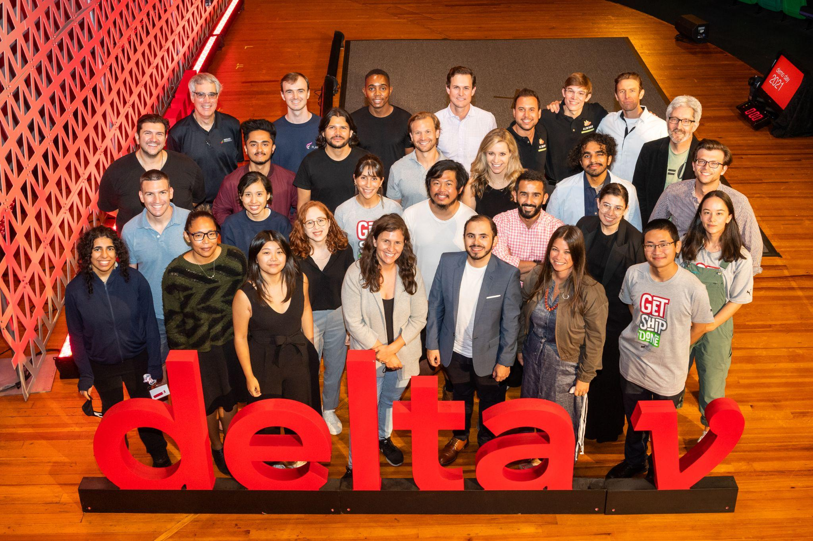


February 5, 2024
MIT Orbit Product Update
Disciplined Entrepreneurship
“Piloting AI-Enabled Assistance”
dougw1@mit.edu
https://orbit.mit.edu/disciplined-entrepreneurship

Slide 2
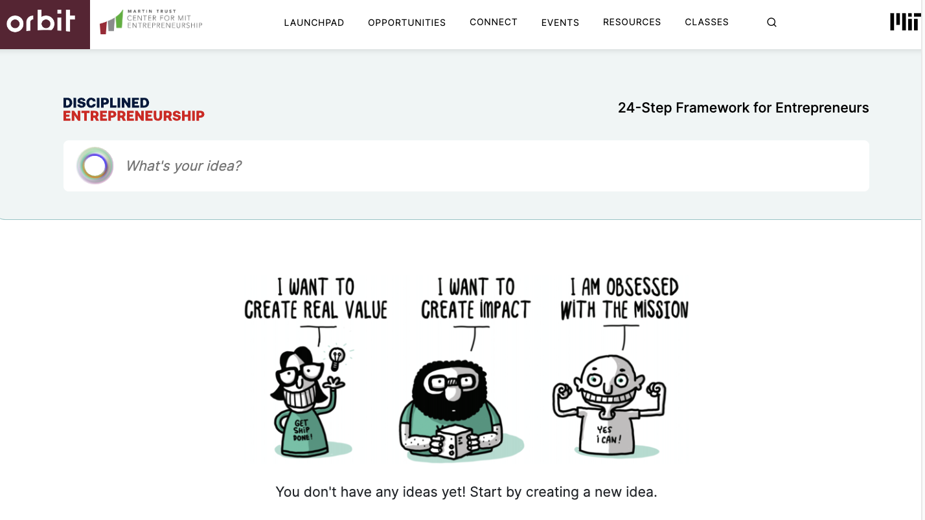
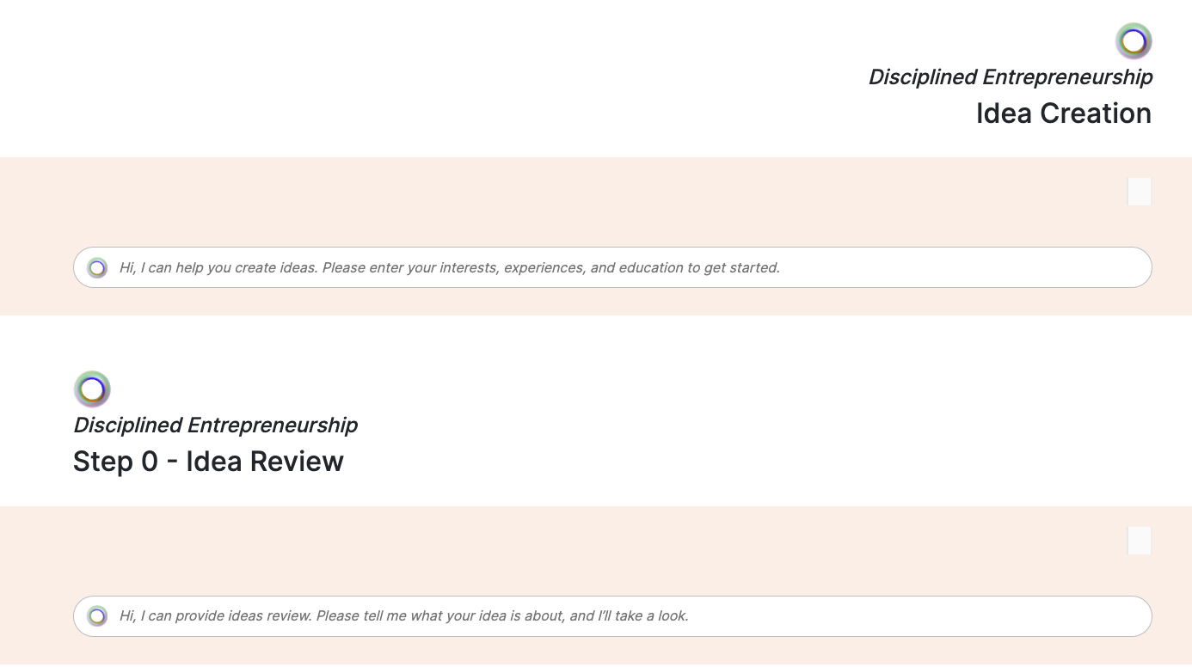
Orbit - Disciplined Entrepreneurship - AI Guidance
Enter your startup idea…
Or try idea creation, and review

Slide 3
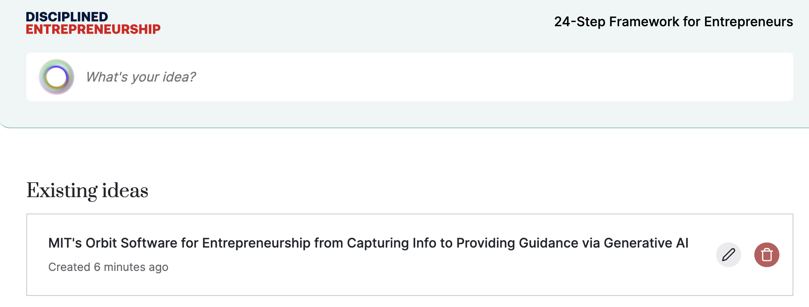
Orbit - Disciplined Entrepreneurship - AI Guidance
Once you enter your idea…
It saves to your “idea bank”

Slide 4
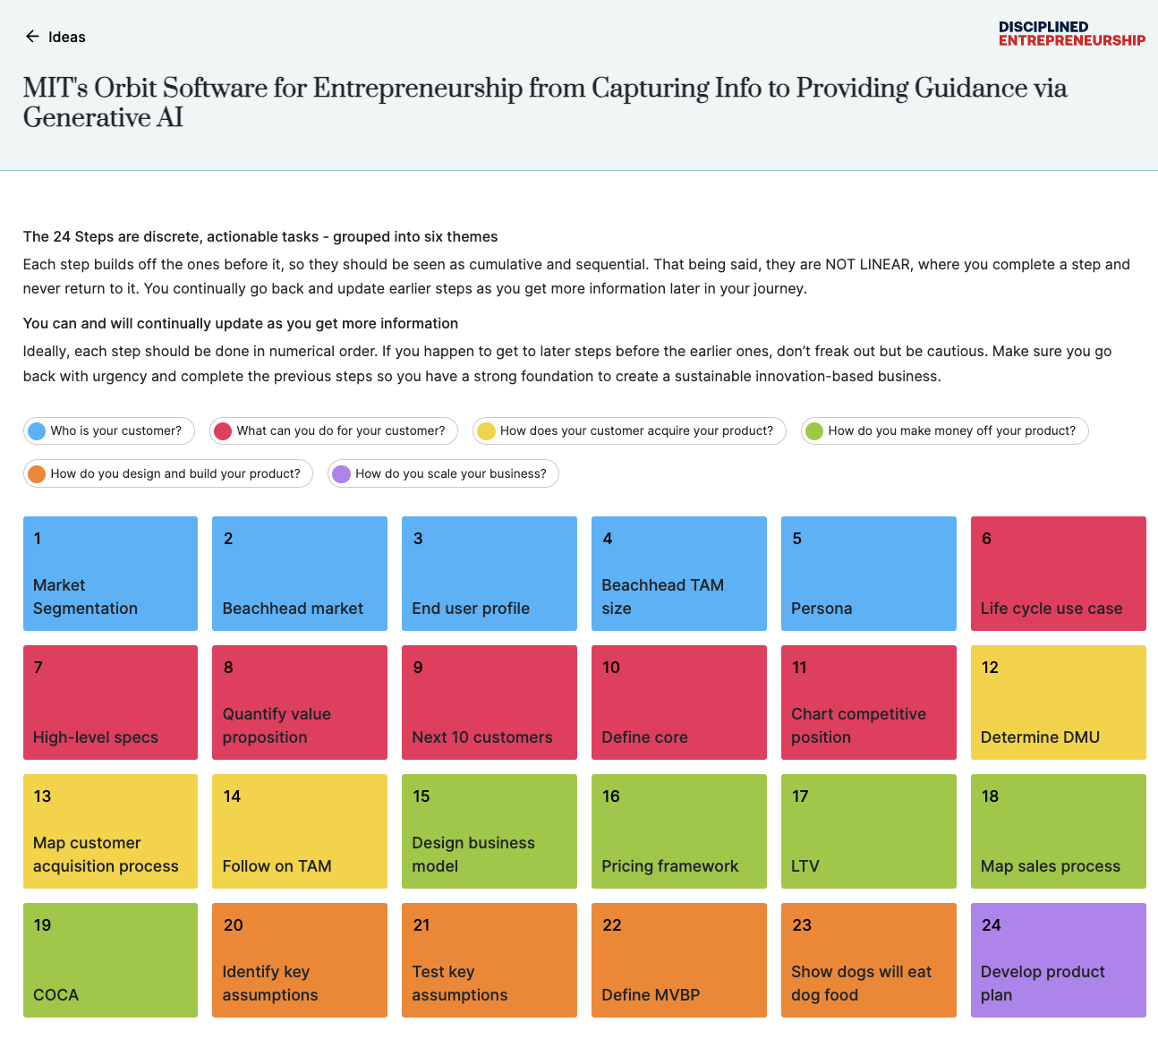
Orbit - Disciplined Entrepreneurship - AI Guidance
Click on your idea, to take you to the Disciplined Entrepreneurship framework, “the 24-Steps”

Slide 5
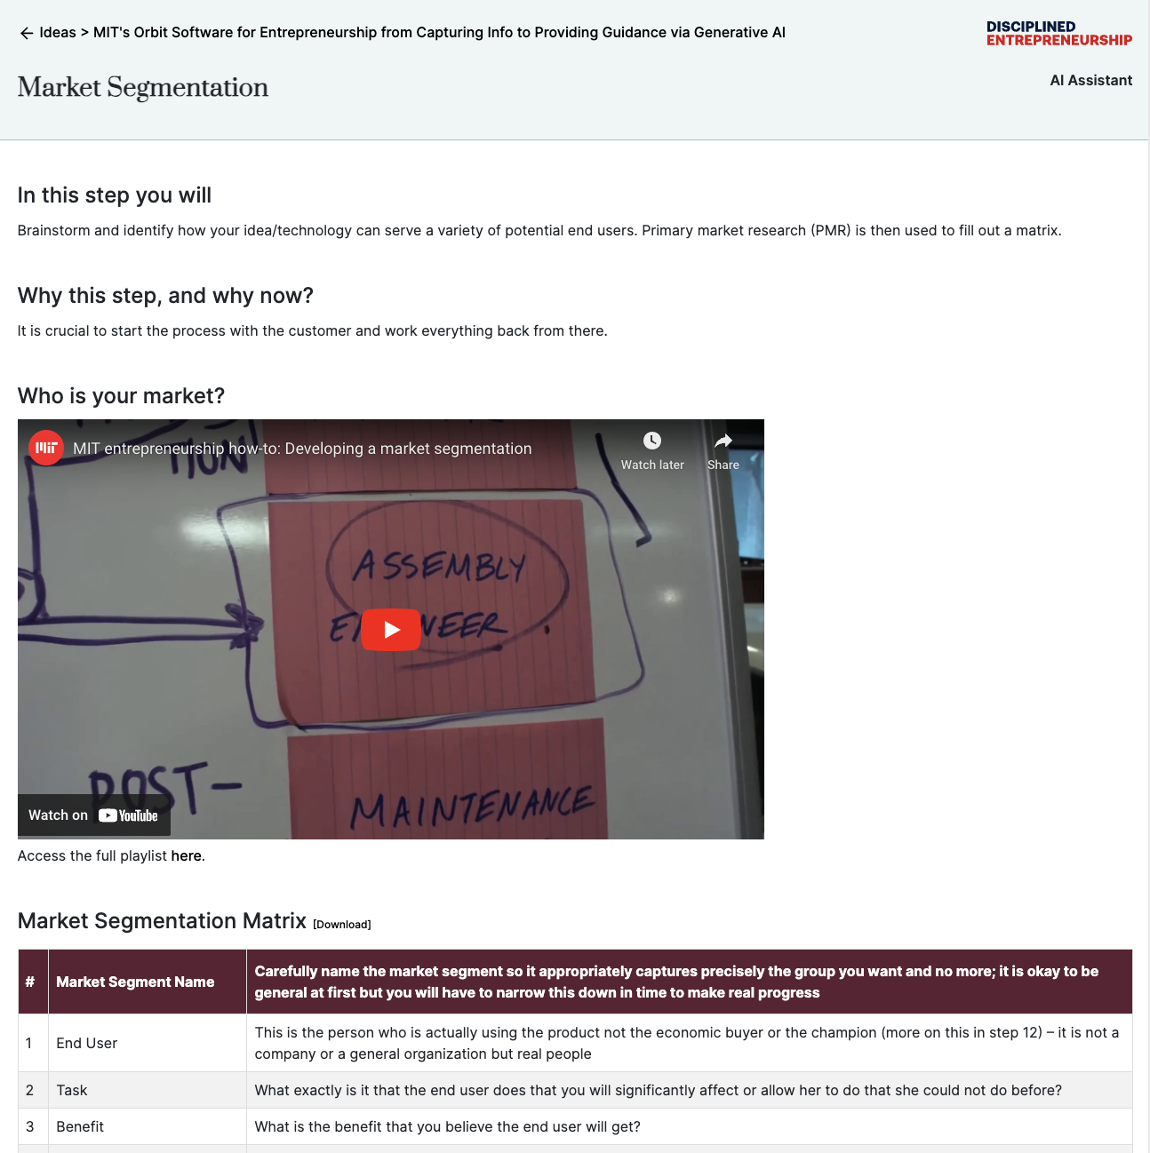
Orbit - Disciplined Entrepreneurship - AI Guidance
Step 1 - Market Segmentation:
Videos, Worksheet, and AI Assistant

Slide 6
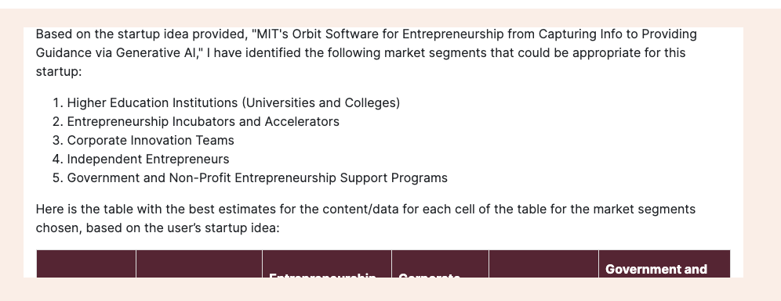
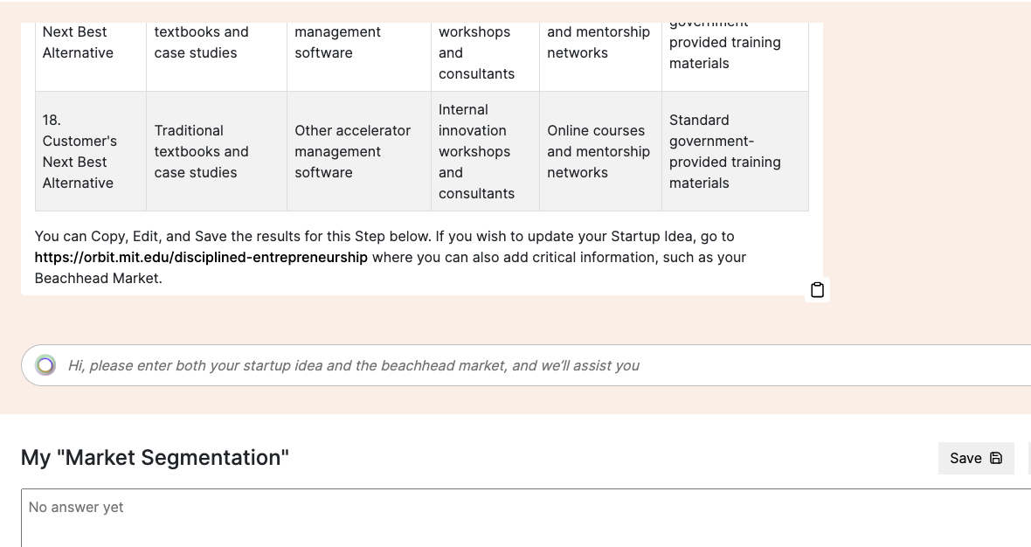
Orbit - Disciplined Entrepreneurship - AI Guidance
AI Assistant fills out the Market Segmentation worksheet…
And you can save to
“My Market Segmentation”

Slide 7
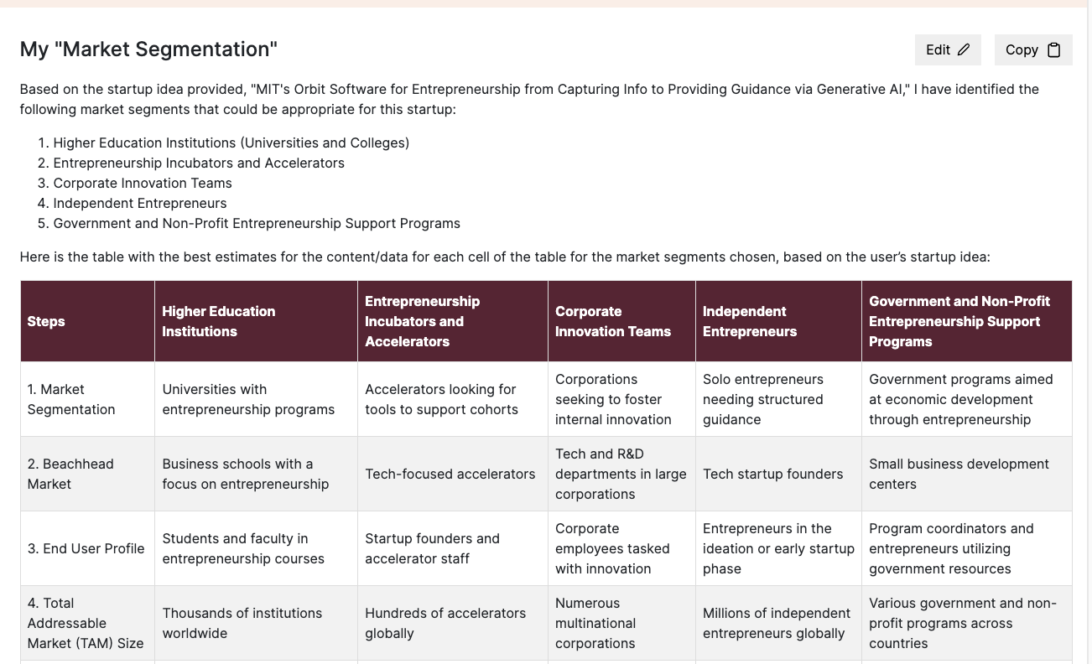
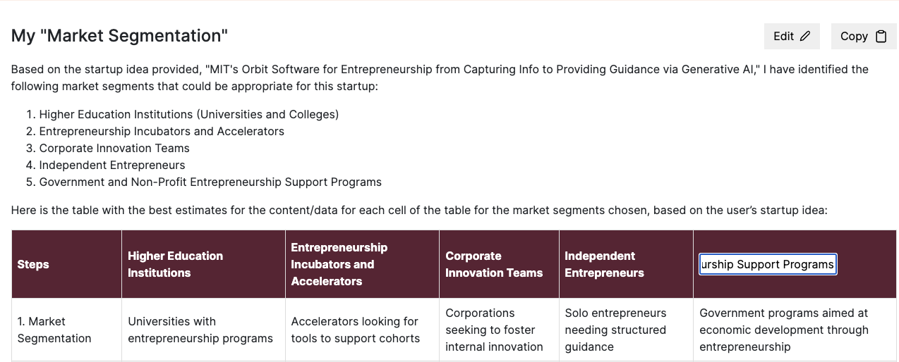
Orbit - Disciplined Entrepreneurship - AI Guidance
Can edit the entire output…
OR, individual cells 😎

Slide 8
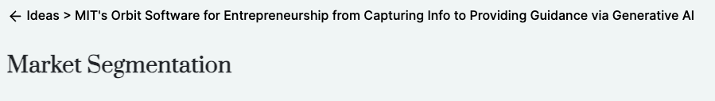
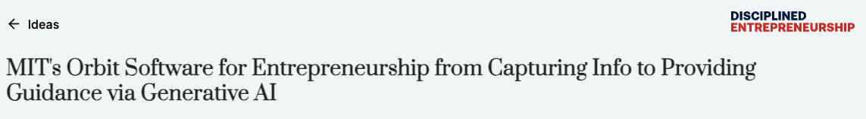
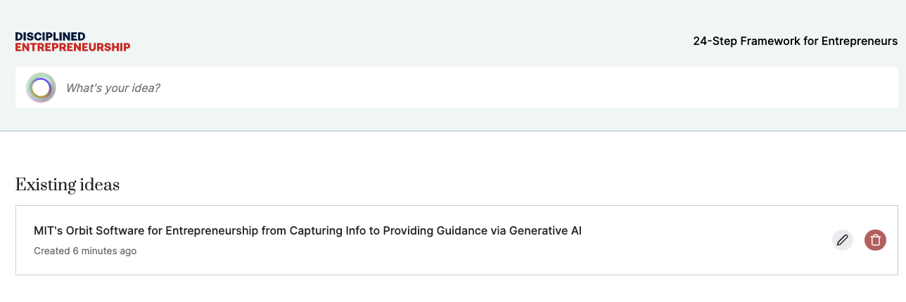
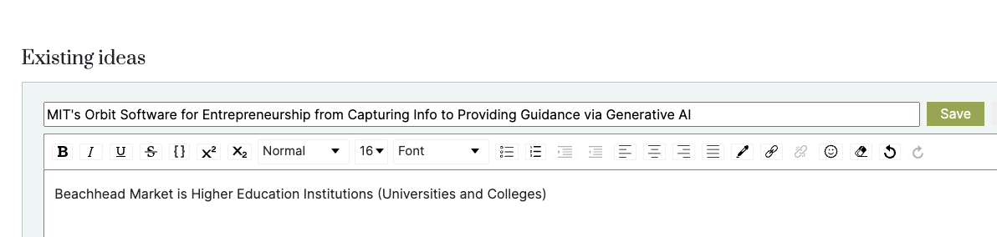
Orbit - Disciplined Entrepreneurship - AI Guidance
OR, individual cells 😎
Can edit the entire output…
Can then edit the idea, add beachhead market, adjacent markets etc

Slide 9
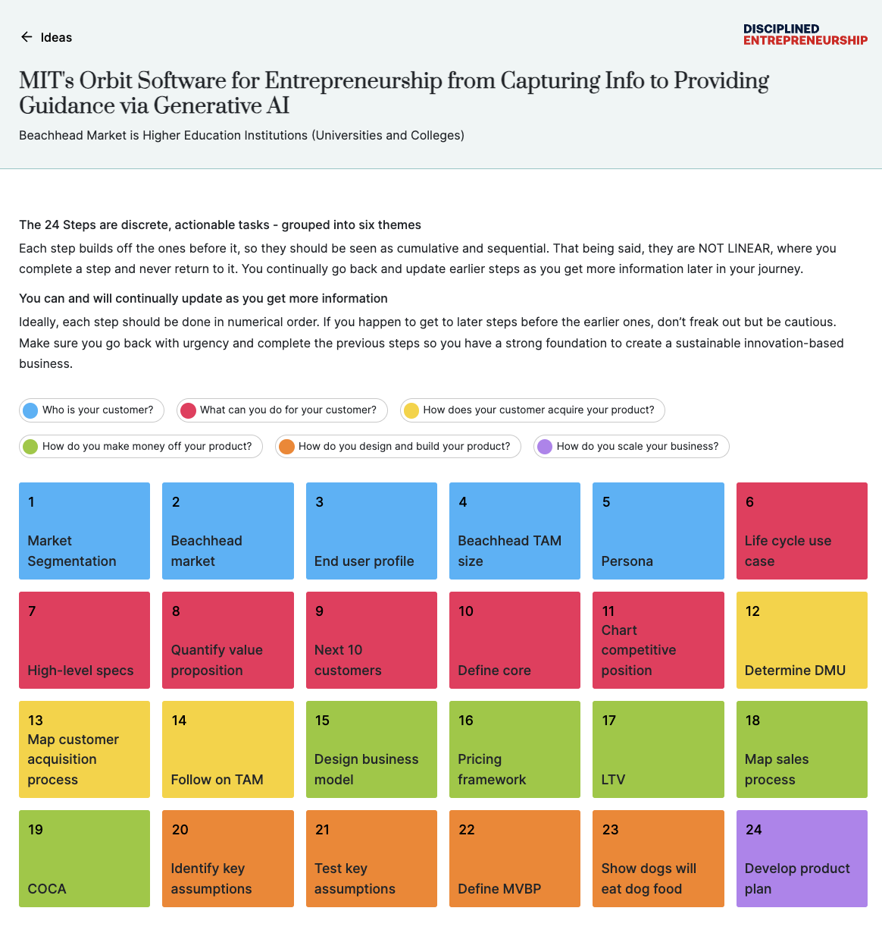
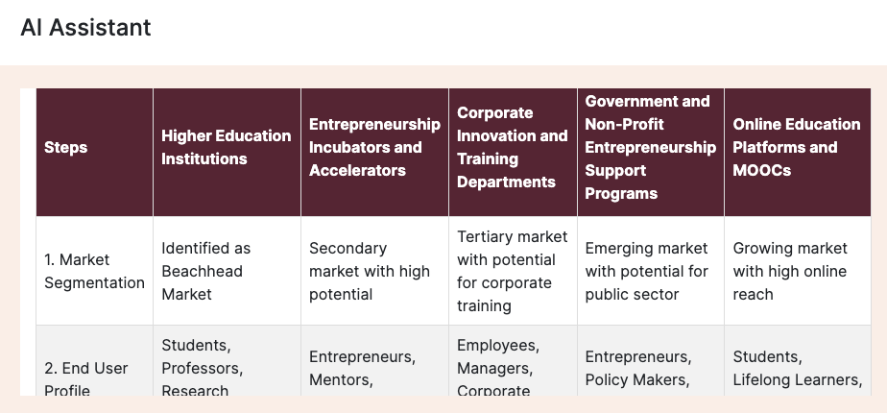
Orbit - Disciplined Entrepreneurship - AI Guidance
OR, individual cells 😎
Can edit the entire output…
Allowing you to iterate quickly on your ideas, beachhead markets etc

Slide 10
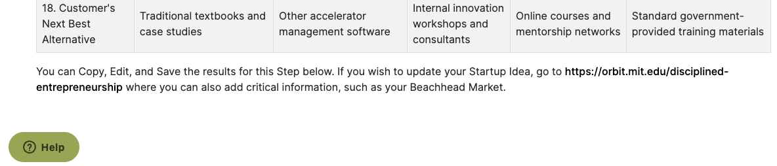
Orbit - Disciplined Entrepreneurship - AI Guidance
OR, individual cells 😎
Can edit the entire output…
Questions / Feedback
Email Doug Williams, dougw1@mit.edu
Many thanks to Nav (design), Alfredo (code), Amu (AI)
Pablo/StackAI (“No Code GenAI Platform)
Paul, Bill, MIT Alumni (inspiration, guidance)
Still lot’s to update

Slide 11
February 5, 2024
MIT Orbit Product Update
Disciplined Entrepreneurship
“Piloting AI-Enabled Guidance”
dougw1@mit.edu
https://orbit.mit.edu/disciplined-entrepreneurship

Slide 12
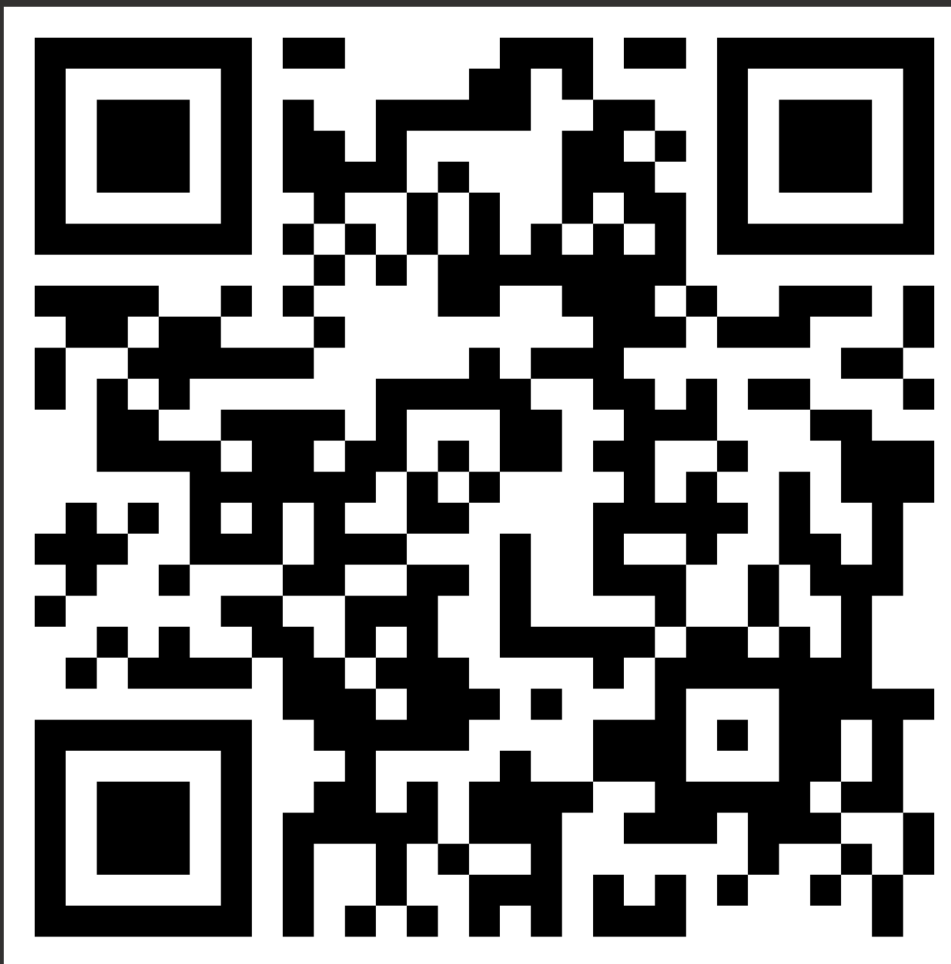
New Enterprises - 2/12 Class Attendance - QR Code
OR, individual cells 😎
Can edit the entire output…

