Slide 1
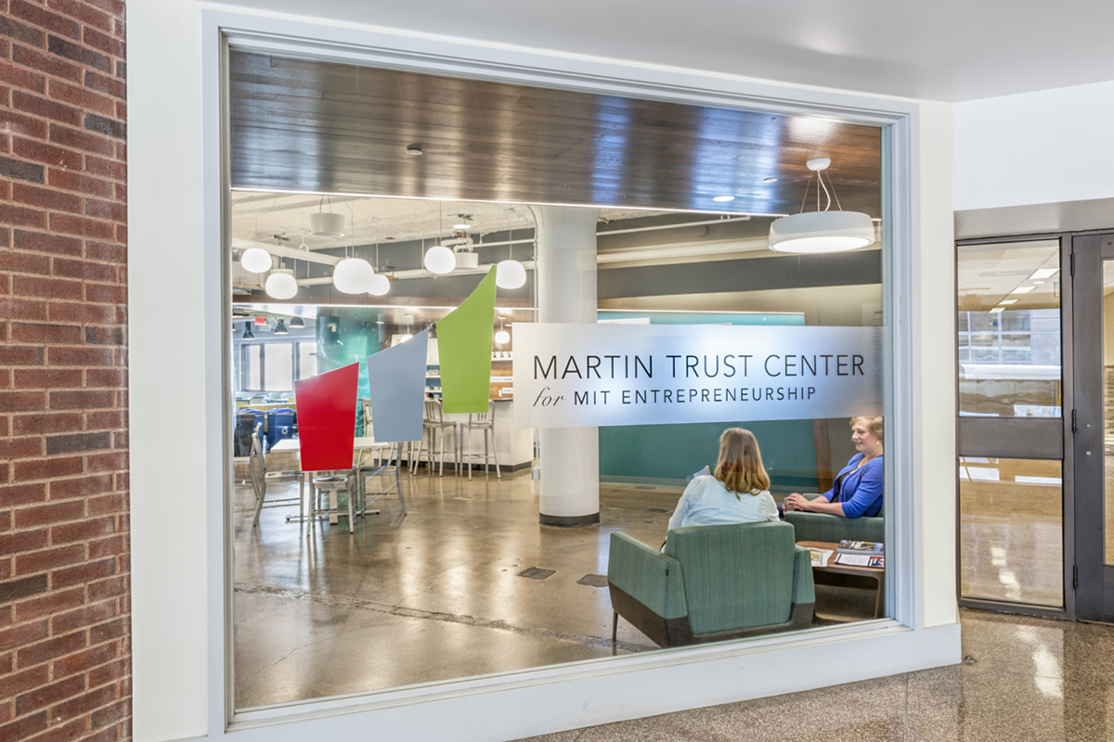
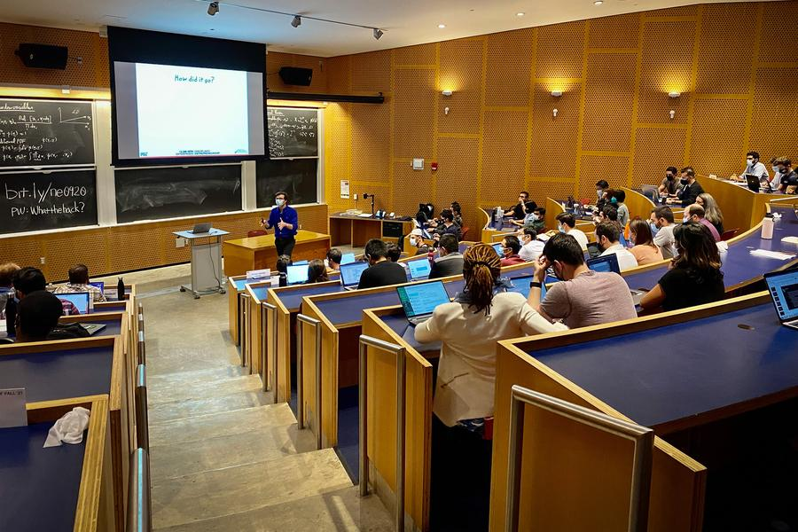

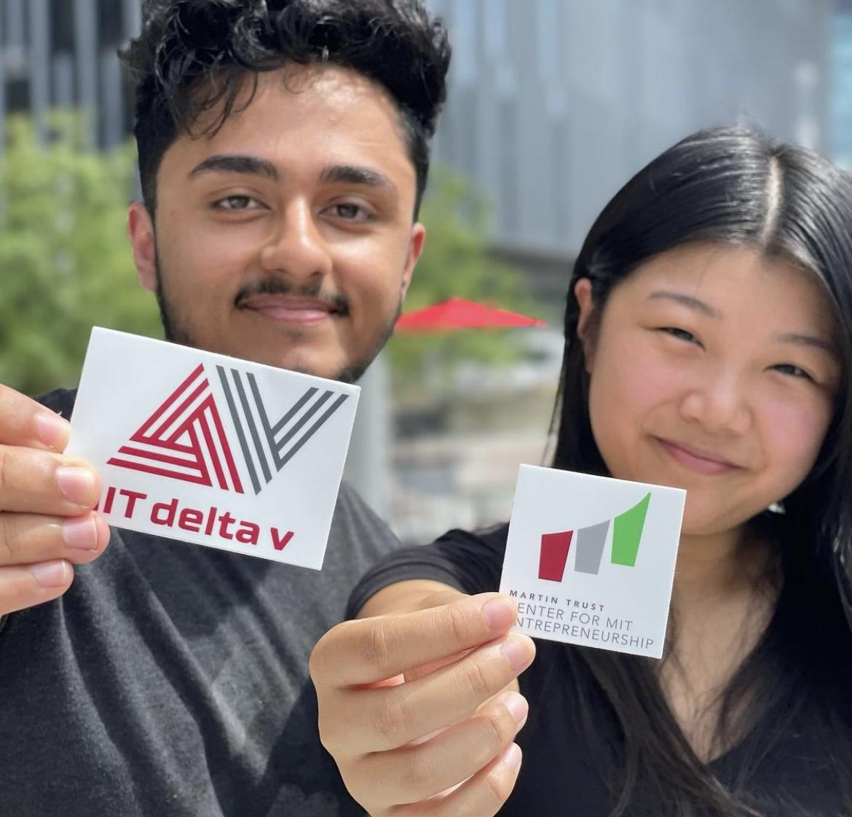
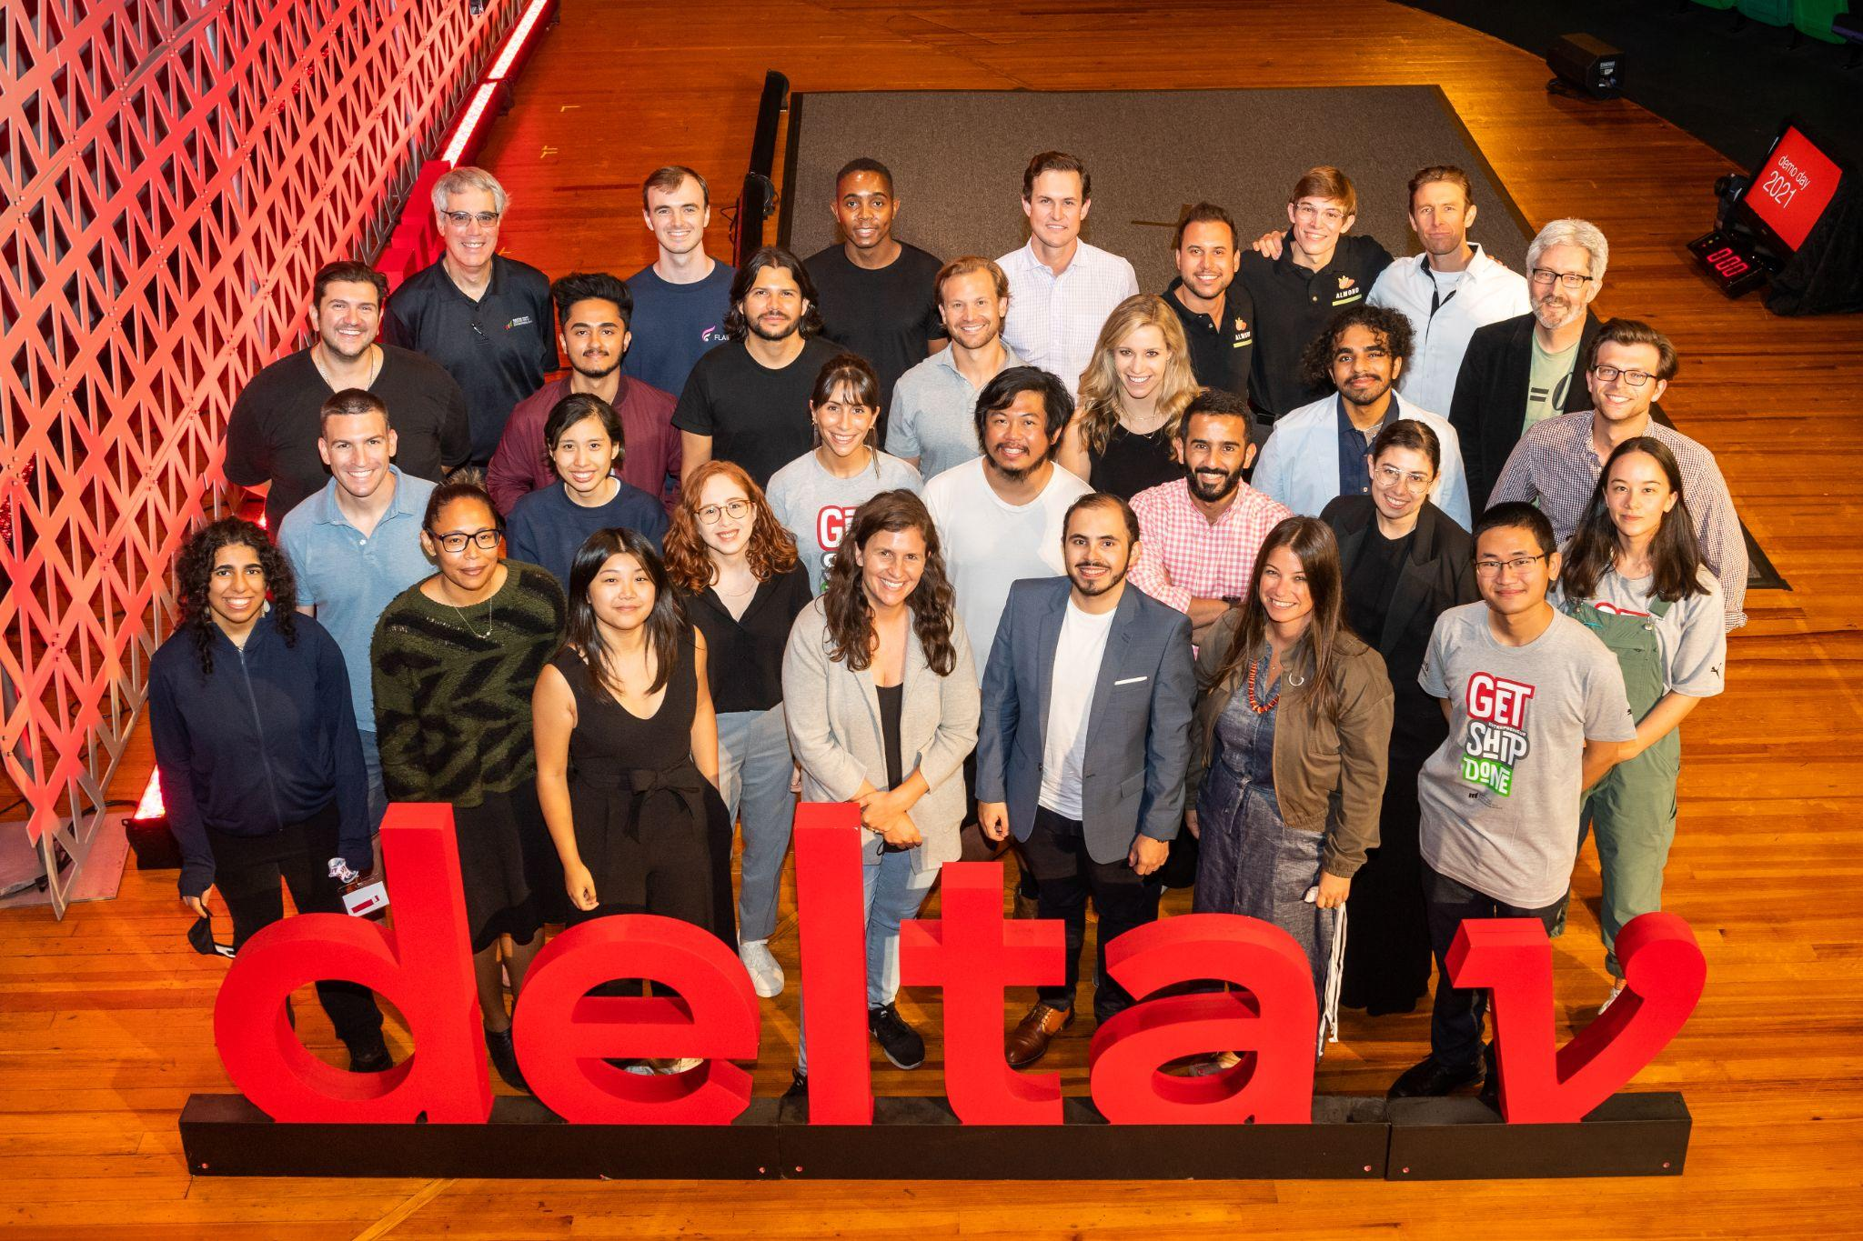


February 12, 2024
MIT Orbit Product Update
Startup Tactics
“Piloting AI-Enabled Assistance”
dougw1@mit.edu
https://orbit.mit.edu/disciplined-entrepreneurship

Slide 2
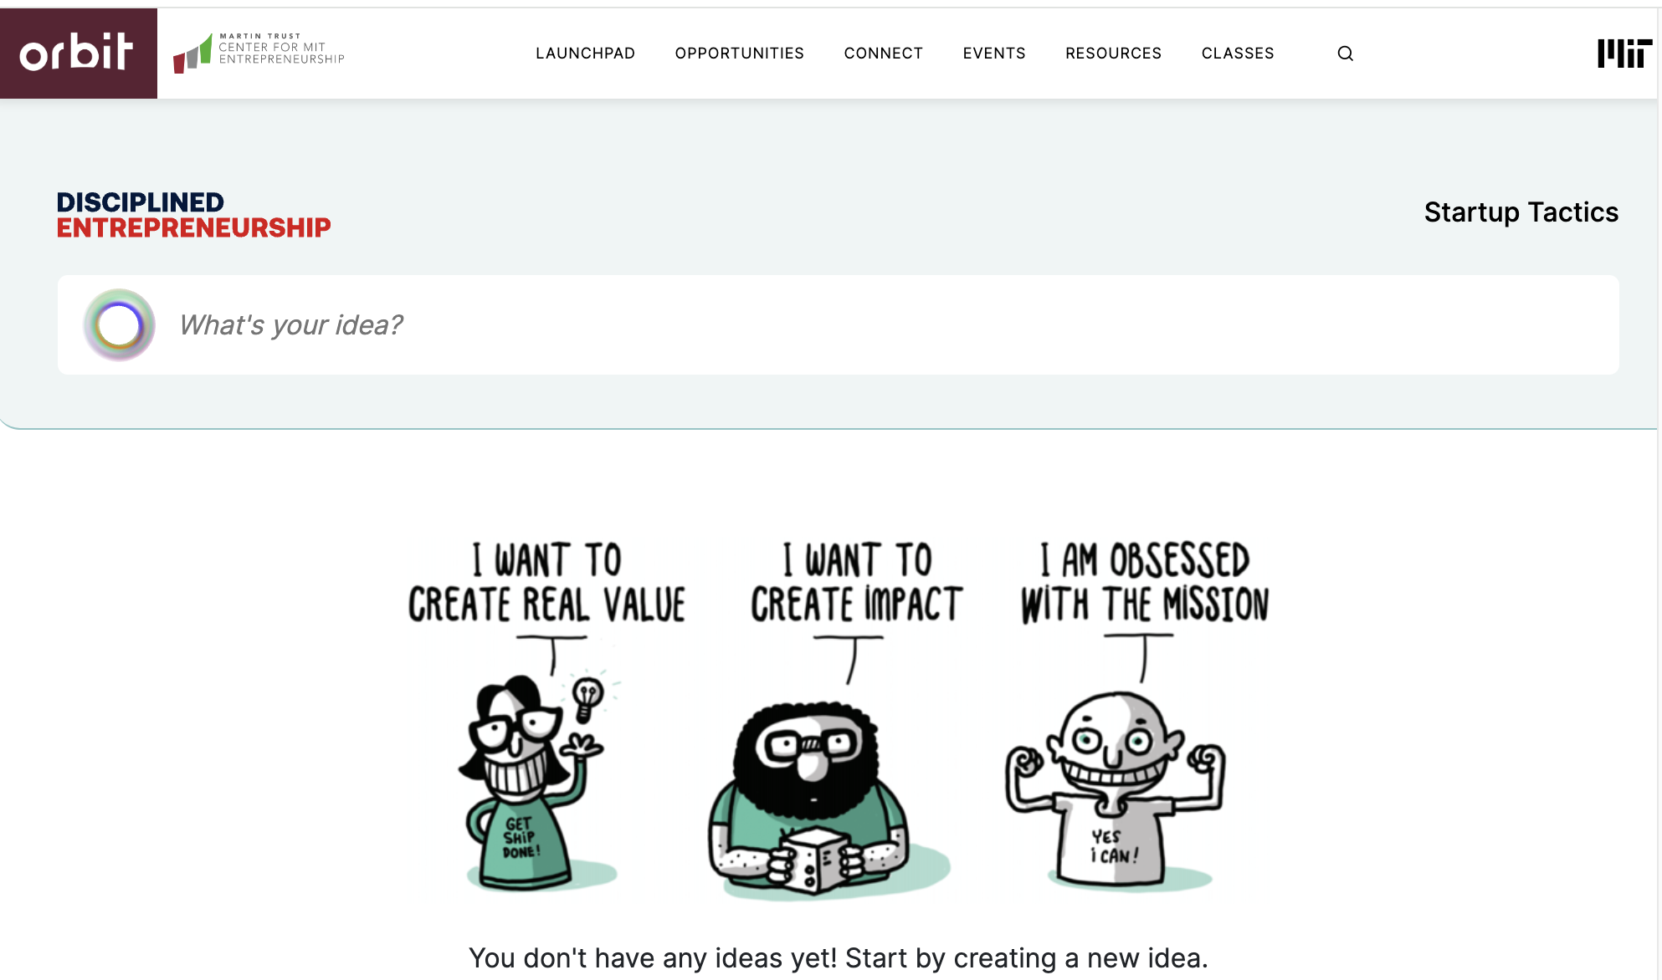
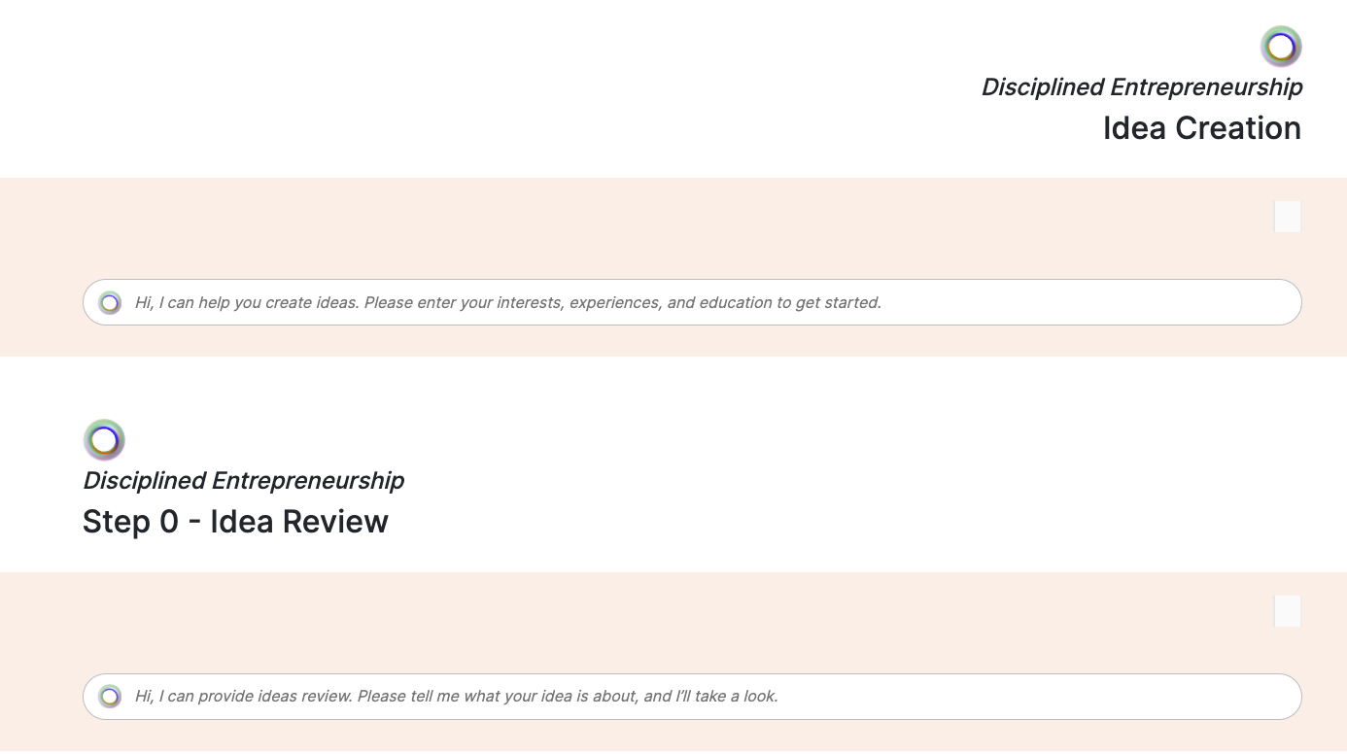
Orbit - Startup Tactics - Enter Your Idea
Enter your startup idea…
Or try idea creation, and review
(moving to a separate page)

Slide 3
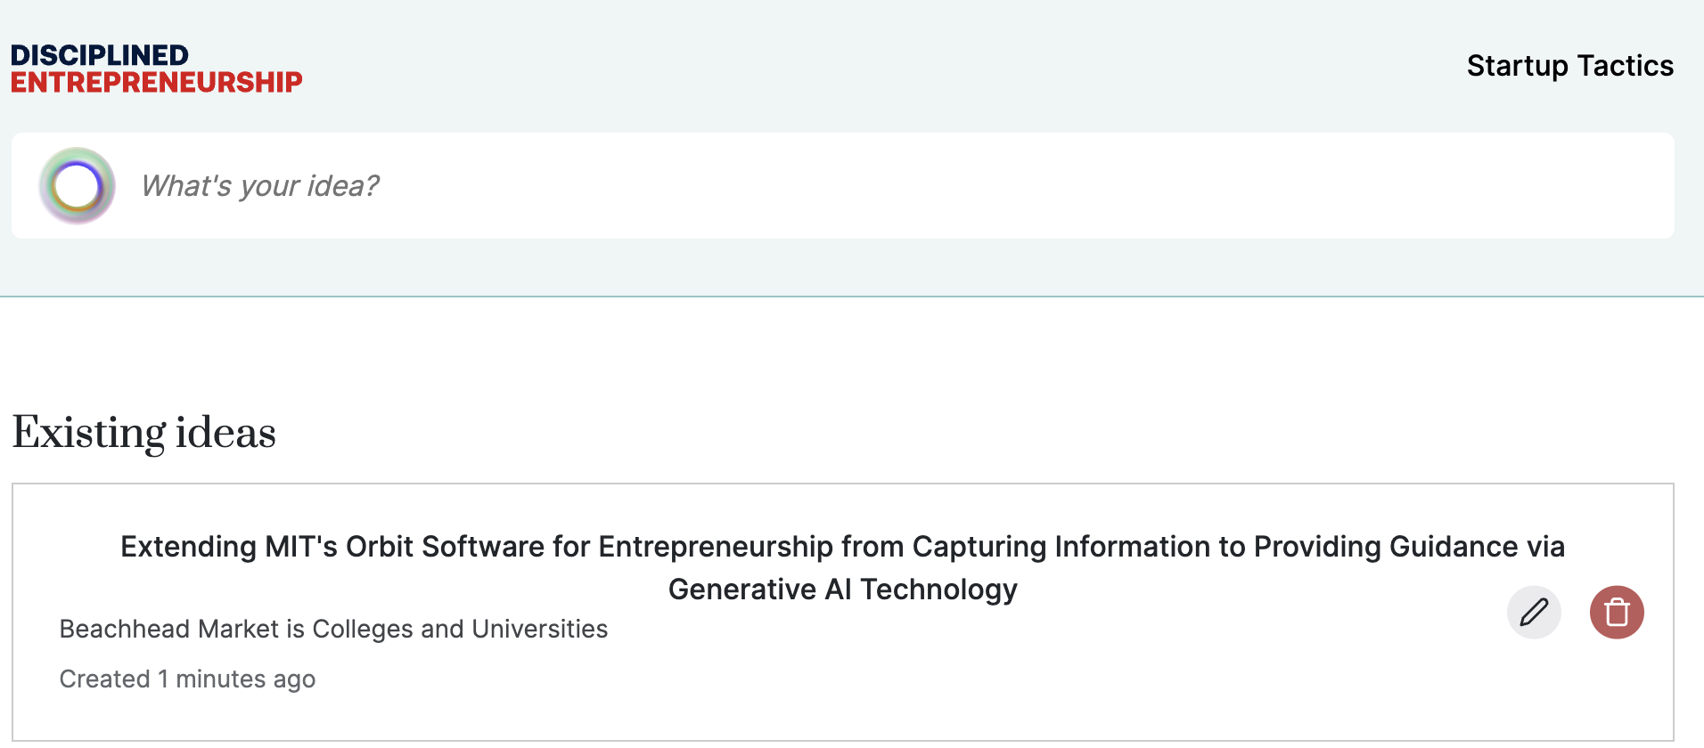
Orbit - Startup Tactics - Save Your Idea
Once you enter your idea…
It saves to your “idea bank”

Slide 4
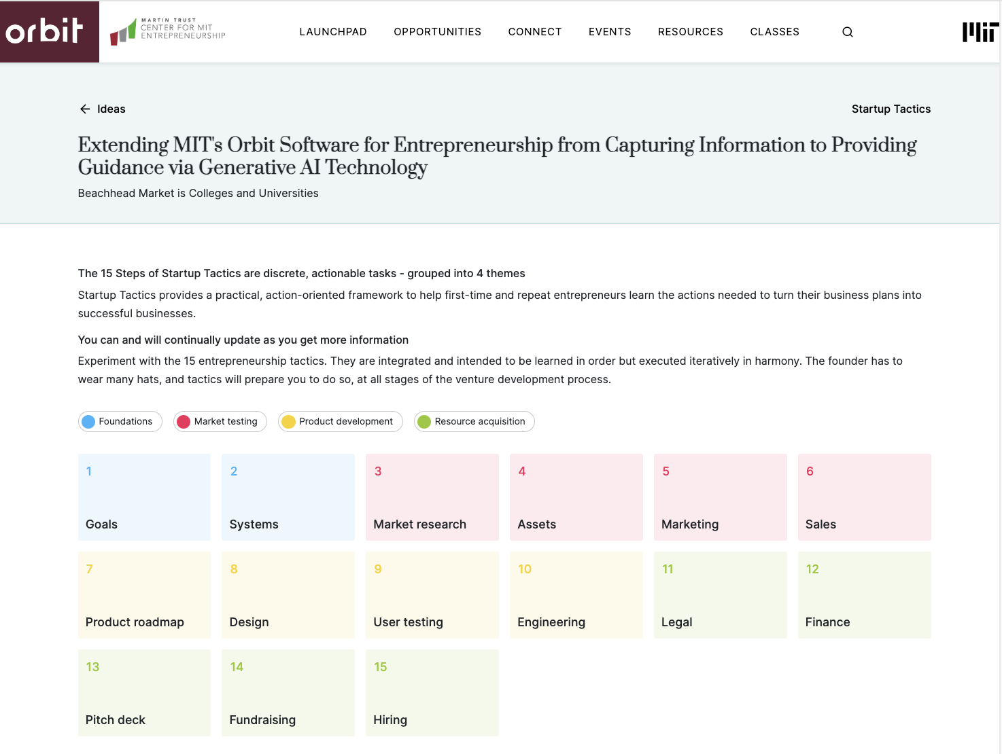
Orbit - Startup Tactics - 15-Steps
Click on your idea, to take you to the Startup Tactics framework, “the 15-Steps”

Slide 5
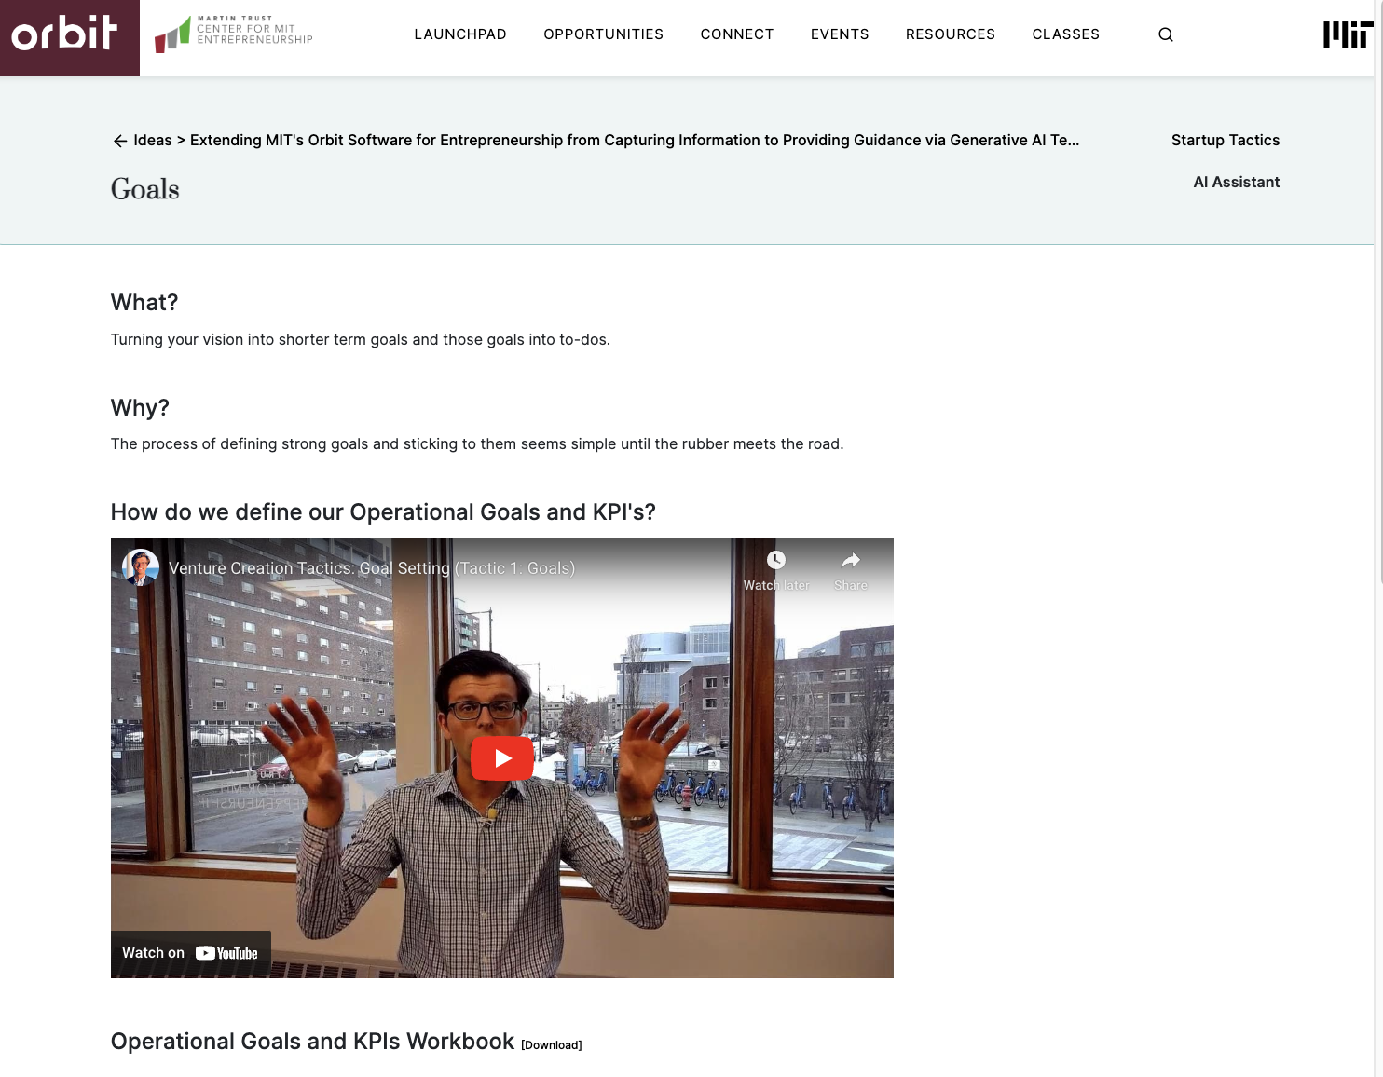
Orbit - Startup Tactics - Step 1 - Goals
Step 1 - Goals:
Videos, Worksheet, and AI Assistant

Slide 6
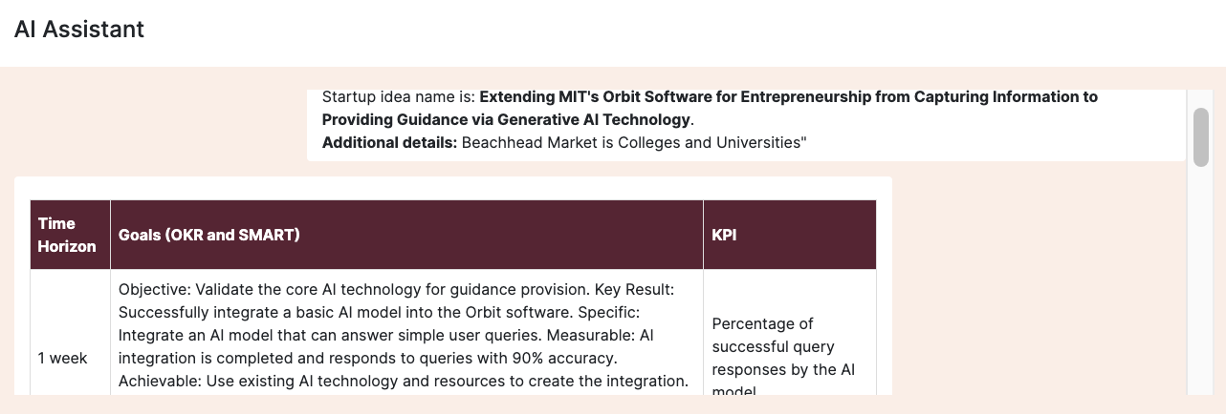
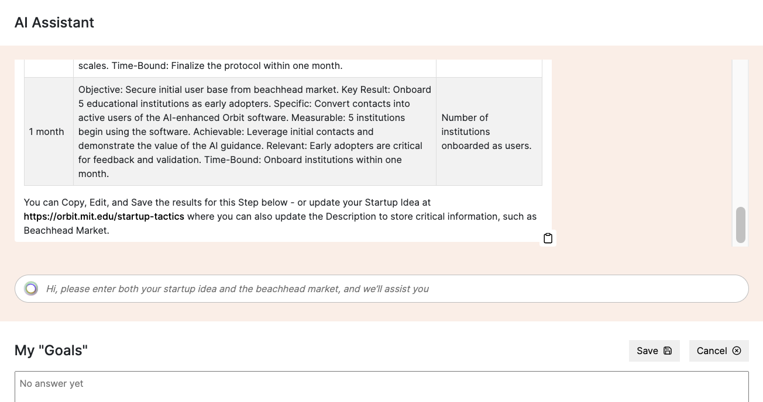
Orbit - Startup Tactics - Save Your Goals
AI Assistant fills out the Goals worksheet…
And you can save to
“My Goals”

Slide 7
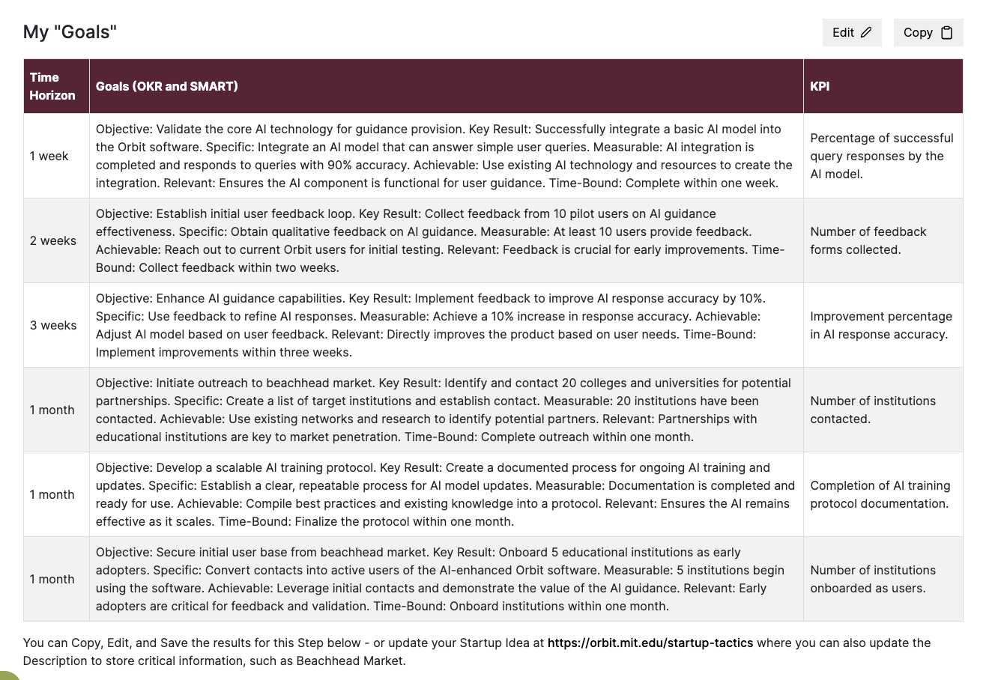
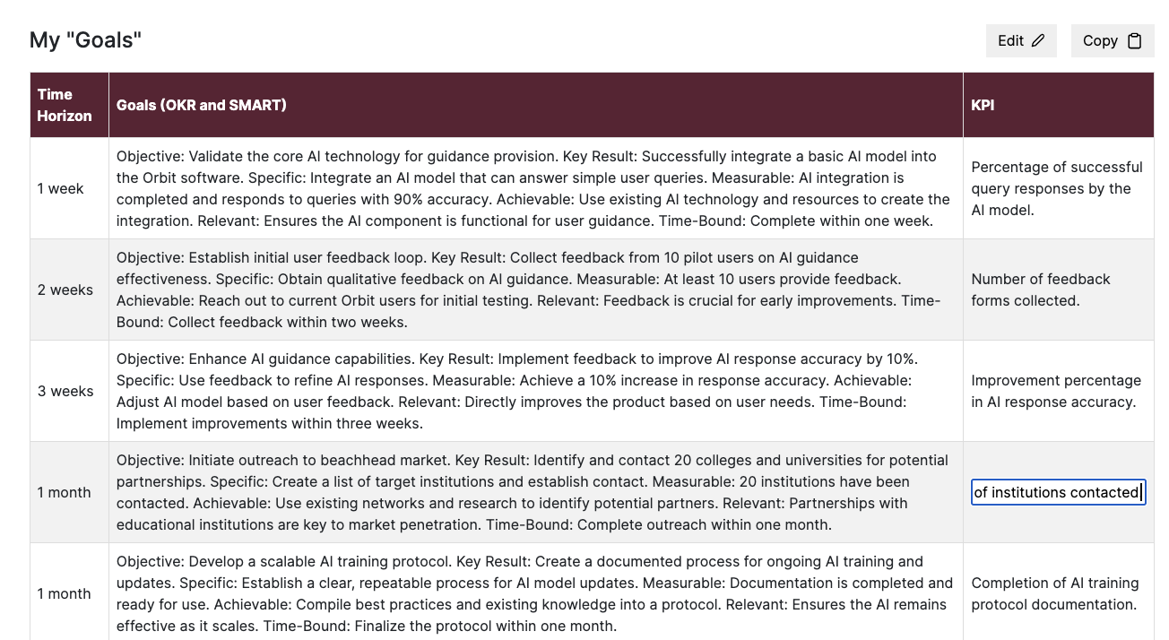
Orbit - Startup Tactics - Edit Your Goals
Can edit the entire output…
OR, individual cells 😎

Slide 8
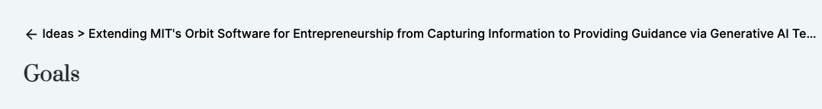
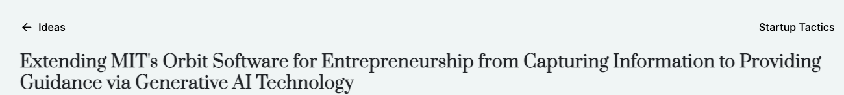
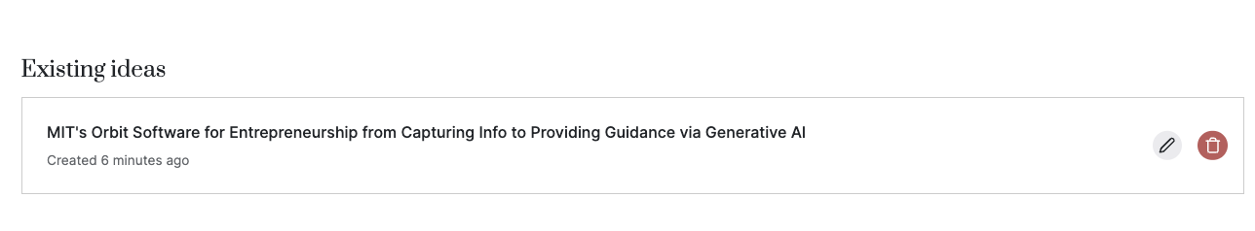
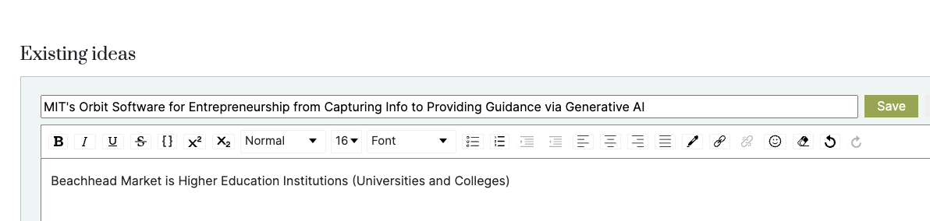
Orbit - Startup Tactics - Update Idea And Details
OR, individual cells 😎
Can edit the entire output…
You can edit the idea, add beachhead market, adjacent markets etc
Your idea and details will be sent to the AI Assistants for each step

Slide 9
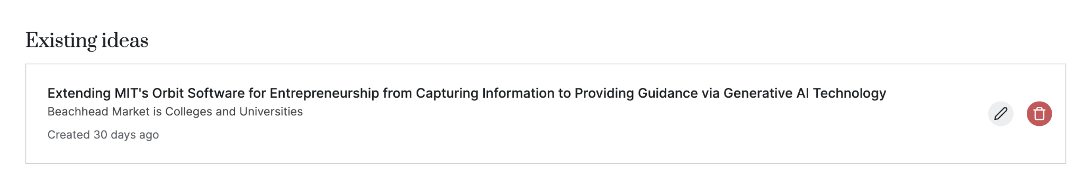
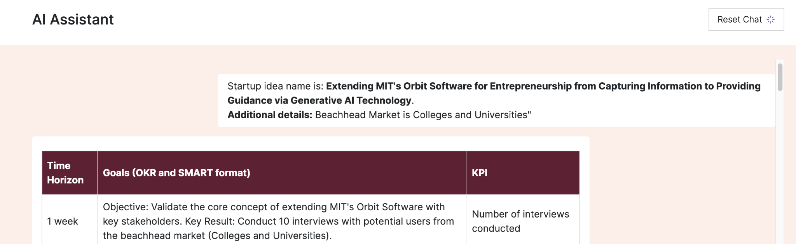
Orbit - Startup Tactics - Update Idea And Details
OR, individual cells 😎
Can edit the entire output…
Once you’ve updated your idea and added details, ie beachhead market
You can click Reset Chat, to reflect your updated idea and details

Slide 10
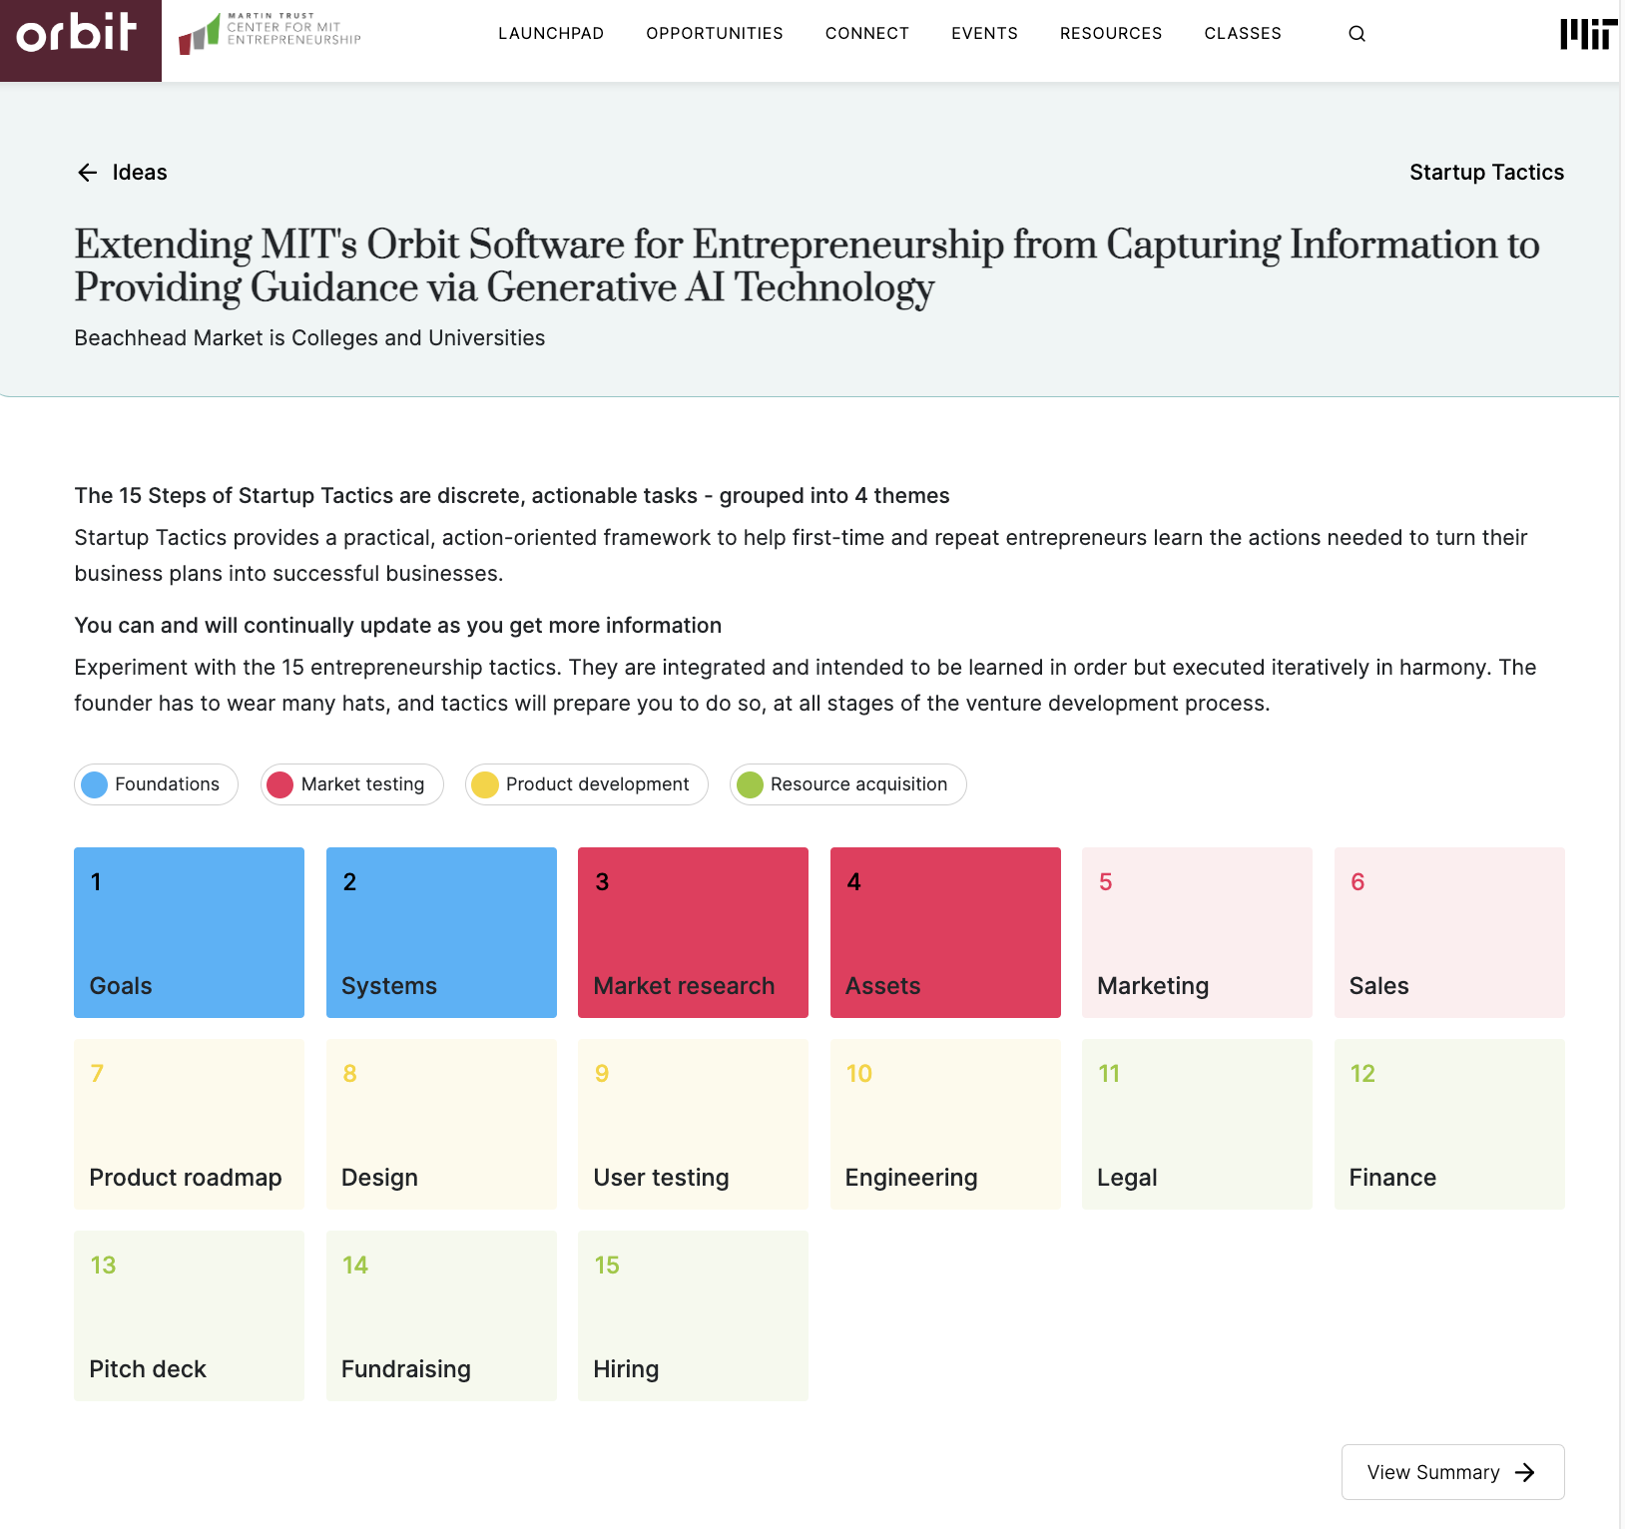
Orbit - Startup Tactics - Tracking & Summary Report
OR, individual cells 😎
Can edit the entire output…
Steps are shaded where you’ve saved the output from the AI Assistant to allow me to track progress
You can generate a Summary Report reflecting your saved / edited outputs

Slide 11
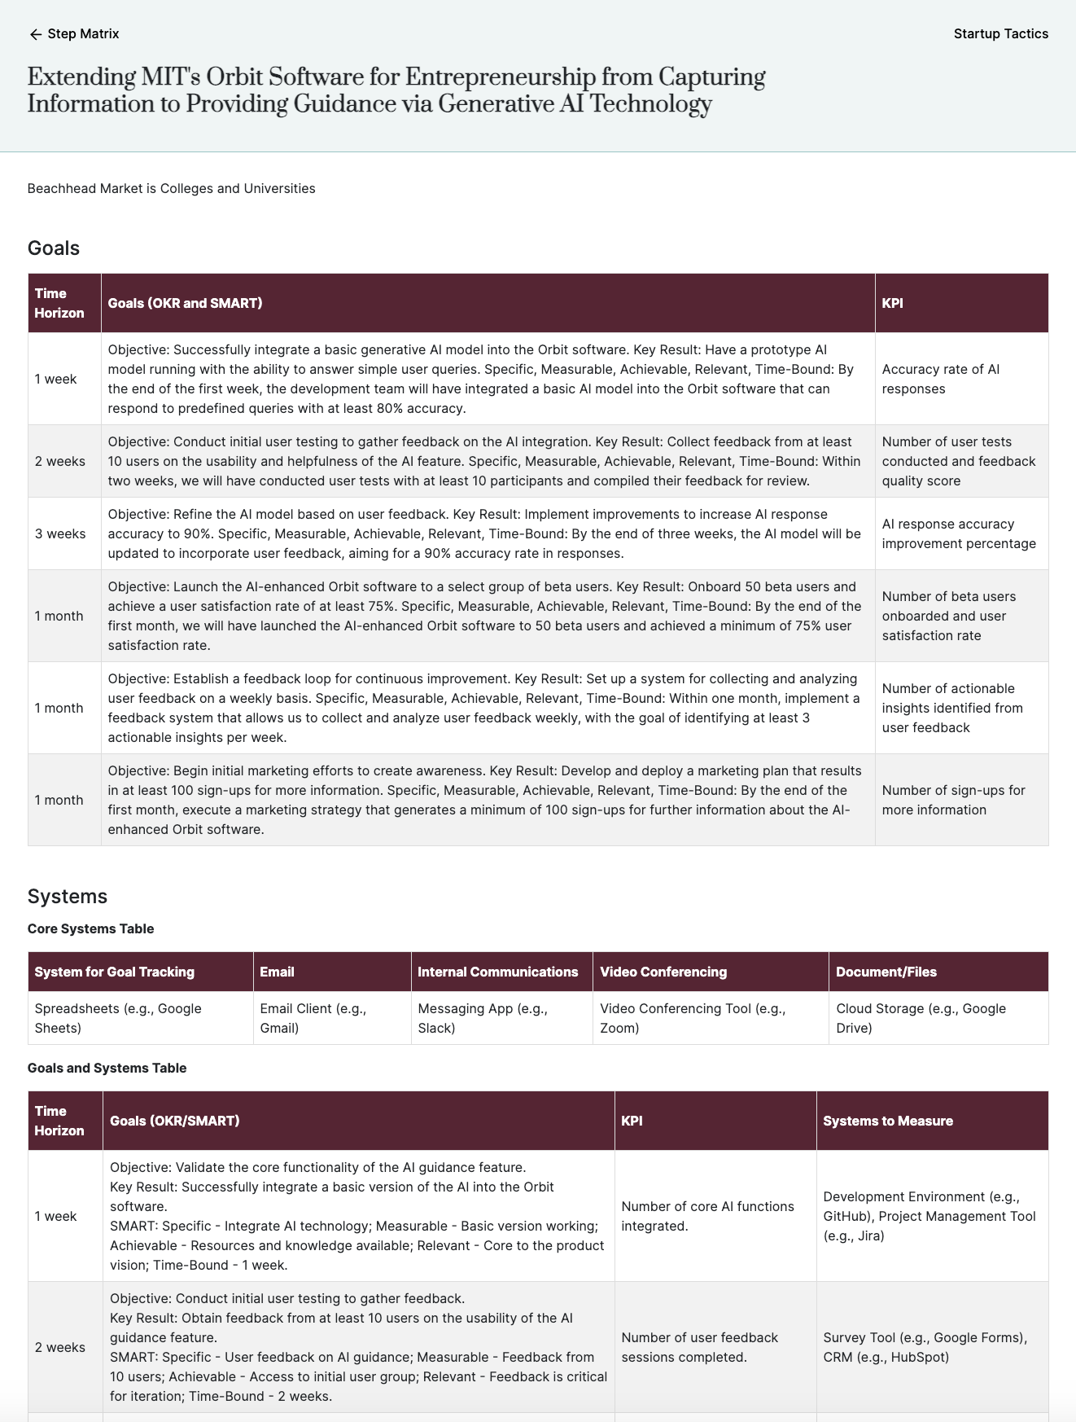
Orbit - Startup Tactics - Summary Report
OR, individual cells 😎
Can edit the entire output…
Your startup Idea
Your added details ie beachhead market
Your goals - saved and edited in Step 1
Your systems - saved and edited in Step 2
The summary report will include all the steps with saved - and edited - output

Slide 12
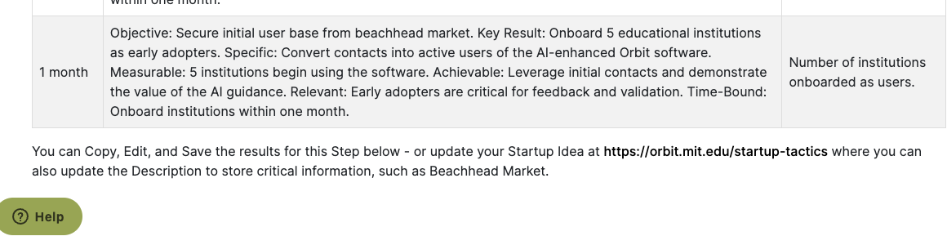
Orbit - Startup Tactics - AI Assistance
OR, individual cells 😎
Can edit the entire output…
Questions / Feedback
Email Doug Williams, dougw1@mit.edu
Many thanks to Nav (design), Alfredo (code), Amu (AI)
Pablo/StackAI (“No Code GenAI Platform)
Paul, Bill, MIT Alumni (inspiration, guidance)
Still lot’s to update
Feedback

Slide 13
February 12, 2024
MIT Orbit Product Update
Startup Tactics
Piloting AI-Enabled Assistance
dougw1@mit.edu
https://orbit.mit.edu/disciplined-entrepreneurship

