Slide 1
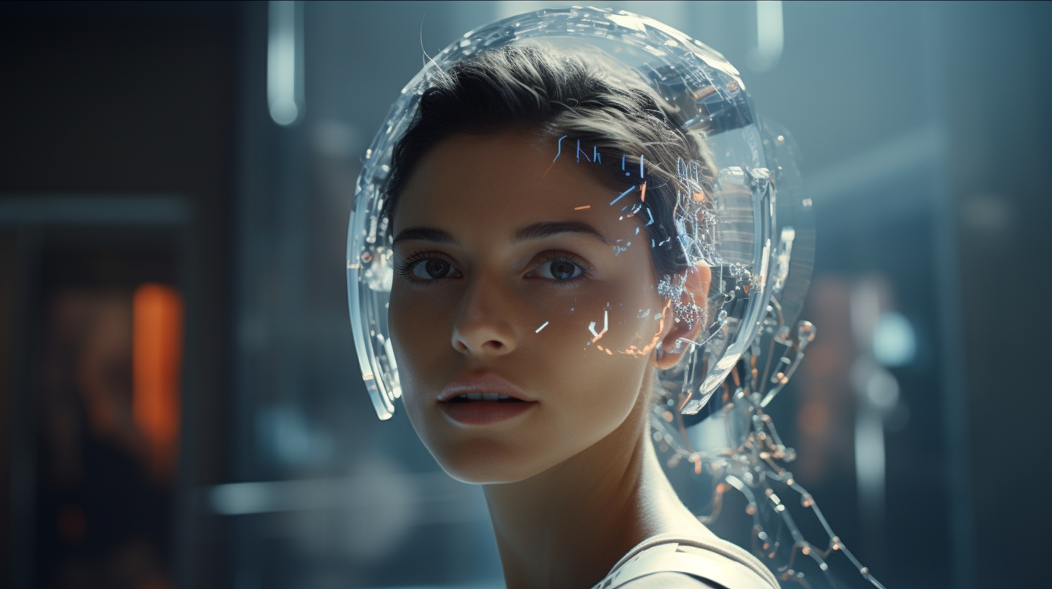
GenAI for Busy Professionals
Dr. John J. Sviokla
john@gaiinsights.com
How GenAI Radically Changes the Economics of Knowledge Work
@
Leveraging Real Business Value Conference
May 16, 2024
Sunnyvale, CA

Slide 2
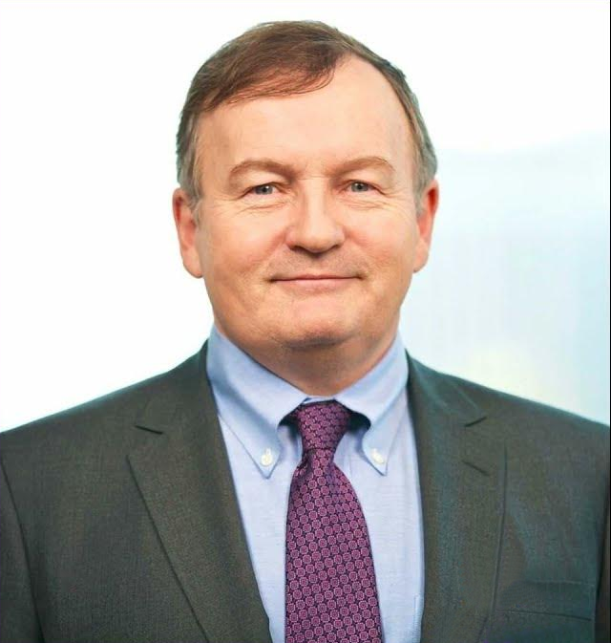
About John & GAI Insights
Dr. John J. Sviokla
Principal and Co-founder
GAI Insights
Former PwC Partner
HBS professor (12 years)
3 books and 90+ HBR articles, TV, etc.
Served on multiple boards
Earned DBA, MBA, BA from Harvard
Speaker, writer, researcher, consultant, coach
john@gaiinsights.com
GAI Insights
GenAI/AI enablement firm
Serve the enterprise AI leader
Key services:
  Research
  Speeches
  Best practices
  AI/GenAI strategy
  Executive briefings
  Training
  Learning labs
  Prototypes
  Learning Community
www.gaiinsights.com

Slide 3
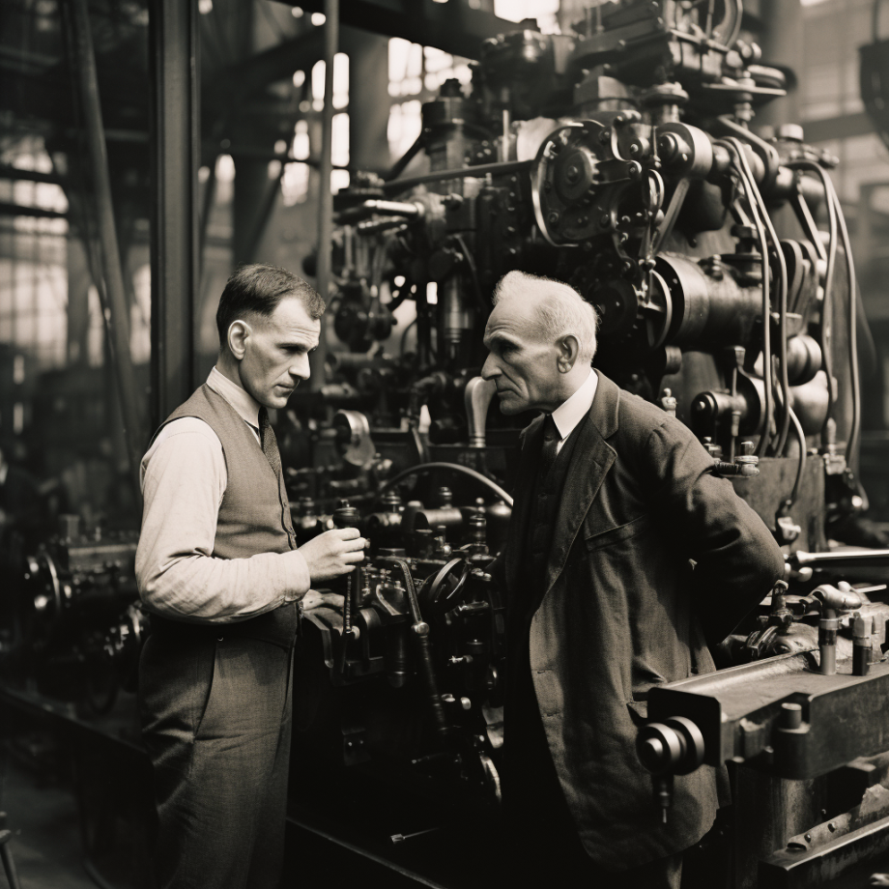
Taylor: The most influential modern thinker…
Darwin, Marx, and Freud make up the trinity often cited as the "makers of the modern world." Marx would be taken out and replaced by Taylor if there were any justice... For hundreds of years there had been no increase in the ability of workers to turn out goods or to move goods... When Taylor started propounding his principles, nine out of every 10 working people did manual work, making or moving things, whether in manufacturing, farming, mining, or transportation... By 2010 it will constitute no more than one-tenth...-- Peter Drucker, The Rise of the Knowledge Society Wilson Quarterly (Spring 1993) p.63-65
https://transportgeography.org/contents/chapter1/the-setting-of-global-transportation-systems/ford-cost-production-1908-1924/#:~:text=When%20the%20Ford%20Model%20T,total%20of%2016.5%20million%20units.

Slide 4
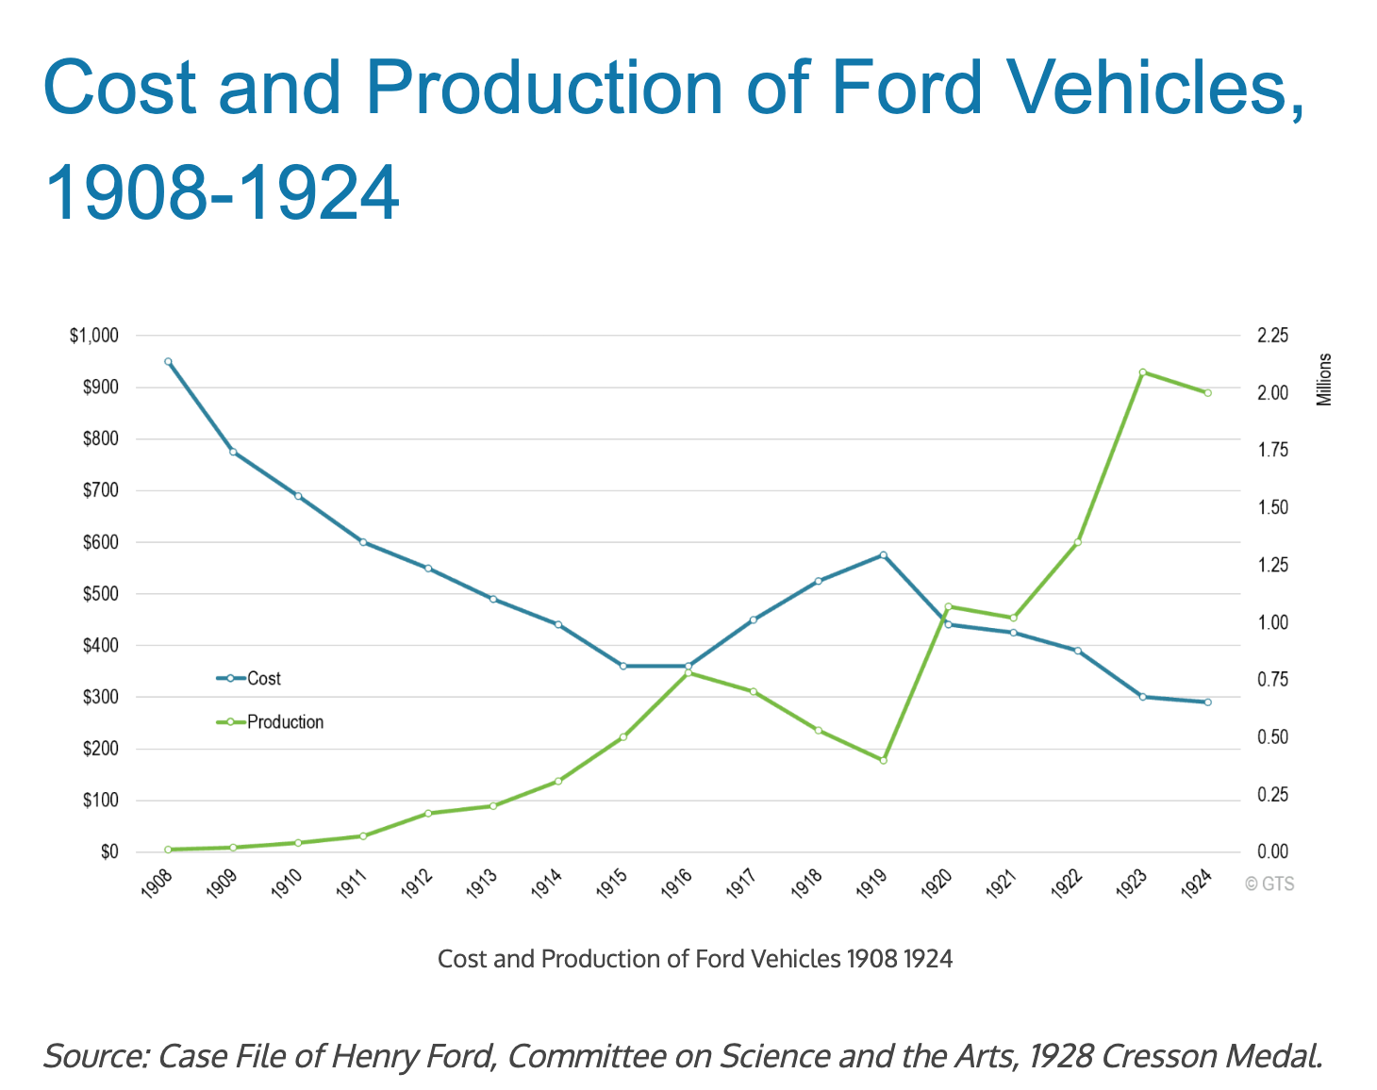
Management = Knowledge Management

Slide 5
GenAI Drives New Knowledge Economics
History of Automation
Physical
Information - Knowledge
Types of tasks
Structured
Data
Unstructured
Data
Years of automation
125 years
60 years
1 year
Surplus
Labor
Capital
Customer
90% of the information in a firm is unstructured data

Slide 6


Law of Computability
Causation
Correlation
Categorization
Level of
Knowledge
*
Level of
Digitization
=
Computability
From not computable to computable
GenAI & AI Accelerate Computability

Slide 7
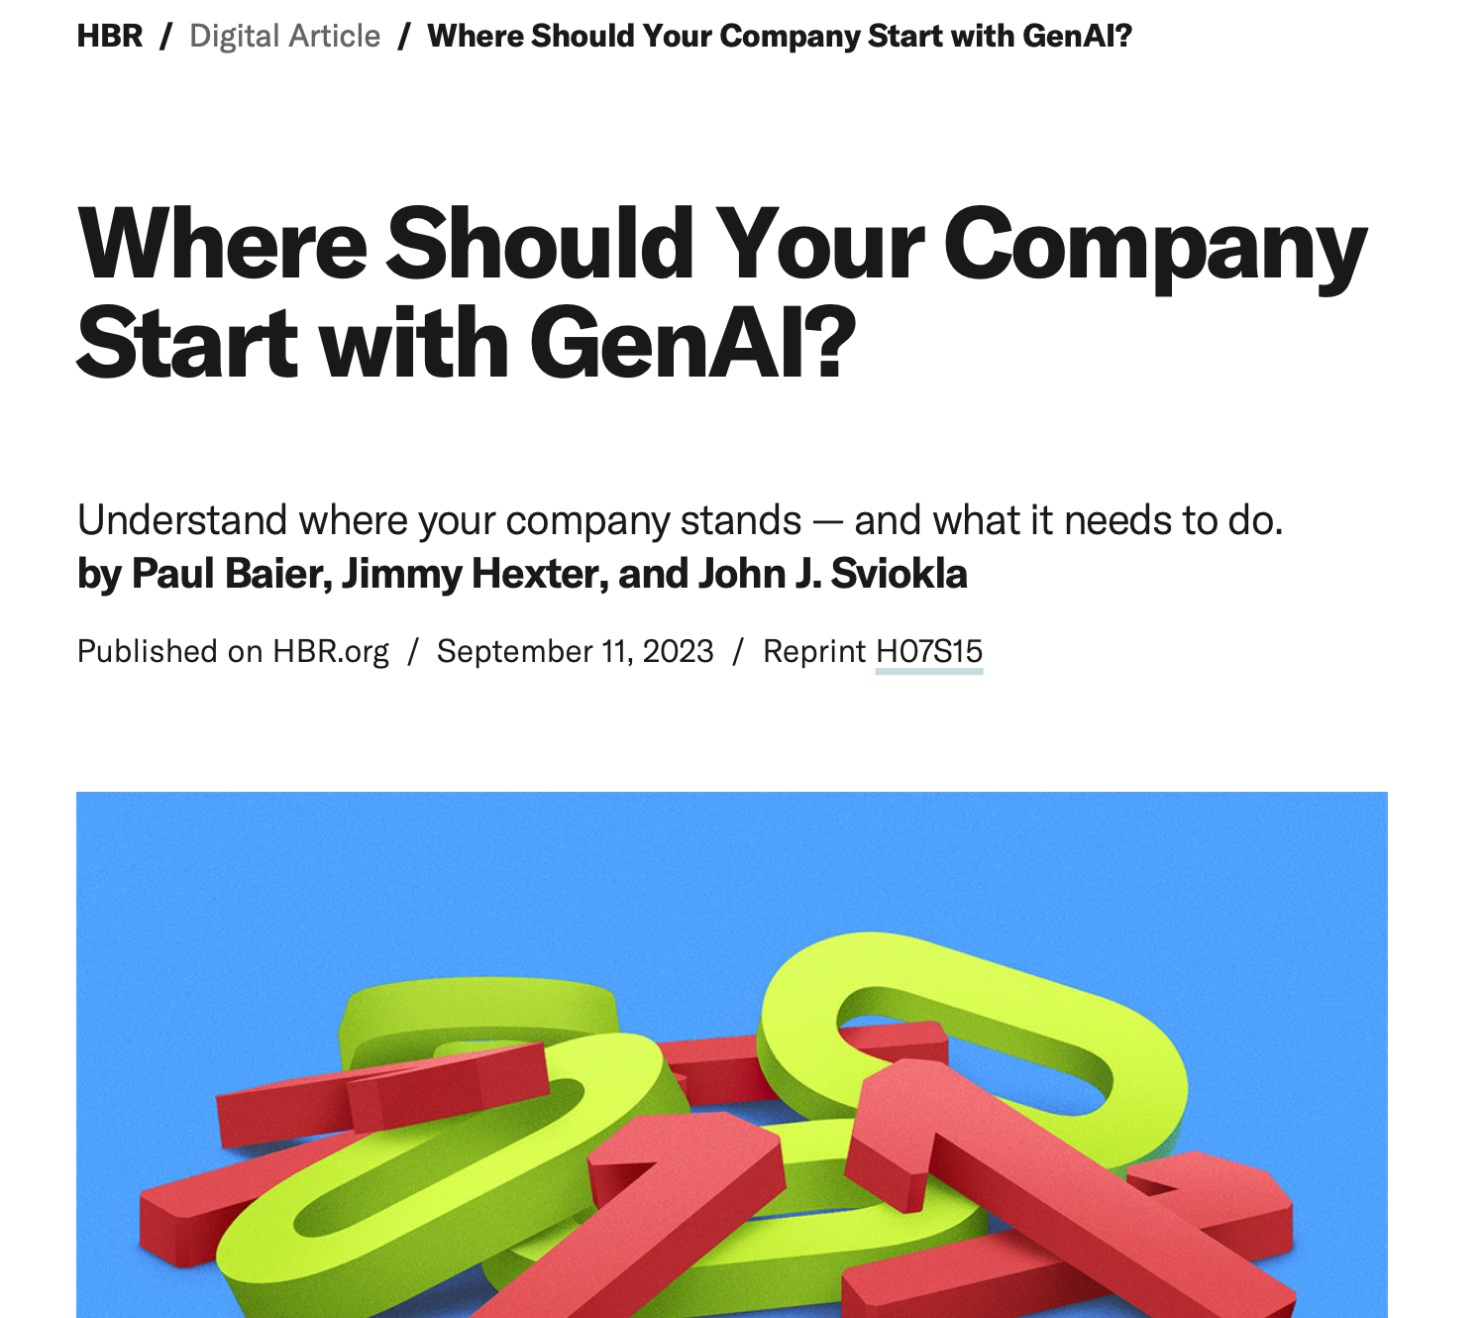
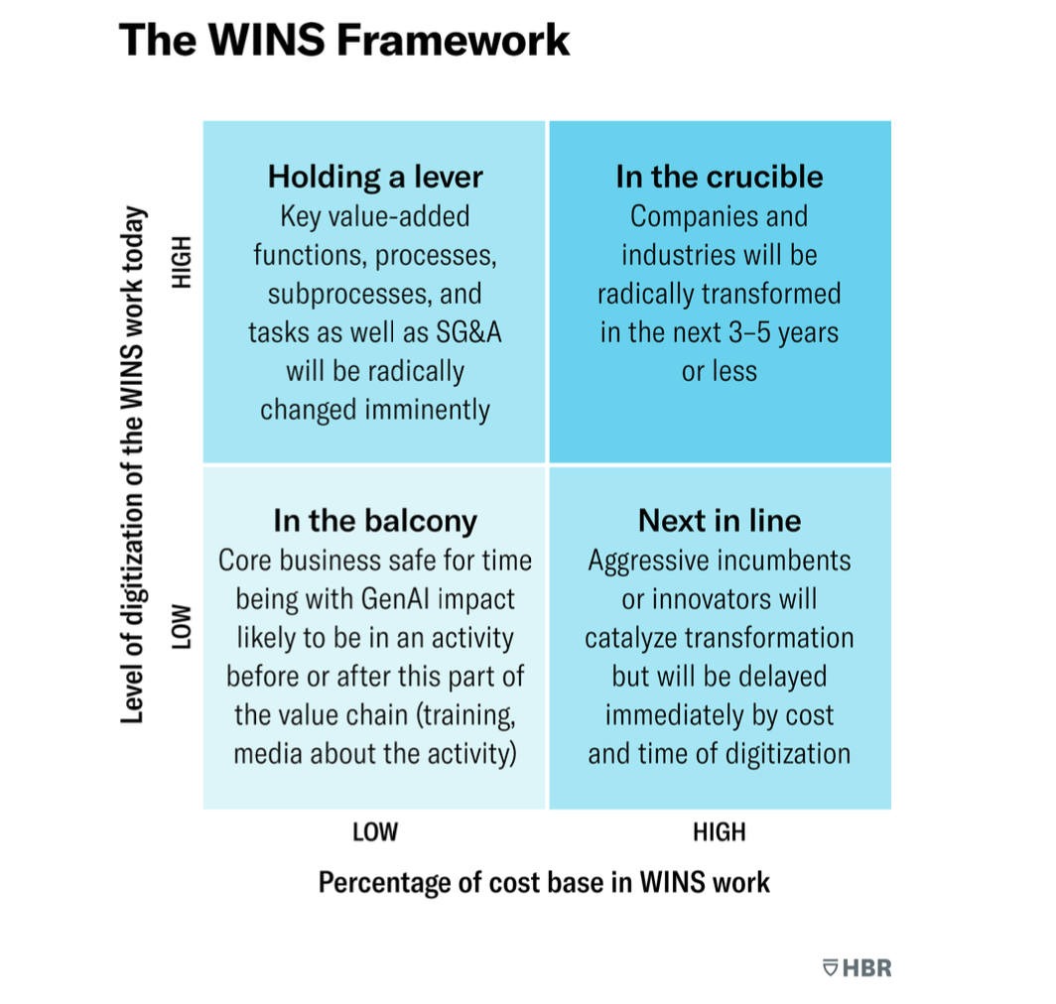
Where’s the Frontier of Computability? The WINS Framework

Slide 8
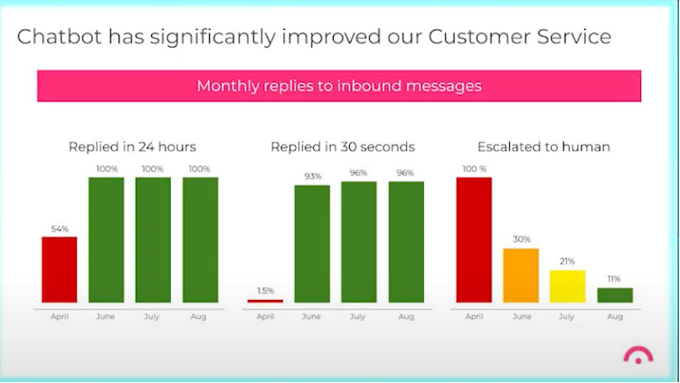
getjerry.com has ongoing ROI of $4MM/year

Slide 9
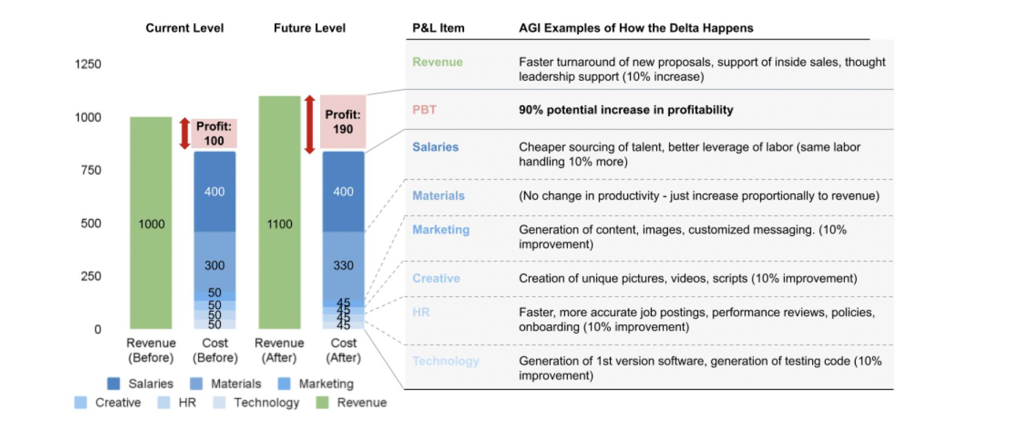
Driving Operating Leverage and Margin

Slide 10
Recommended Action Today…
Understand GenAI/AI radically changes the economics of knowledge
Recognize we are at a Ford/Taylor moment
Think of this as an organizational capability – not an IT project
Acknowledge three phases: understanding, leverage, transformation
Share the surplus with customers and labor too if you want a lasting competitive advantage.

Slide 11



Resources
How GenAI/AI Radically Changes the Economics of Knowledge Work Presentation
GAI Insights Newsletter Signup
My Information

