Slide 1
Generative AI and the Future of Corporate Innovation: Data
June 5, 2025
Alex Slawsby & Scott Kirsner, InnoLead
InnoLead.com

Slide 2

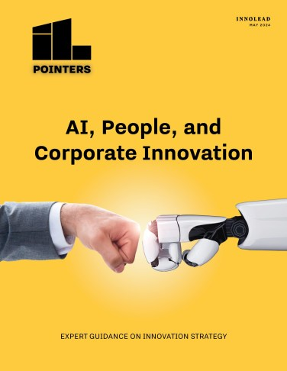
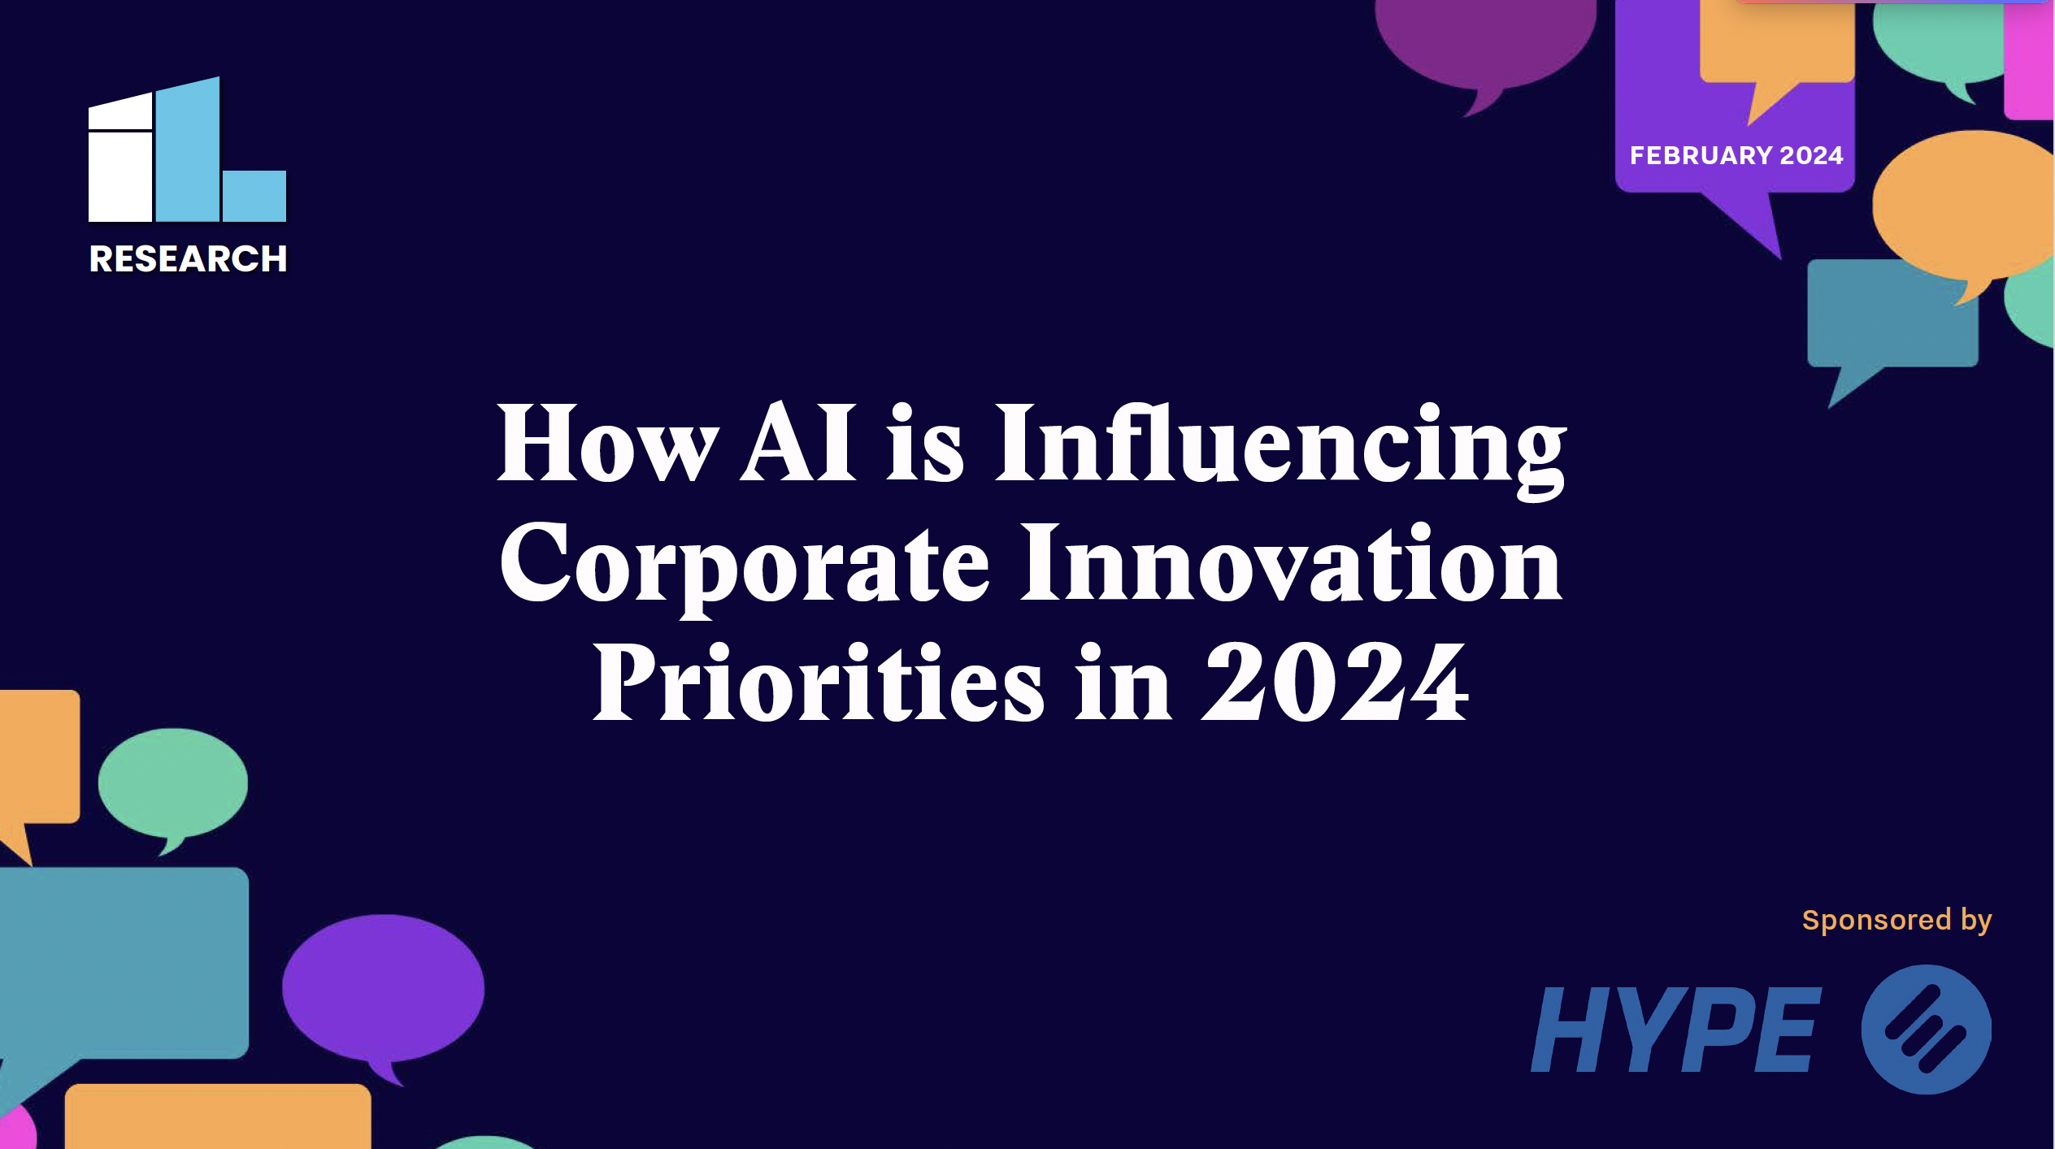
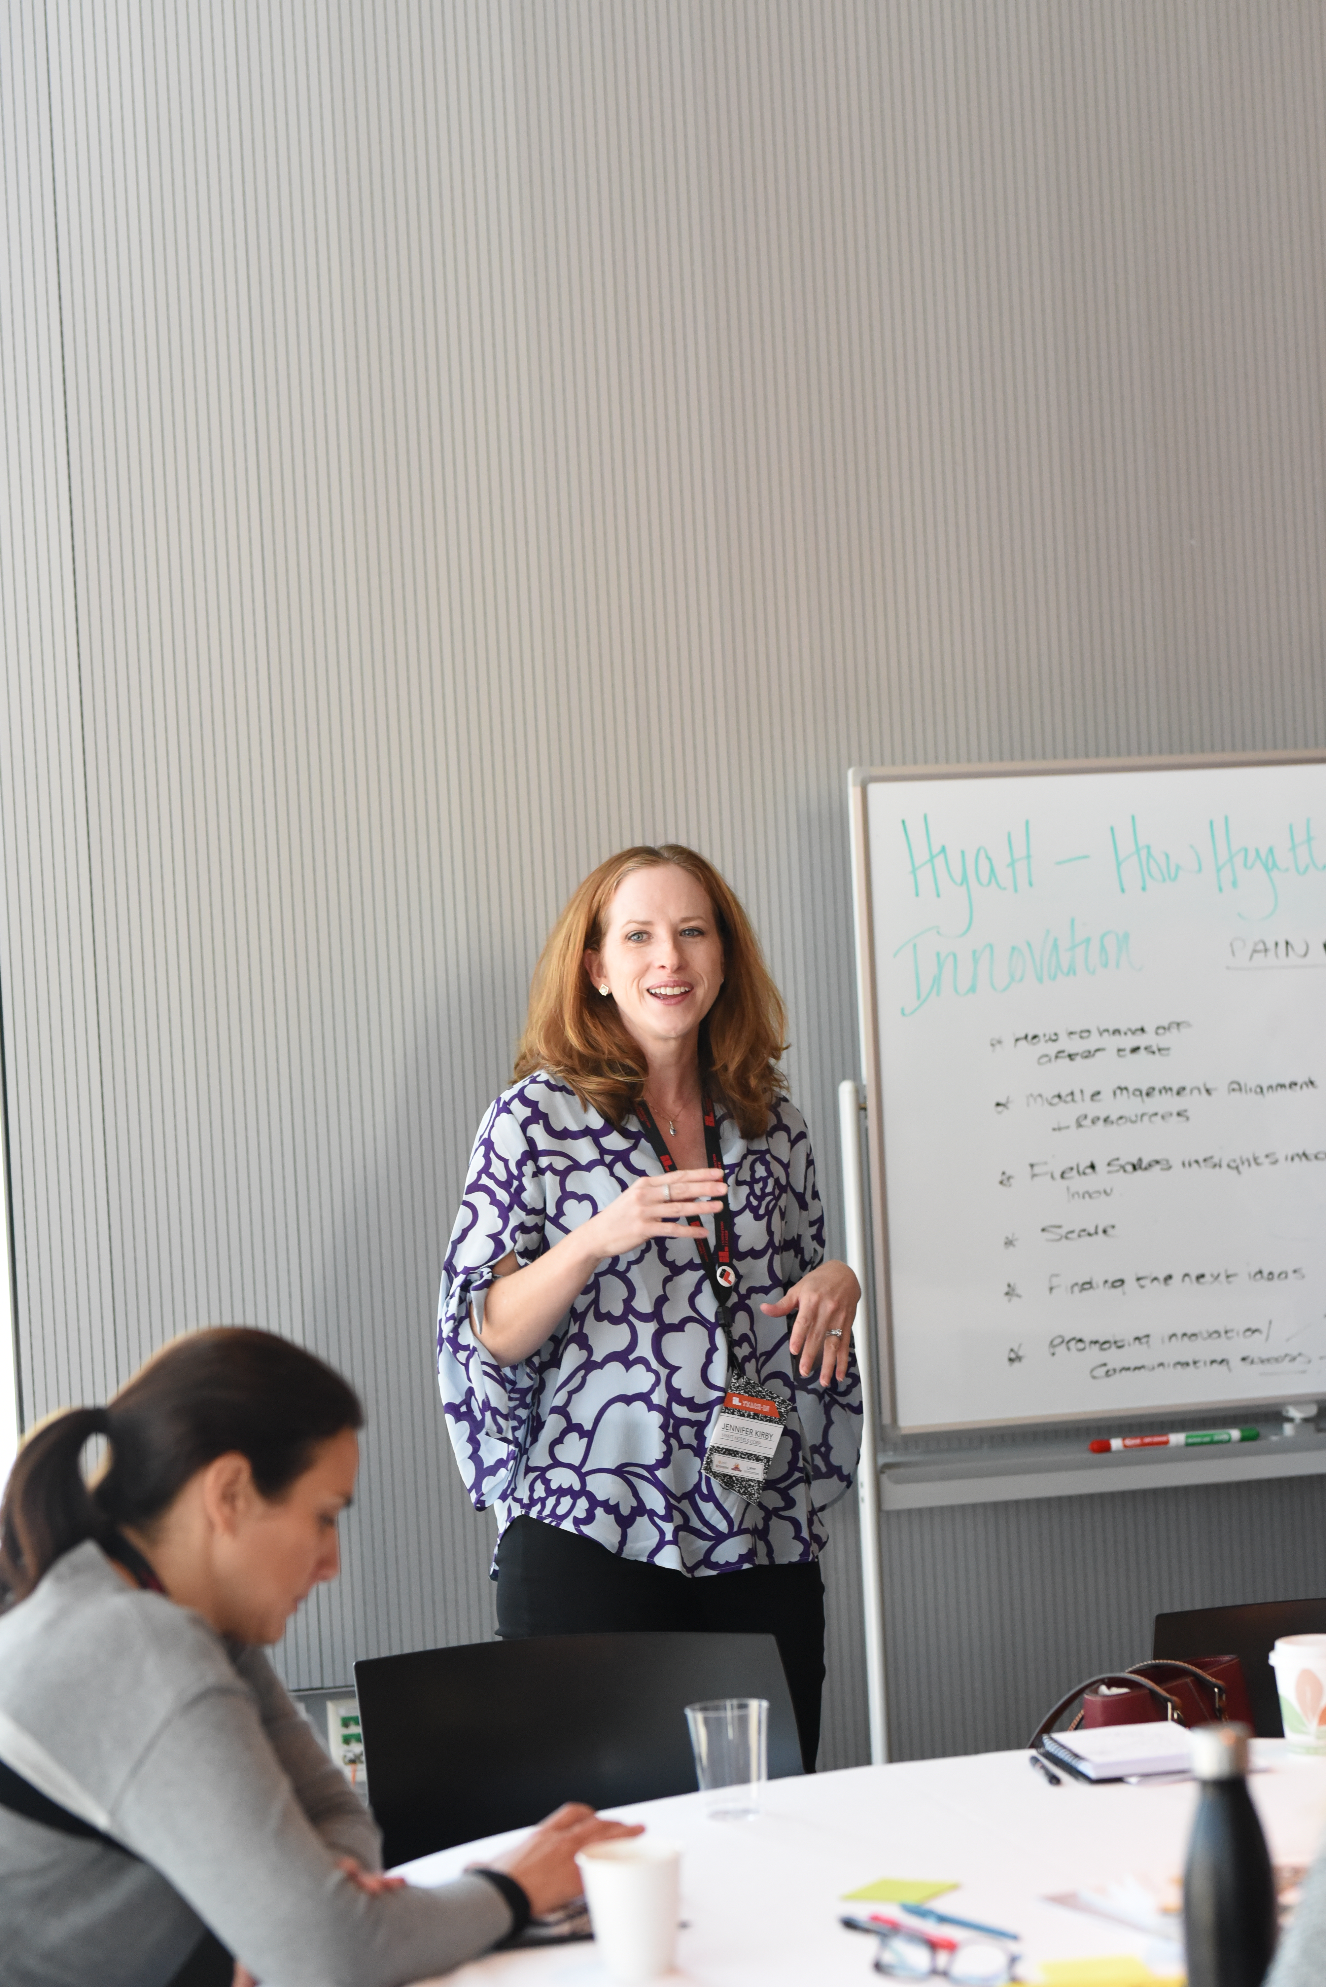
About InnoLead
We’ve built the largest community of corporate innovators, strategy execs, and R&D leaders — and we work hard to help them achieve real impact in their organizations.
innolead.com
@innolead on X, LinkedIn, and Instagram

Slide 3

The ascent (and descent?) of the corporate innovator

Slide 4
An expanding array of innovation tool options…
Which of the following software or service solutions do your organization use for innovation activities?
78%
52%
44%
(e.g., Google Docs, Jira, Office 365, Monday.com, Salesforce, Trello)
(e.g., edison365, HYPE, Innosabi, Qmarkets, Sopheon)
(e.g., ChatGPT, Claude, Gemini, Copilot)
Source: InnoLead Research, 2024

Slide 5
…but organizational adoption varies widely
Today, our team…
…doesn’t use AI tools
…is largely prevented from using new AI tools
…is exploring the AI tools landscape
…regularly uses one AI tool
…regularly uses several AI tools
Source: InnoLead Research, 2024

Slide 6
Those who are experimenting…a breadth of use cases…
How are you or your organization using generative AI to support innovation activities?
“Both Microsoft Copilot and ChatGPT help contribute to innovation by streamlining tasks, reducing repetitive work, and providing intelligent assistance, allowing us to concentrate on the creative and strategic aspects of the projects.” – Technology
“Mostly to consolidate and evaluate data that is publicly available — like product reviews — or to assist in limited concept descriptions for consumer screening, except we don't put any sensitive or confidential information in AI tools.” – Consumer Goods
“I have used it to help distill customer comments and observations into themes and insights. I’m playing around with it for meeting notes and routine communications.” – Pharmaceuticals & Life Sciences
“Still mostly productivity enhancers, draft emails, document summarization, etc. We are not allowed to utilize ChatGPT, Bard, others due to security concerns of sharing sensitive data, so our a dedicated chatbot was rolled out based on a version of ChatGPT.” – Pharmaceuticals & Life Sciences
“Helping to create project proposals faster based on bullet point texts.” — Media & Telecom
“As a supplement to standard search engines.” — Engineering & Construction
“Asking questions and entering generic information before and during meetings / workshops to provide another ‘perspective’ for a more well-rounded answer / solution.” — Unspecified industry
“Help uncover data and to generate early concept drawings or renderings.” — Consumer Goods
“Develop ideas as well as create reports, presentations.” — Professional Services
“Mostly to consolidate and evaluate data that is publicly available.” — Consumer Goods
Source: InnoLead Research, 2024

Slide 7
…and belief that gen AI will impact how they use tools…
How much impact do you believe the use of generative AI will have on your use of innovation management software?
A great deal
A lot
A moderate amount
A little
None at all
Source: InnoLead Research, 2024; Note: Percentages may not total 100% due to rounding

Slide 8
…and belief that gen AI will impact how they use tools (cont.)…
“A great deal. Half the battle is being able to generate and manage large number of ideas and often that requires bring lots of people together to ideate, refine the concepts and then capture the value. I feel with AI-based capabilities we will be able to streamline that process — and with less people who are busy solving pain points / issues.” – Healthcare
“A lot. We are hoping [our existing vendor] will be adding these types of features to their platform. If not, we will likely look for someone who does.” – Pharmaceuticals & Life Sciences
“A lot. These tools will drastically speed up our scouting and evaluation eventually.” – Retail
“A moderate amount. We use these tools to gather intelligence. GenAI would likely taint the insights if incorporated into idea submission. Data review and summarization would be useful, but not a game changer.” – Financial Services
“None at all. In my view, both have various objectives and I don't see any impact as such. Innovation management solutions are more of systematic software to plan and organize ideas...” – Media & Telecom
“None at all. The AI can’t crowdsource ideas from the users/SMEs.” – Financial Services
Source: InnoLead Research, 2024

Slide 9
…and uncertainly about impact on teams going forward.
The use of generative AI by my organization will ultimately reduce our need to employ dedicated innovation professionals
Definitely would
Probably would
Not sure
Probably would not
Definitely would not
Source: InnoLead Research, 2024; Note: Percentages may not total 100% due to rounding

Slide 10
Ownership of AI (generally, gen AI) is in flux
With regard to AI (artificial intelligence), who has significant responsibility for exploring potential use cases in your organization?
Technology / IT
Innovation
R&D
Business units
Other functions
Marketing
Unclear
HR
Source: InnoLead Research, 2024

Slide 11
Resource allocation to AI initiatives growing as expected
With regard to budget/human resources being devoted to AI in your organization... In 2023, did they:
Increase dramatically
Increase somewhat
Remain stable
Decrease somewhat
Decrease dramatically
Not sure
Source: InnoLead Research, 2024

Slide 12
Perceived generative AI “test & learn” speed varies
My organization is moving fast enough when it comes to exploring / experimenting with / deploying Generative AI
Strongly agree
Agree
Neither agree nor disagree
Disagree
Strongly disagree
Mixed
Source: InnoLead Research, 2024

Slide 13
There’s no time to waste…but there could be wasted activity…
Explore the tool landscape (small / medium / large vendors)
Develop a hypothesis about how AI — aggressively deployed by established rivals or new entrants — could change your competitive landscape
Bring in legal, compliance, and risk colleagues to help define policy and guardrails
Emphasize the importance of running internal experiments first
Create a list of external use cases — and prioritize
Track what others in your industry (and outside it) are doing
Set up external-facing pilots, refine, and deploy

Slide 14
The ascent (and descent?) of the corporate innovator?
InnoLead

Slide 15
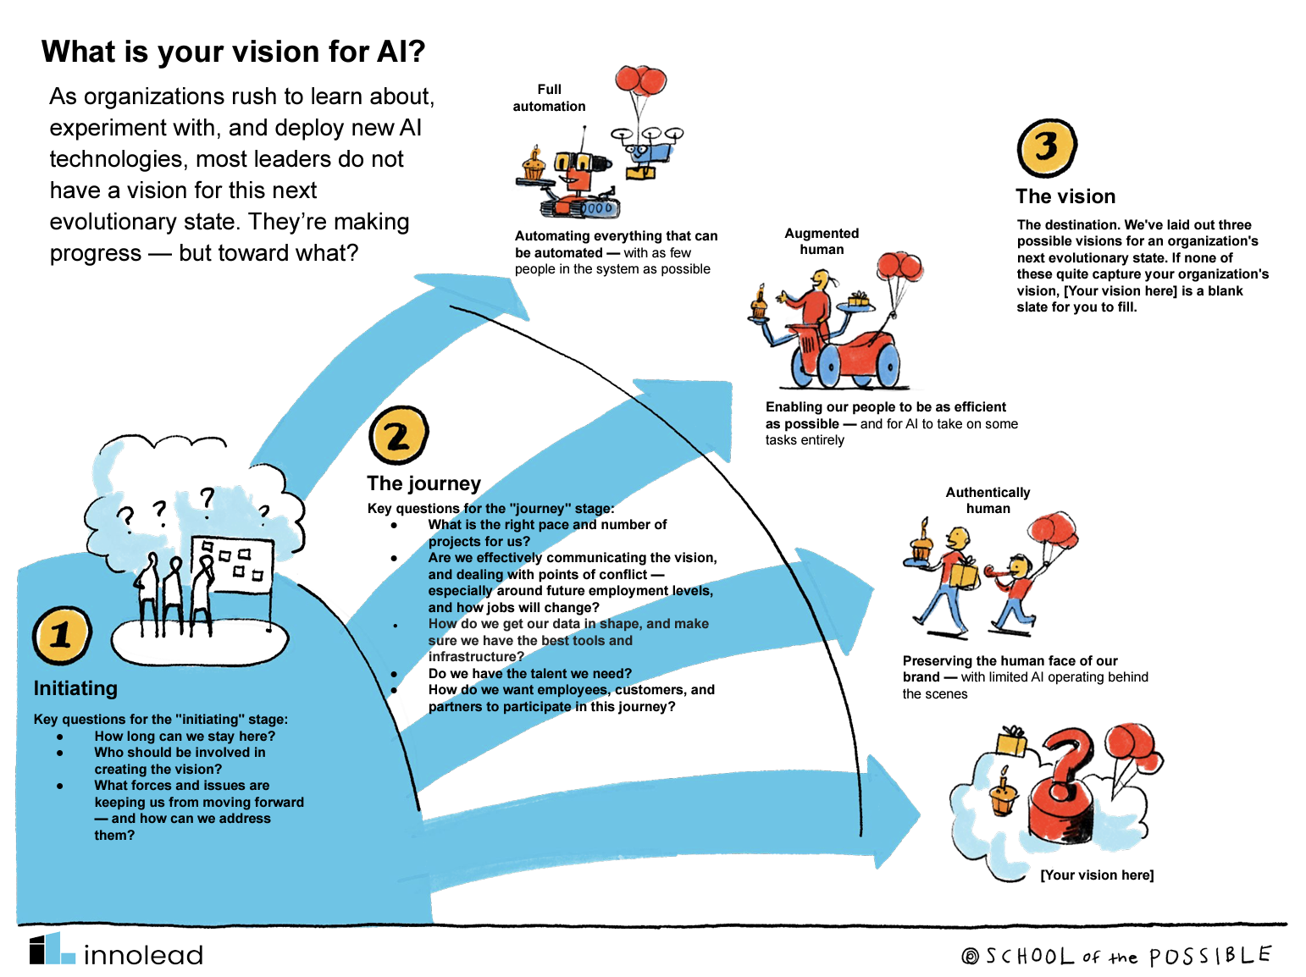
The AI vision map
InnoLead

Slide 16
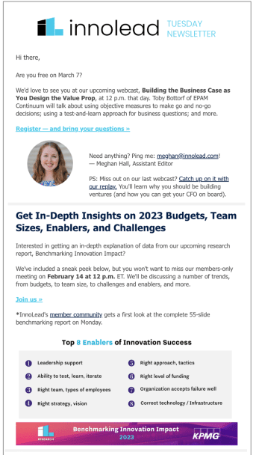
Thanks!
Our email newsletter is at innolead.com/email
Website: innolead.com
@innolead on X, LinkedIn, and Instagram
alex@innolead.com / scott@innolead.com
Our annual conference, Impact, is in Boston this fall: innolead.com/impact

