Slide 1
Art of the Possible
GenAI
KARIM R. LAKHANI
  Dorothy and Michael Hintze Professor of Business Administration | Harvard Business School
  Co-Founder & Chair Digital Data Design Institute at Harvard
  k@hbs.edu

Slide 2
1
What is happening with AI?

Slide 3

Artificial Intelligence (AI) Innovation Has Progressed in Waves
WAVE 4
GENERATIVE SYSTEMS
(2020s )
WAVE 3
TRAINED EXPERTS
(1980s-90s)
CYBERNETICS
(1950s-70s)
GOOD LEARNERS
(2000s-2020s)
WAVE 2
WAVE 1

Slide 4
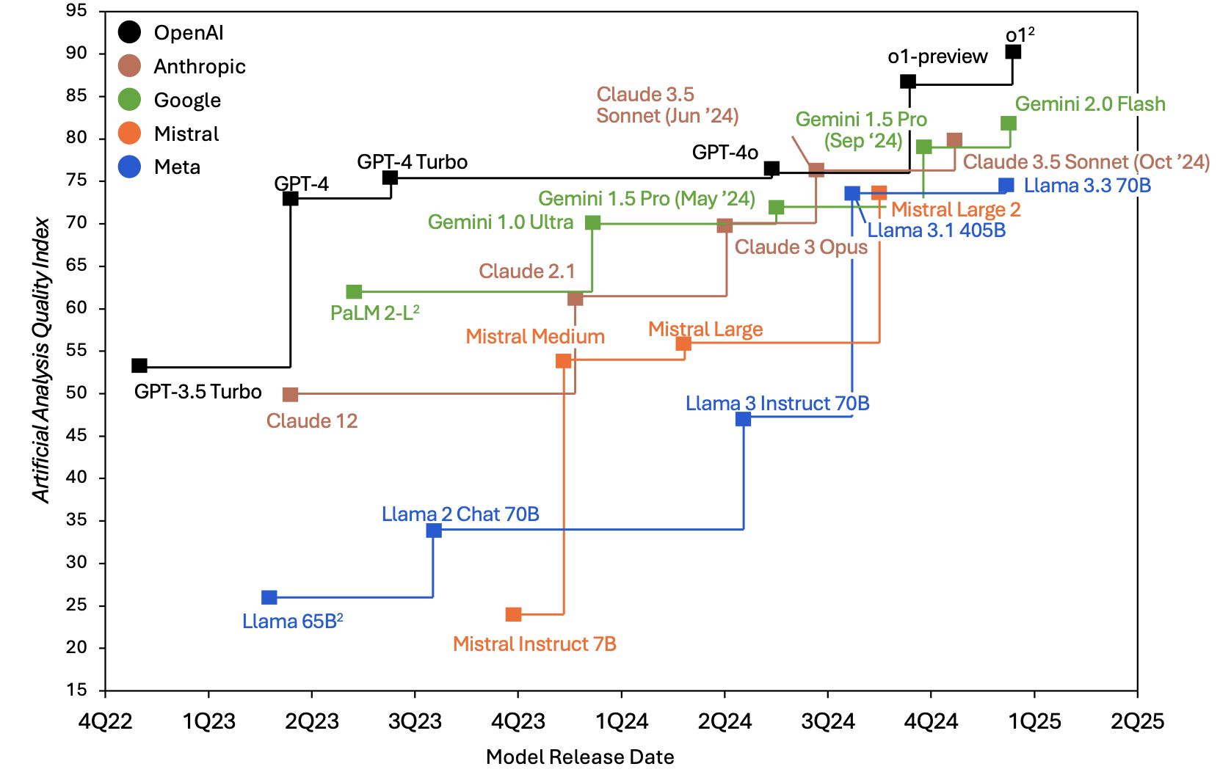
Frontier Language Model Intelligence
Artificial Analysis Quality Index: MMLU, GPQA Diamond, MATH-500, HumanEval. Top 5 Labs by Market Share.

Slide 5
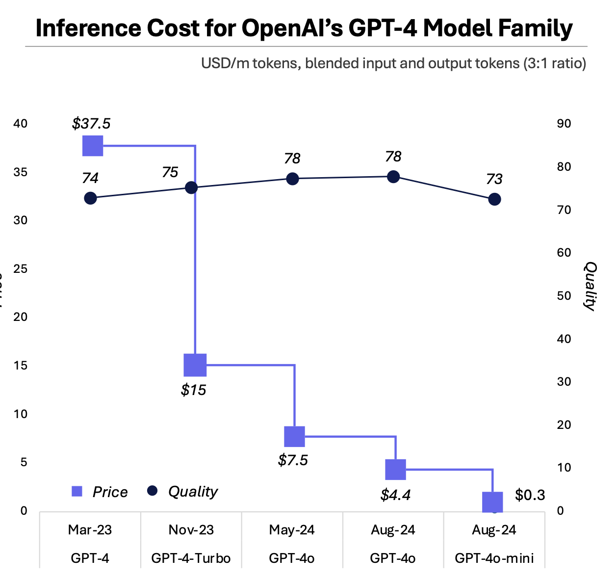
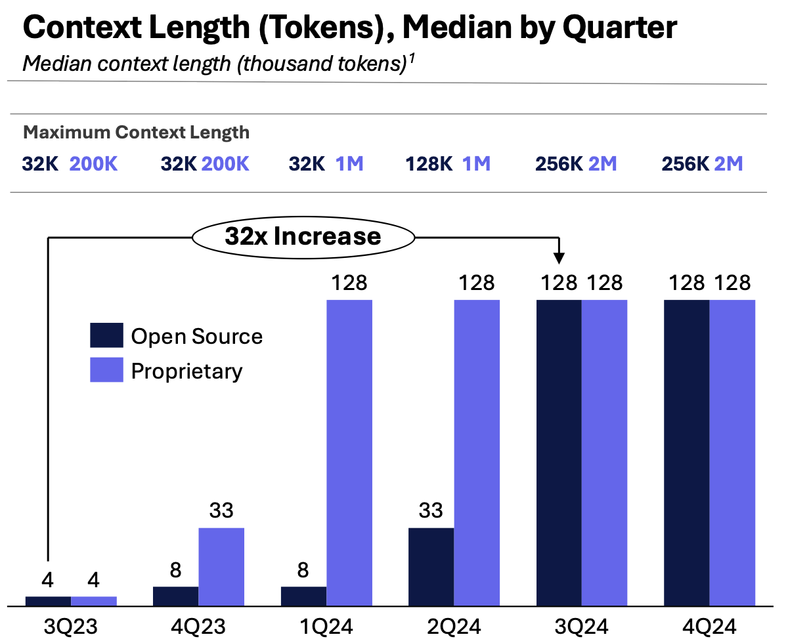
Models Over Time: More Context & Getting Cheaper

Slide 6
Today’s models are the worst they will ever be.

Slide 7
The Adoption Gap is Growing Rapidly
Time
Advancement in AI Technology
OPPORTUNITY: CLOSING THE GAP
Adoption of AI in Business
Rate of Change

Slide 8
Agentic AI Poised to Impact Organizations & Work
Concept 1
Reimagining workflows end-to-end for and with AI
Value Creation
Faster time to value
Improved quality of outcomes
Concept 2
Autonomous agents empower every individual and team
Value Creation
Increased scalability
Significant cost reductions

Slide 9
Agentic AI Poised to Impact Organizations & Work
Concept 3
Mix of Human and Agent Led Teams
Value Creation
Optimized value creation, capture & devilver

Slide 10
Case study:
J.P. Morgan
How to apply AI in private banking?

Slide 11



Navigating Expertise in a Global Organization
Which system can help me do this?
Let me get back to you on that
How long will this take?
Who is the best expert at this?
Who should I call about this?

Slide 12
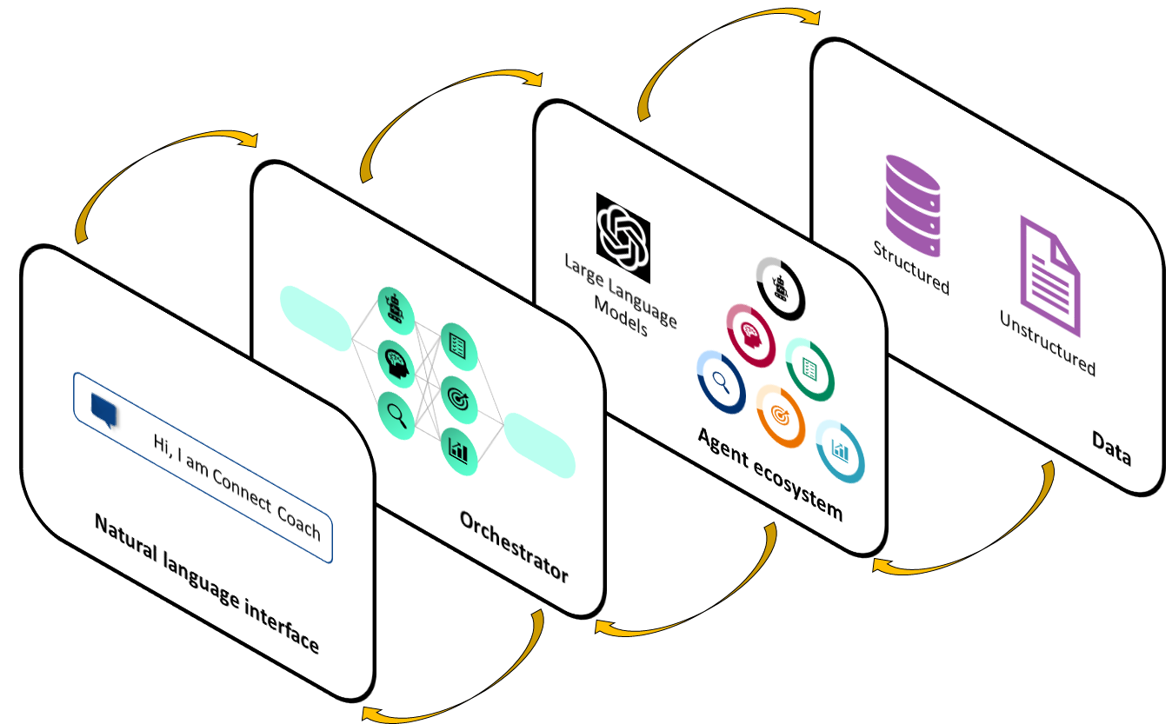
Coach as the Central Orchestrator
A natural language interface where advisors can ask questions to Coach and quickly get answers
An orchestrator that determines which underlying agent to route a user prompt
An open and modular agent ecosystem where teams host LLM-based services
Both structured and unstructured data that agents can pull data from to return to the user

Slide 13



How Coach Orchestrates Advisor Expertise
“Help me prepare for my meeting with Michael Smith”
Feedback
A
B
C
Advisor asks a question
Coach understands the query
Activates multiple expert agents
Synthesizes response

Slide 14
Case study:
Moderna
How to apply AI for getting drugs to market faster?

Slide 15

GenAI for Drug Discovery
Responding to regulatory questions
Completed now in minutes instead of weeks
Moderna has over 2,000 custom GPTs
Sample of GPT Functions & Efficiencies Gained
Predicting the structure of new enzymes
Manufacturing results: Better yield and reduced waste
To determine optimal dosing

Slide 16
Case study:
Nissan
How to reduce time to market with AI?

Slide 17


Auto Industry Challenge
Car Industry
Under disruption
Product cycles
60 month to 30 months?
Volume
Millions of vehicles
Complexity
EV transition/ AV advancements
Technology
Software+AI
Confidential & Proprietary

Slide 18

AI-Powered Journey from Customer Insights to Product Development
Customer Intelligence
Customer needs and wants in real time
Deep market analysis in hours, not weeks
… Integrated with Product Development
Seamlessly translate market signals to product that delight the customer
New product designs in days and not months and years
Confidential & Proprietary

Slide 19
Case Study | Nissan cut concept development time by 75% with Collaborative AI Tool
Idea to vehicle concept > 12 – 18 months
Impact
STARTING POINT
COHORT DEFINITION 4-6 months
CONCEPT DEVELOPMENT
+8-12 months
Time to Market
Agility
Cost Savings
Customer Centricity
Idea to concept with AlgoVerde > 3 – 4 months
-75%
STARTING POINT
COHORT DEFINITION 1 month
CONCEPT DEVELOPMENT
+2-3 months
Confidential & Proprietary

Slide 20
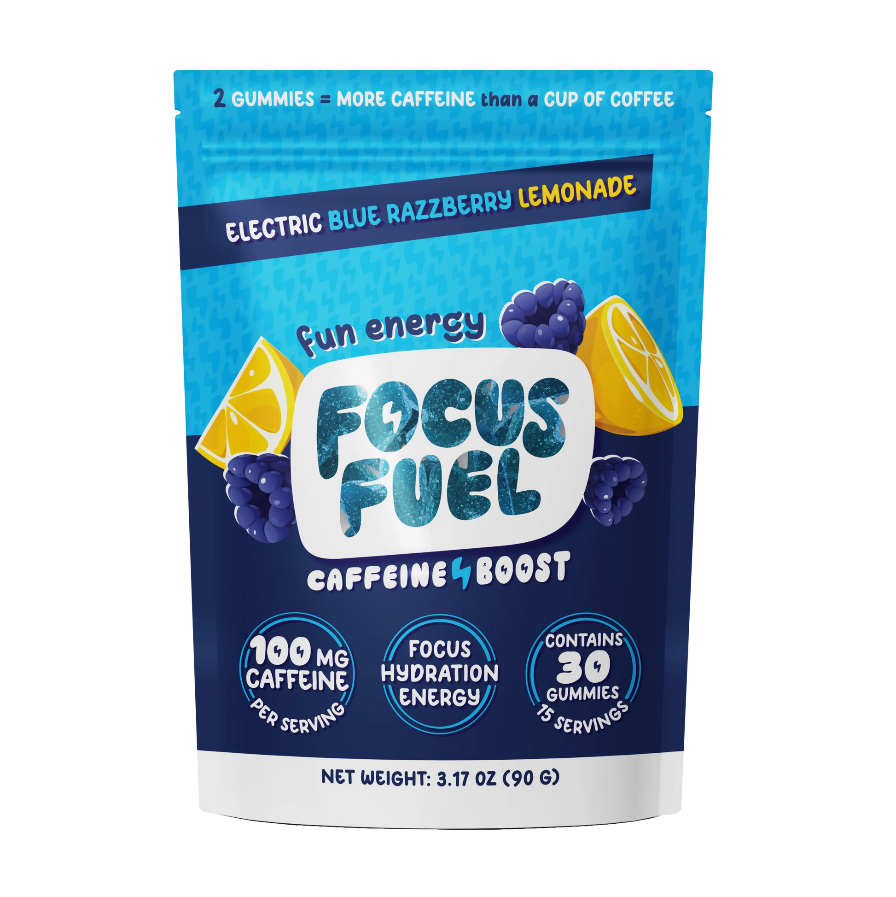
Focus Fuel
thefocusfuel.com
Focus Fuel is a brand offering caffeine gummies designed to provide a convenient and tasty way to boost energy, focus, and electrolyte balance.

Slide 21
2
Cost of Expertise

Slide 22









Transformational Technologies Shift Business Models
?

Slide 23
AI Lowers the Cost of Expertise

Slide 24

Coding with AI
55.8%
FASTER
WITH COPILOT
W/O COPILOT
Source: The Impact of AI on Developer Productivity (Peng et al., 2023, arXiv)

Slide 25
Greater Impact on Knowledge Workers than Firms
WITH AI
Even inexperienced employees can now perform at median level
# OF PEOPLE
WITHOUT AI
Expertise is normally distributed among employees
SKILLS

Slide 26
GenAI Outperforms on Accuracy & Empathy
Doctors vs. Generative AI
DIAGNOSIS RATINGS
EMPATHY RATINGS
CHATBOT
DENSITY
DENSITY
CHATBOT
PHYSICIANS
PHYSICIANS
Very Poor
RESPONSE OPTIONS
Very Good
Not Empathetic
RESPONSE OPTIONS
Very Empathetic

Slide 27

Individual Contributors
With AI
43%
With Prompt Engineering Training
Underperformer
Improvement
25%
17%
Faster Task
Completion
Above Average
Improvement
40%
(-20%)
Higher
Creativity
For Tasks Outside
of AI’s Ability

Slide 28
Cross Functional
Teams with AI
Consumer Packaged Goods Context
Individuals with AI produced higher quality output than teams & individuals without AI
Significantly faster task completion for individuals & teams using AI
With-AI individuals & teams produced more balanced output. AI provided the missing complementary skillset.
Notes:
Is there a way to show some of these results for individuals and teams in a more visual way?

Slide 29
Experimental Conditions
Without AI
With AI
230 participants
115 solutions
252 participants
126 solutions
Team
154 participants
155 participants
Individual

Slide 30
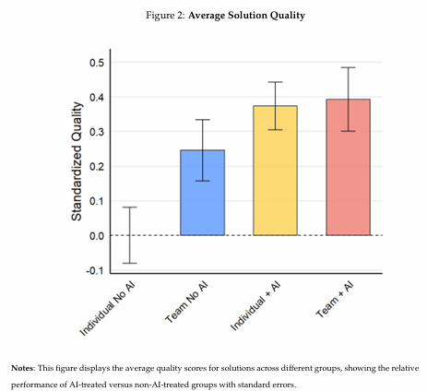
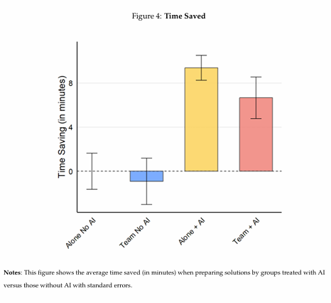
Individuals with AI >> Teams Without AI (and Faster)

Slide 31
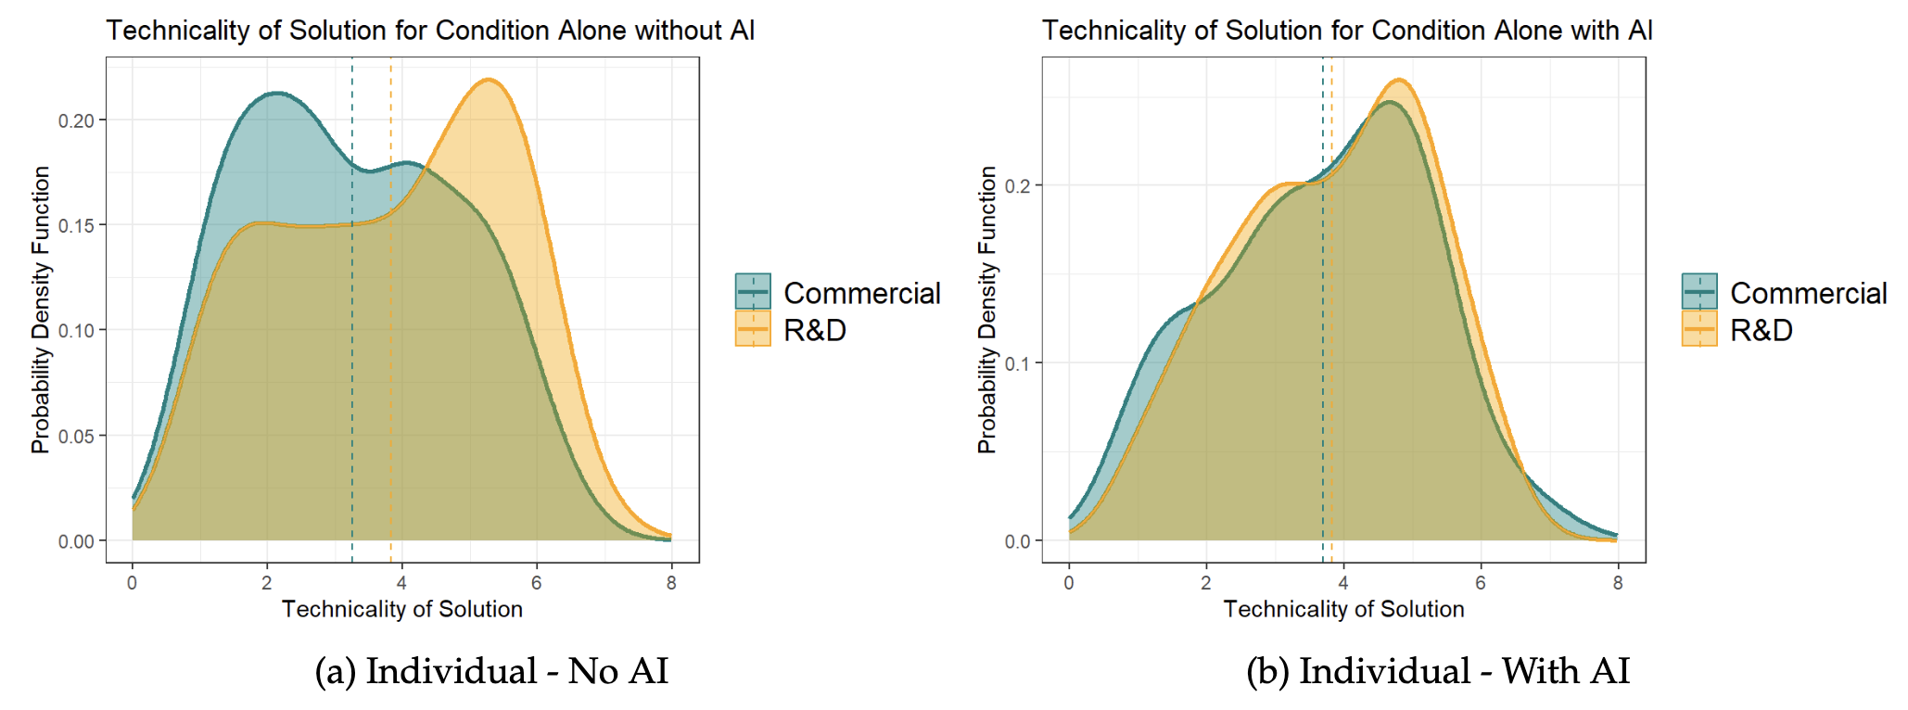
Skill Substitution Effect: AI Breaks Down Professional Silos

Slide 32
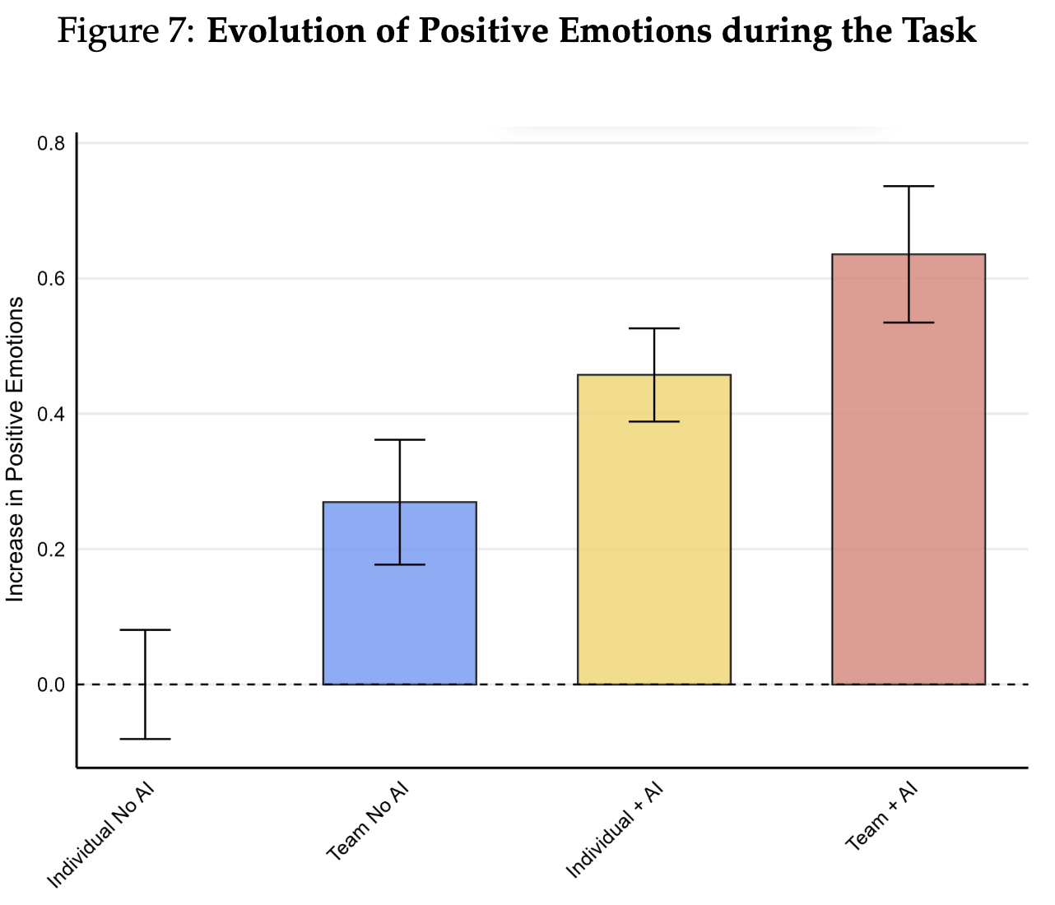
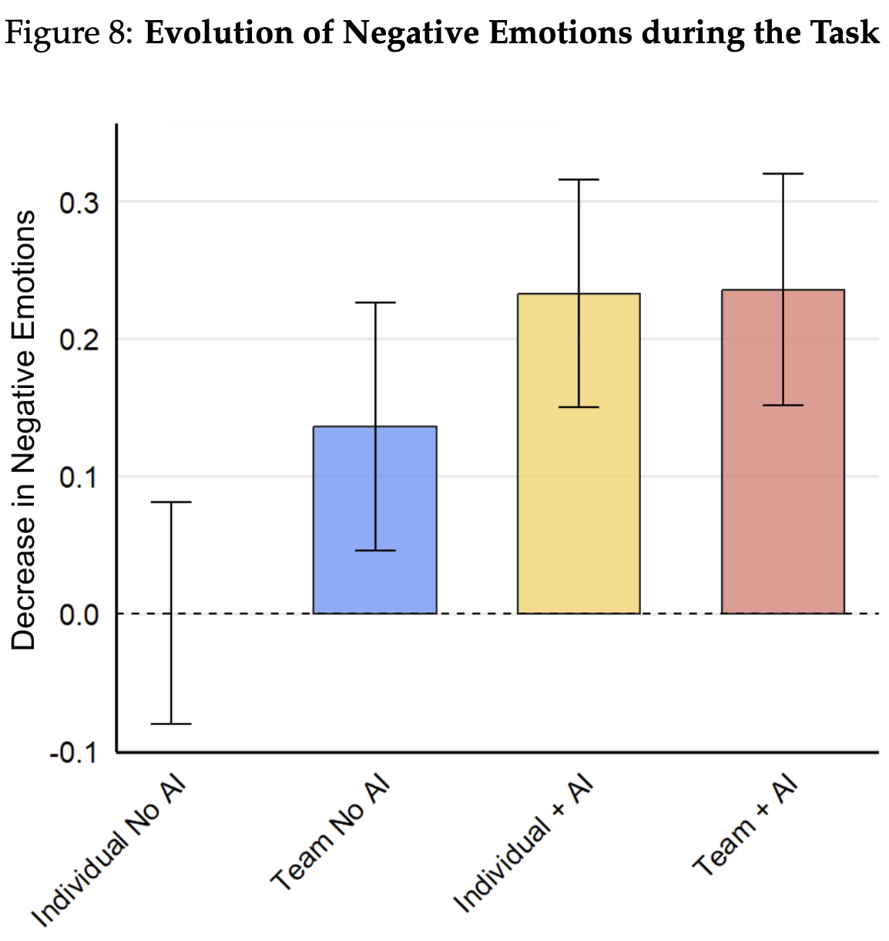
Emotions are More Positive with AI
Positive Emotions
Negative Emotions

Slide 33

Potential Impact on Knowledge Workers
REPLACEMENT
AUGMENTATION
TRANSFORMATION

Slide 34
Focus Fuel
thefocusfuel.com
Focus Fuel is a brand offering caffeine gummies designed to provide a convenient and tasty way to boost energy, focus, and electrolyte balance.

Slide 35
3
Value Creation

Slide 36
Strategy
AI will Redefine the Nature of Competition
HOW DO YOU AND YOUR COMPETITION STAY AHEAD OF AI?
HOW DO YOU STAY AHEAD OF COMPETITION?
YOU
COMPETITOR
AI

Slide 37
Strategy
AI will Redefine the Nature of Competition
YOU WITH AI
AI
HOW DO YOU AND YOUR COMPETITION STAY AHEAD OF AI?
COMPETITOR
AI

Slide 38


Companies can Concentrate Resources on Activities that Matter
DIFFERENTIATING ACTIVITIES
    Build deep relationships with key influencers to craft marketing campaigns
    Refine brand strategy to attract target customers
    Market analysis
    ALL OTHER
    NON-CORE PROCESSES
    Supplier identification
A “THICK” AI PLATFORM
    Packaging design
    etc.

Slide 39

Three Strategic Questions Every Company Should Ask
Which aspects of our customers' needs can now be directly solved by AI?
What are we uniquely good at and where do we need to evolve the most to stay ahead of AI?
What new opportunities are now possible with
AI and how can we capture them?

Slide 40
THANK YOU!
Stay in Touch
klakhani@hbs.edu

