Slide 1







Innosight empowers forward-thinking leaders to OWN THE FUTURE
OUR MISSION
As the leading experts on disruptive innovation and strategic transformation, we help global organizations develop insights into tomorrow’s customers, align around a shared vision of the future and the opportunities ahead, and build the organizational momentum to transform and grow.
We help companies imagine and build new ways to grow, both in their core businesses and in markets that don’t yet exist. Our clients tell us we change the way they think and see, enabling them to do things they could never do before.
OUR CO-FOUNDER
OUR EXPERTISE
OUR SUCCESS FACTORS
Clay Christensen
(1952-2020)
Pioneer of Disruptive Innovation
Author of
The Innovator’s Dilemma (1997)
Competing Against Luck (2016)
Awarded the
Number 1 Management Thinker
in the World in 2011 and 2013 (Thinkers50)
Future-Oriented & Data-Informed
Strategy
Transformation
Innovation
New Business Acceleration
Culture & Change Management
Financial Services Expertise
Customer at the Center
Senior Alignment Expertise
Collaborative Capability Transfer

Slide 2
Poll Question
What role do your current customer relationships play in driving growth and innovation?
Accelerant – We have deep strategic partnerships and actively collaborate to drive change.
Neutral – We have good relationships, but they aren’t a critical asset in our innovation efforts.
Rate-Limiter – We are constrained by our customers’ real or perceived unwillingness to participate in breakthrough innovation efforts.

Slide 3





Strong customer relationships evolve from transactional into consultative, and eventually, strategic collaborations
We define ourselves by:
Impact we have
Problems we solve
Products we sell
Problems we solve
Impact we have
Set Strategy
and Agenda
Identify Execution
Gaps & Solution
Options
Select and Acquire
Resources &
Technology
Implement and
Operationalize
Solutions
Manage and
Improve
Performance
Customers’
Process
Customers’
Key Questions
What strategic changes will improve my business performance?
What do we
need in order to execute on our strategy and improve performance?
Which supplier is best able to give me what I need at a competitive cost?
How do I successfully implement new solutions and capabilities?
What do I do to derive the most value from the strategy & the investment?
WHAT?
HOW?
HOW?
Transactional
BUSINESS
OUTCOMES
BUSINESS
OUTCOMES
Consultative
Strategic

Slide 4






THE SUCCESS FACTORS: Five lessons on successfully building stronger and more strategic B2B relationships
1
2
3
4
5
Deepen your insight of your customer’s jobs to be done
Open up
new ways to create value
for both parties
Establish
relationships beyond your current footprint
Engage in mutual discovery and development
Define and co-lead a joint collaboration process

Slide 5
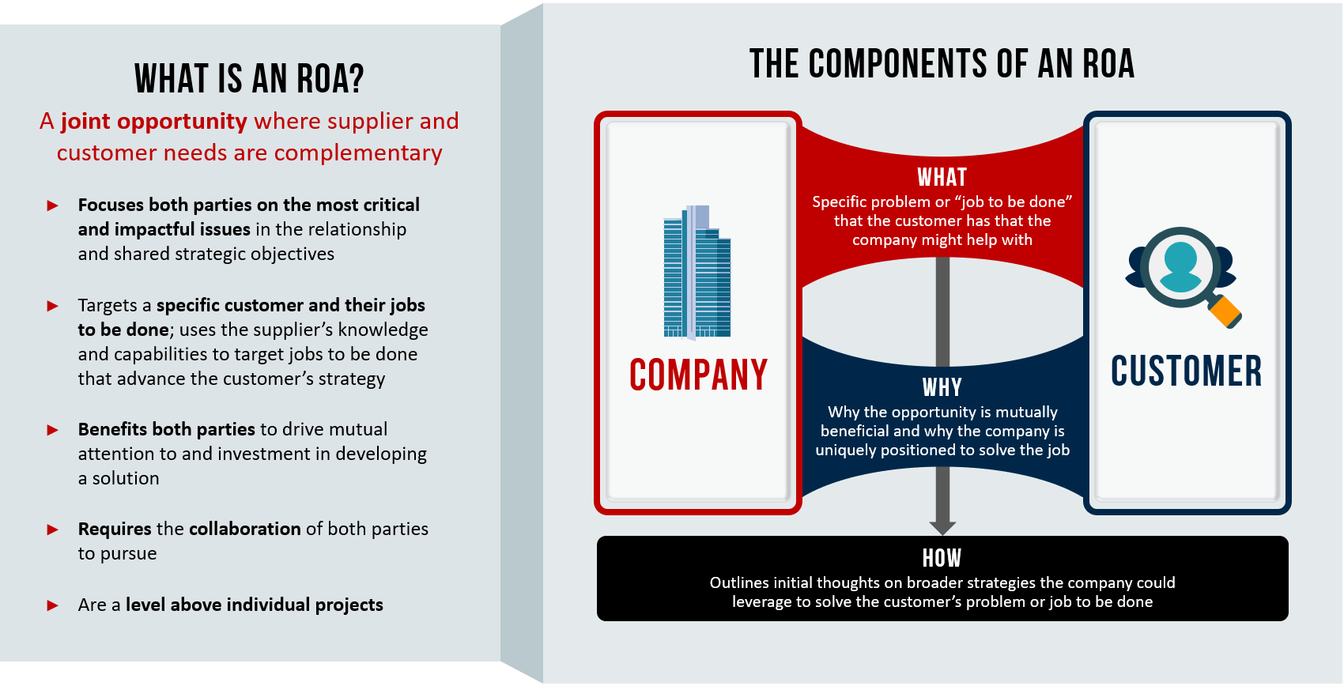
Finding opportunities that serve both you and your customer…
2

Slide 6
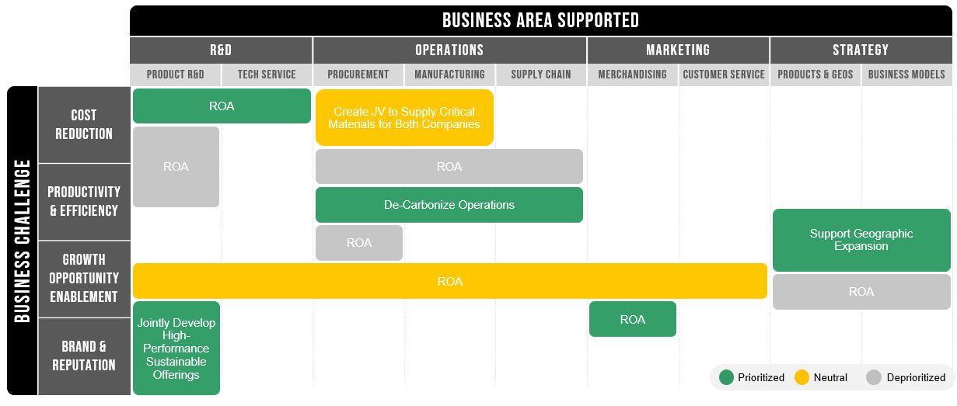
… taking a broad aperture of the customer’s business challenges
2
ILLUSTRATIVE

Slide 7


Slide 8
Poll Question
What do you see as the biggest challenges to implementing SRM in your organization?
Customer willingness to change relationships
Our role in the value chain
Organizational culture and entrenched behaviors
Existing roles and structure within our organization
Team members’ skills and capabilities
Leadership’s willingness to invest
Lack of clear connection to our strategy
Other (Please share in the chat)

Slide 9

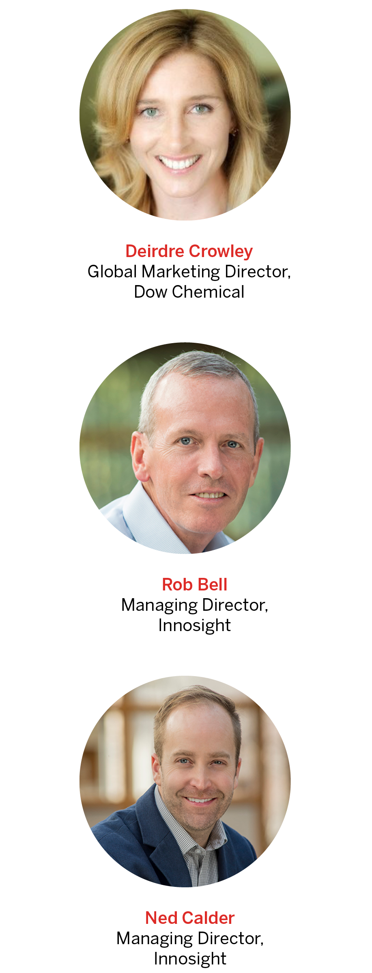
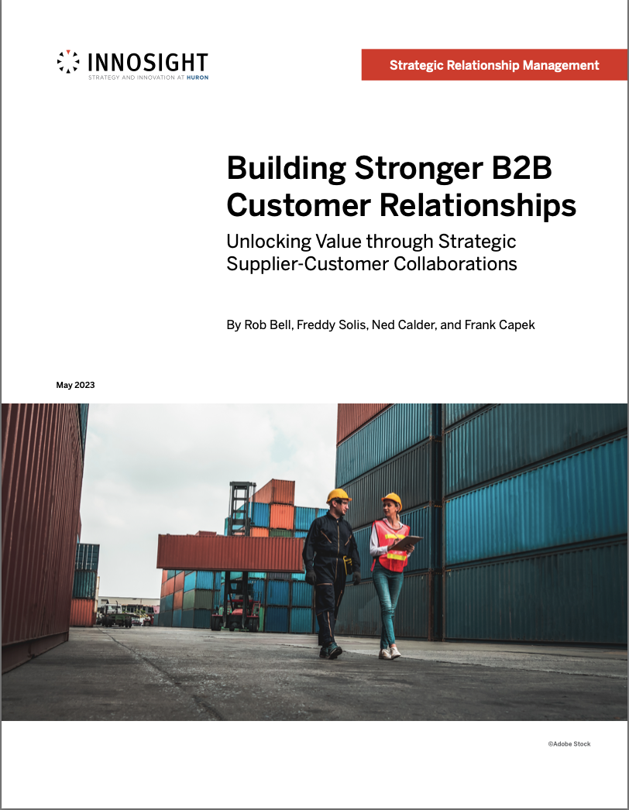
Thanks!
ncalder@Innosight.com
rbell@Innosight.com
Dcrowley@dow.com

