Slide 1

Context: How Big Companies Win in an AI-Powered World
2025 Elliott Parker

Slide 2

We build startups.
Alloy Partners co-creates advantaged startups and venture studios in partnership with leading corporations and entrepreneurs.

Slide 3

Alloy Partners is rooted in the founding of the venture studio model.
History
2015
2017
2020
2025
High Alpha is founded
High Alpha is founded by former ExactTarget CEO
(acq. by Salesforce for $2.5B) and three other entrepreneurs to launch and invest in B2B SaaS startups.
Created the first “venture studio” and pioneered the studio model.
Raised 4 venture funds and $300M+ in AUM over 10 years.
Launched 40+ companies.
First corporate collaborations
Corporations took notice of early success and sought to replicate the model.
Early clients included Xerox, Cummins, Allegion, SVB, and more.
Alloy Partners founded
Elliott Parker spins out Alloy Partners (formerly known as High Alpha Innovation) as a standalone portfolio company of High Alpha.
Founded to expand the playbook and serve corporate clients.
Early clients included SVB, Fidelity, Vanguard, and more.
Portfolio expanded to include studios built with universities and public sector.
The scaled venture studio playbook
Alloy Partners launches the scaled venture studio model based on 4+ years of experience and learnings alongside partners.
Expanding program partners with technology providers to create additional leverage during company building and scaling phases.

Slide 4
We’ve learned a lot about building Advantage over the last five years
40+ Partnerships with Leading Organizations
We’ve helped leading organizations like Koch Industries, Capital One, SVB, P&G,
Elanco Animal Health, University of North Carolina, and Purdue University unlock
growth and transformation.
7 Venture Studios Launched
We help organizations to diversify their growth efforts through a portfolio of venture-backed companies.
Our Track Record
75+ Concepts Sprinted
Sprint Weeks are our forcing function for company creation. Over the course of
3.5 days we build the business, design the product, and test assumptions with customers and investors.
36 Companies in our Portfolio
We and co-create companies snd launch startups in exchange for equity.
31 NewCos Launched
We recruit world-class co-founders, incorporate the business, and surround teams
with the resources they need to go further, faster.
$65M+ in VC Raised by Portfolio Companies
Our startups are designed to rely on market validation, sometimes in the form of venture capital investment, to determine success.

Slide 5
Let’s learn about you…
Describe your role. Are you:
Central innovation team?
Business unit specific innovation team?
Business unit operator?
C-suite?
Researcher?
Professional services provider?
Other?

Slide 6
What we’ll cover
01 The problem
02 Context
03 How to win
04 Getting started

Slide 7
01
The problem

Slide 8


Slide 9


Slide 10
How can you use AI in your business?
Drive efficiency
Improve customer experience
Create new business models
In the chat
Share an example of how your company is using AI
Notes:
Corporations are really just focusing on the first two and nobody doing the third. You need to use that to drive entirely new business models.
How do we leverage your context to build businesses that entrepreneurs and VCs don’t have the ability to do?

Slide 11
The Business Model Framework
What is a “business model?”
Customer Job to Be Done: Whose needs are we solving?
The problem that the business seeks to solve — the type of progress that a particular customer is trying to make in a specific circumstance
Value Proposition: Do people want this?
How the business creates value through its offering, customer access, and payment models
CREATE
VALUE
CAPTURE
VALUE
CUSTOMER JOB TO BE DONE
Resource Model: Can we do it?
How the business delivers value through resources and processes
DELIVER
VALUE
Profit Formula: Is it worth it?
How the business captures value through revenue, cost, margin, reinvestment, and throughput
| ‹#›

Slide 12
What are examples of new, AI-enabled business models?
Co-pilots
Khanmigo: Personalized education
GitHub Copilot: Complete code
Workpack: Image-based cost estimator
Agents
GetIntro: Sales lead gen
Slang: Voice responder for restaurants
Howie: Virtual scheduler
AI-enabled services
Reserv: Automates insurance claim process
Displaid: Infrastructure monitoring/insights

Slide 13
In the chat
Share examples of your favorite AI-enabled business models

Slide 14
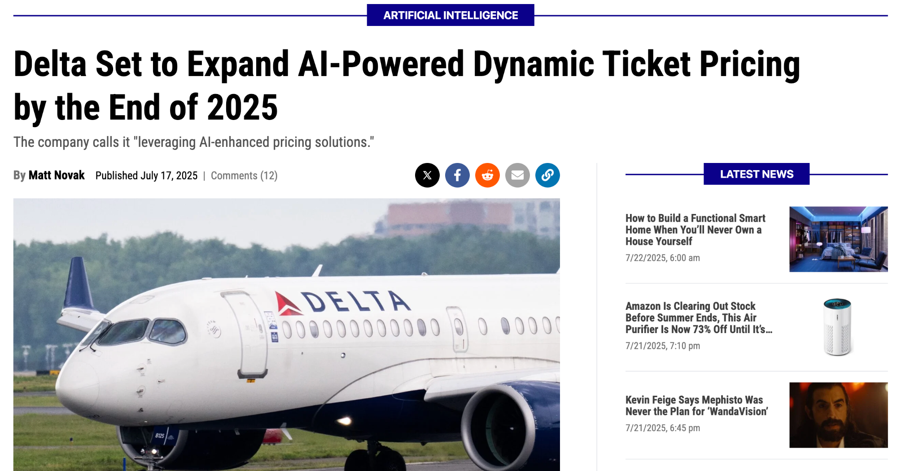
Notes:
Dynamic pricing actually powered by Fetcherr

Slide 15
Question
Why are most of the new AI-business models coming from startups?
Why aren’t established corporations doing more?

Slide 16

The worst place to develop a new business model
is from within your
existing business model.
-Clayton Christensen
Notes:
Several of us here at High Alpha Innovation had the honor of working closely with the late Harvard Business School professor Clay Christensen at the consulting firm he co-founded where we partnered with large organizations to deliver growth through innovation and transformation. The corporate innovators we worked with were typically tasked with executing innovation and investment strategies to defend against disruptive competitors and technologies or to capture transformational growth opportunities that pushed the organization into new markets, customers, and/or business models. While these innovators were well versed in innovation and deeply understood the need to transform their organization, they felt frustrated by the lack of funding, support, and resources to launch and scale truly transformational efforts. The root cause of this lack of support was often Wall Street quarterly pressures and the organization’s senior executives that were compensated based on short-term metrics like EPS. To his credit, Clay realized early on that the worst place to develop a new business model is from within the existing business model. The only way to successfully pursue disruptive or transformational opportunities was to keep them as separate as possible from the core. We here at High Alpha Innovation have built our business around this simple premise. We partner with large organizations to - quite literally - create separate new companies that can help the organization avoid disruption and capture transformational opportunities.

Slide 17
Innovation in a scaled enterprise
Optimized for efficiency improvements to protect the status quo
PROCESS
GOVERNANCE
INCENTIVES
TALENT
Innovation programs to drive efficiency of existing business
Utilizes existing structure to support new initiatives

Slide 18
Innovation in a startup
Optimized for learning to build what comes next
Designed for learning through quick experimentation
Decisions made with limited data (probabilities not certainties)
Binary nature of outcomes drives activity
Access to talent comfortable with ambiguity
PROCESS
GOVERNANCE
Innovation to drive market disruption
INCENTIVES
TALENT
Uses dramatic incentives and rapid experimentation, prioritizing learning over efficiency

Slide 19
02
Context

Slide 20
Poll
Have you used AI for health advice?

Slide 21
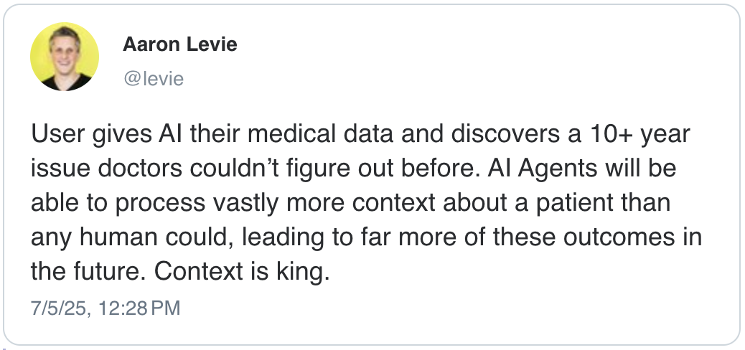

Slide 22
Building blocks to deepen understanding
Context
Lab Panels
CT
MRI
Unexplained Symptoms
ChatGPT
Conclusion: Gene Mutation → Consulted with PCP for treatment
Notes:
Ten years of tests after tests ordered by the best doctors and specialists available with inconclusive results. With all of their results, this patient took matters into his own hands and hired AI to do the job that his doctors couldn’t do – give him a clear direction. He gave the GPT all of the context he had – a mix of data and history of the symptoms he’d experienced over the years and was given a clear direction to explore with his doctor. The AI was able to see the connections between the test data and first-hand experience that had otherwise been missed.

Slide 23
Context in the realm of AI refers to all the background information, circumstances, and relationships that give meaning to data, actions, or decisions used to generate an intended output.
Context is the “operating environment” surrounding raw data deepening understanding and creating opportunity for connection
Context

Slide 24
Sources of business “context” that can form basis for competitive advantage
Context
Data
Historical customer behaviors
Pricing patterns
Supplier performance
Relationships
Existing distribution network
Customers
Ecosystem partners
Experience
Customer problems
Internal challenges
Market issues
Market Knowledge
Market trends
Regulatory landscape
Competitive dynamics
Access Control
Suppliers
Distribution partners
Context + action creates competitive advantage.
Notes:
Data // Raw data is perceived as being a source of advantage but everyone has data. LLMs are amazing at creating synthetic data
Market // Corporations understand the market, players, etc. context better than anyone else.
Context to spot opportunities and build on it.
Data alone is not your advantage, nor are your relationships. But if you were to aggregate all of the context spread across the business in the form of relationships, experience with problems, market knowledge, and your control of the availability and access to the data – that’s where you have real opportunity to build entirely new business models.

Slide 25
03
How to win

Slide 26
Poll
How will your company’s investment in AI change next year?

Slide 27
Leading corporations are investing heavily in AI
How to Win
$563B
2028 AI compute TAM estimate
by Citigroup as Nvidia continues to show dominance in AI chips and the broader AI infrastructure market ¹
288%
One-year increase in global M&A deals involving AI startups to $50B
In the first half of 2025 alone, deal value already surpassed $55B, with U.S. Fortune 100 companies leading many of these acquisitions.
¹ “Citi lifts Nvidia's price target on booming sovereign AI demand” Yahoo Finance →
2 “AI Startup M&A Deal Volume and Valuation Hit Records” PYMNTS →

Slide 28
Case study: Top 5 pharma company has a problem it’s been trying to solve for 15 years…
How to Win
What unique context does the company have that could become the basis for competitive advantage?

Slide 29
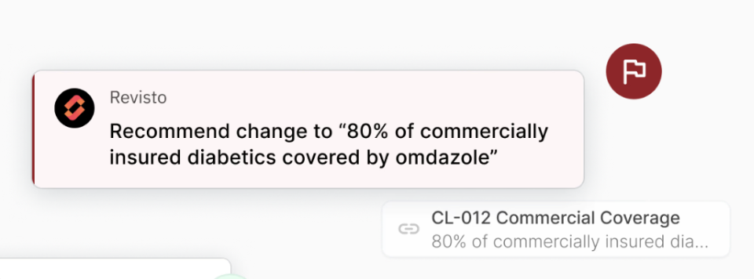
Revisto: Accelerating medical, legal, & regulatory review
Example
A top 5 global pharmaceutical company wanted to identify opportunities for innovations that aligned with its business units’ needs while embracing AI in a highly regulated industry.
One pain point they had spent years trying to solve was removing barriers that prevented rapid go-to-market and promotion of new drugs. Using our venture building playbook, we explored several concepts that could accelerate Medical, Legal, and Regulatory (MLR) reviews and enable faster approval and dissemination of drug-related marketing materials.
Together, we co-created and launched Revisto, an AI-powered solution that streamlines the MLR process through advanced automations and smart content recommendations. Our partner will see up to $15 million savings per drug brand per year.*
*Our partner alone has 50+ drug brands, and the pharmaceutical industry boasts 6,100+ companies with 20,000+ drug brands approved for marketing.
20%
Predicted time savings for the pharma-
ceutical brand’s marketing and legal teams who conduct MLR reviews together
$15M
Projected cost annual savings per drug brand that adopts Revisto to streamline MLR reviews
Alloy Partners | Confidential - 2025

Slide 30
Using business context to build AI-enabled business models
How to Win
Data
Historical customer behaviors
Pricing patterns
Supplier performance
Relationships
Existing distribution network
Customers
Ecosystem partners
Experience
Customer problems
Internal challenges
Market issues
Market Knowledge
Market trends
Regulatory landscape
Competitive dynamics
Access Control
Suppliers
Distribution partners
Conclusion

Slide 31
04
Getting Started

Slide 32
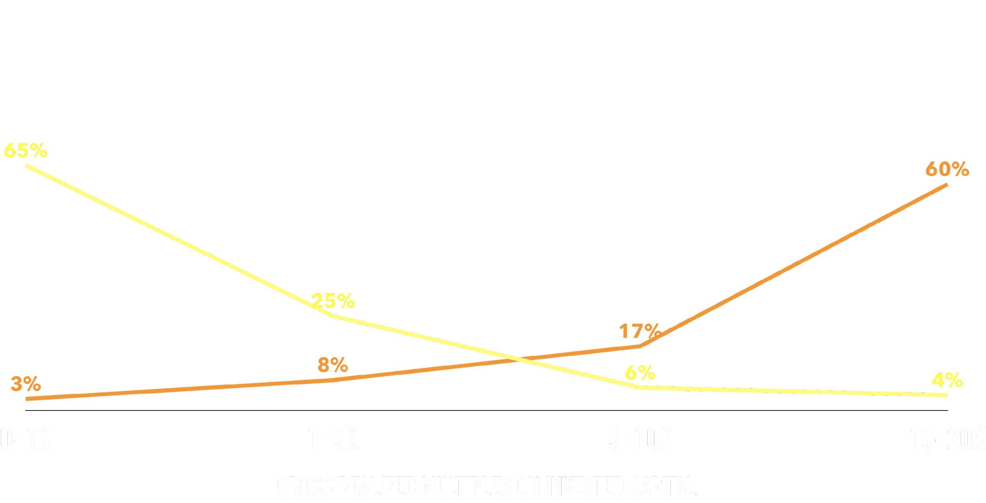
It’s the magnitude, not the frequency,
of correctness that matters
of Returns
of Deals
SOURCE: CORRELATION VENTURES ANALYSIS (N=21,640 FROM 2004-2013)
The Venture Capital Power Law
A few investments generate a majority of the returns
Notes:
Yes, we understand that individual startups are risky and a majority fail. In our experience the failure rate is actually not too dissimilar to internal P&L funded transformational ventures. The “power law of venture capital” implies that a few “winners” will return the fund and cover the losses of all the “losers.” 6% of deals return 60% of the returns. The business of venture capital is about hitting grand slams/home runs, not maximizing on-base percentage.
If a scaled organization wants to pursue external funding the optionality to raise outside venture capital to share in the risk of transformational ventures then it needs to swing for the fences with external ventures. The process itself of trying to raise outside capital for an external startup is actually a great litmus test for whether the venture truly has the exponential growth potential that scaled orgs need.
This power law dynamic is why VCs create funds that invest in many startups over a set period of time. The portfolio approach diversifies individual startup risk and increases the odds of hitting one or more out of the park. Scaled organizations should follow the VC approach and build a portfolio of external startups each with exponential growth potential.
https://medium.com/@MarkSita/power-laws-and-startup-investing-b62865423379 -

Slide 33
It’s time to start building
How to Win
01
02
03
Consider your unique context
Establish viable framework for experimentation
Run more experiments: fast, cheap, weird
Notes:
Think about the unique context your company has
Use to design new AI-enabled business models
Governance - build external

Slide 34












Alloy Partners
Launching companies is easy. What comes after is hard.
Legal
Terms of Formation, Pre-seed Investment, Pair with Counsel, Establish Board
Metrics
Manage Key Metrics,
Benchmarks for Founders
Growth Coaching
Entrepreneurial Operating System, Coach for Implementation, Board Management, and Fundraising
Company Set-Up
Procurement, Insurance & Compliance, Tech Stack
Network
Insights, Validation,
Advisors
Recruiting
World-Class Talent,
Access to 0–1 Experience,
BOD Recruiting
Finance
Path to Seed Funding,
Business Model, Pricing
Reputation
Alloy Partners and [COMPANY] Brand Names for Early Credibility
Customer
Access to Customers for Insights,
Sales and BD Expert Network
Design
Brand Identity, Name & Logo Suite,
Style Guide, Pitch Deck, Website,
Email, Social Assets, Collateral
Fundraising Strategy
KPIs, Milestones, Overall Health
What We Do
Alloy Partners | Confidential - 2025

Slide 35
Thank you!
Contact
elliott@alloypartners.com

