Slide 1
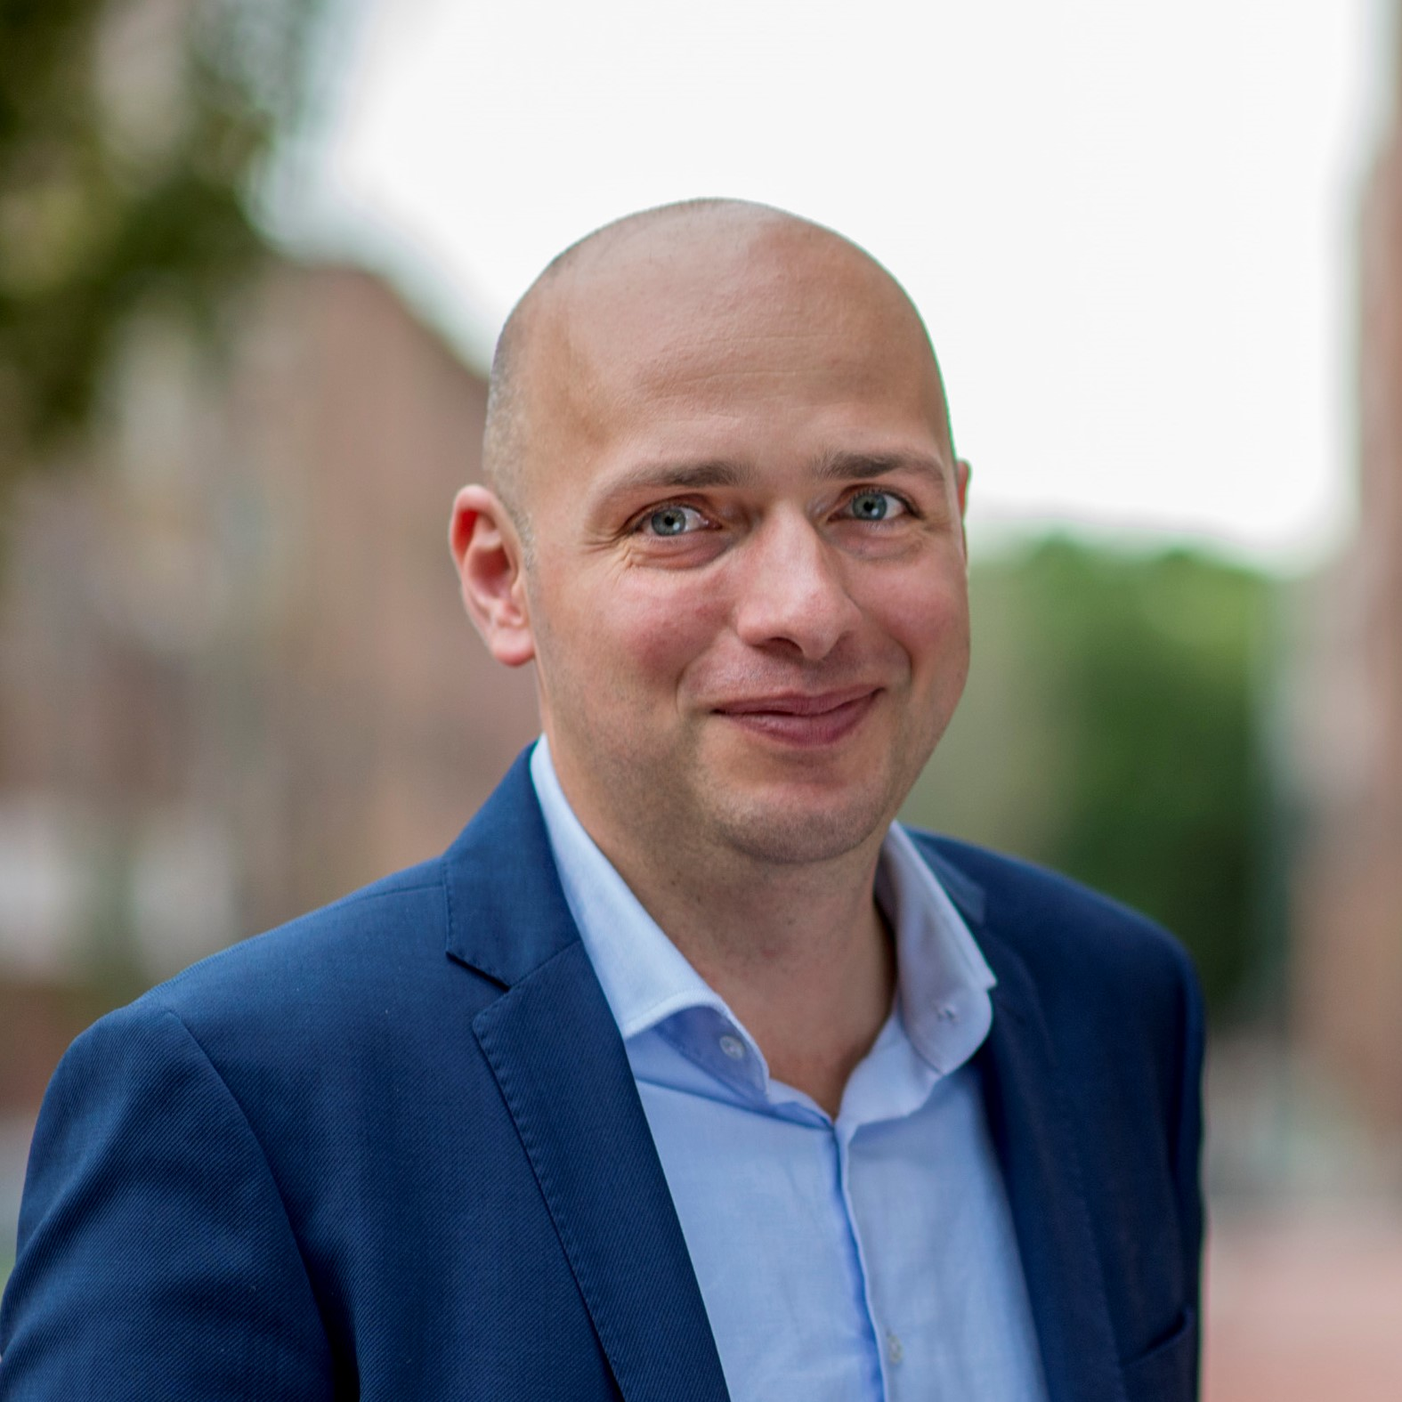
Sharing my experience with
Digital Transformation in large multinationals
Alexandru Darie

Slide 2
Me in 5 bullet points
5 transformation in 20 years in high-tech environment
Transformation at product level, system level, business model level
Organization structure and Business Process transformation
Innovation management and New idea generation
Connected systems and Data monetization

Slide 3
Thoughts on best practices
Hire the right people
Use external consultants to evangelize change internally
Get System and Data Architects involved early on
Find a meaningful problem and deliver first results fast
Launch fast and often

Slide 4
I’ve I had a penny…
Agile/Scrum only applies to software products
We can not commit to a delivery! We are working agile!
Available digital platforms are not good enough for what we need
Design (Thinking) is a lot of fluff and takes too much time
Go fast, experiment, failure is normal
We have empowered teams!

Slide 5
Some relevant reads…
LEAN STARTUP
  Lean Startup – Eric Ries
  Lean Product Playbook – Dan Olson
  All Alexander Osterwalder series
ORGANIZATION
  Working Backwards – Colin Bryar
  The AI Organization – David Carmona
INNOVATION PROCESS
  The Innovator’s DNA – Clay Christianson
  Platform Revolution – Geoff Parker

Slide 6
Few slides I use to tell the story

Slide 7
Inspired by LEAN movement of Toyota Production and applied to the world of innovation
LEAN
START-UP
strive to avoid / reduce /eliminate waste
by working in small batches,
when problems occurs, stop and analyze and
react proportional to impact of the issue
operate under extreme uncertainty
to create a sustainable business
through rapid iterations
and continuous user feedback

Slide 8
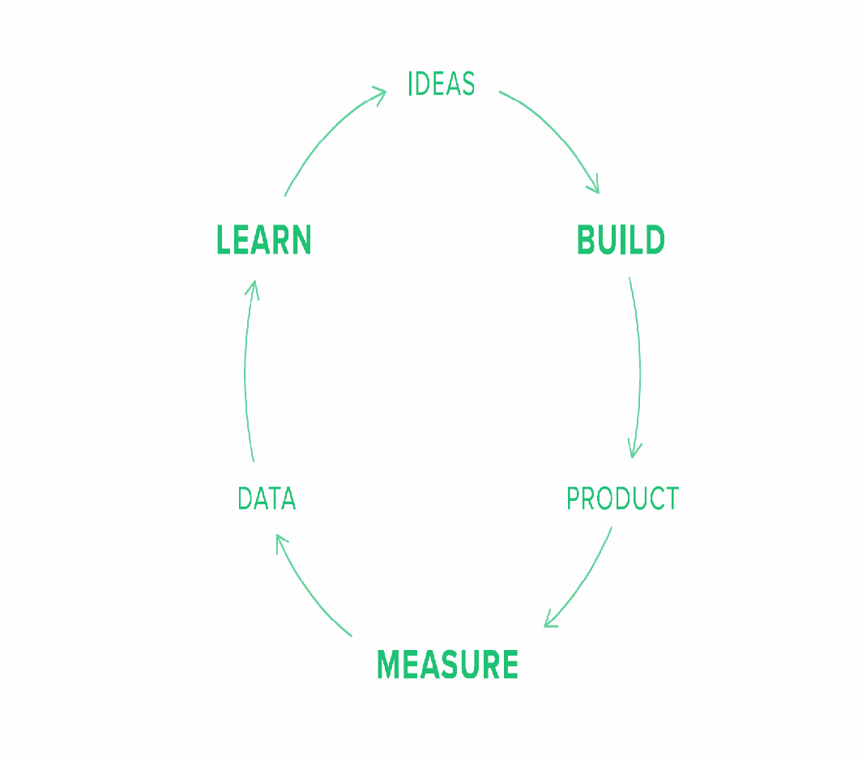
Achieve Product-Market-Fit and Accelerated Growth by ever faster BUILD-MEASURE-LEARN execution cycle
EXECUTION
PLANNING
Build-Measure-Learn cycle is the engine that powers the growth of the business. As the cycle repeats, it also shorten, accelerating with each iteration. There are 3 types of GROWTH ENGINES: Sticky, Viral, Paid
Collecting right data enables the INNOVATION ACCOUNTING that is key to steering the execution in order to avoid waste.
Every investment in execution has to be VALIDATED leading to what it is now called
VALIDATED LEARNING
There are 3 main LEARNING MILESTONES:
      1. Create the BASELINE
      2. TUNE the engine
      3. PIVOT or PERSEVERE
IDEAS
Planning cycle works in reverse from Execution one
It is the key to SUCCESS by enabling FAILURES. It advocates for up-front definition of the learning goals and then to validate those.
There are 2 types of HYPOTHESIS – one is addressing the expected GROWTH and other the supposed VALUE delivered to users
To be able to validate those hypothesis, right METRICS need to be defined, avoiding so called vanity metrics.
Knowing what you need to measure, it is time to define what is the fastest and the cheapest way of engaging with the users and collect the necessary data to confirm or infirm your hypothesis. Those are your Minimum Viable Products or MVPs
EXECUTION
CYCLE
LEARN
PLANNING
CYCLE
BUILD
HYPOTHESIS
MVPs
DATA
PRODUCT
METRICS
MEASURE

Slide 9
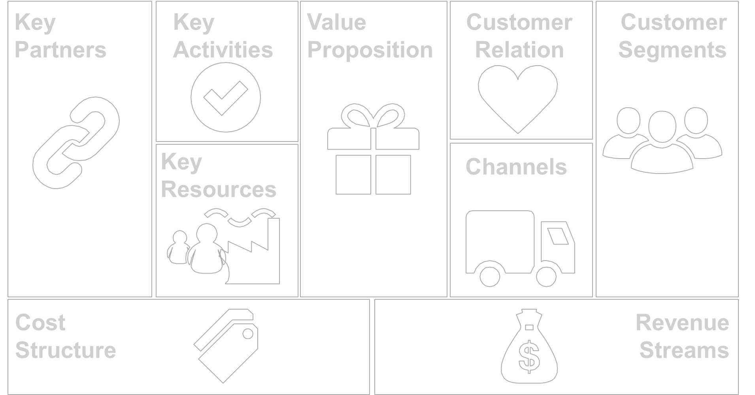
Set clear Objectives with SMART Key Results, focused on outcome rather than deliverables.
Run iterative cycles to reduce the market, product and business risk of idea not being Viable, Desirable and Feasible.
Prioritize based on IMPACT and TIME. Define right Experiments to collect data and validate they hypothesis
Discovery Based Planning
VIABLE – Should we do this?
Strategic fit
Opportunity size
Right to play and Control points
DESIREABILITY – Do they want this?
Offer and Customer benefits
Customer persona, access and channel
Willingness to pay
FEASIBILITY – Can we do this?
Features
Skills & Partners
Cost roadmap
Following IDEO and Strategyzer.com methodology
FEASIBLE
DESIRABLE
“Can we do this?”
“Do they want this?”
VIABLE
“Should we do this?”

Slide 10
What is an MVP and other ways to LEARN FAST
QUALITATIVE
QUANTITATIVE
Marketing materials
Landing page
Explainer video
Ad campaign
Marketing A/B tests
Crowdfunding
DELIGHTFUL
MVP
USABLE
PRODUCT
PRODUCT TEST
MARKETING TEST
Wireframes
Mockups
Interactive prototype
Wizard of Oz
Concierge
Live product
Fake door
Product analytics
Product A/B tests
RELIABLE
FUNCTIONAL
Not-an-MVP

Slide 11
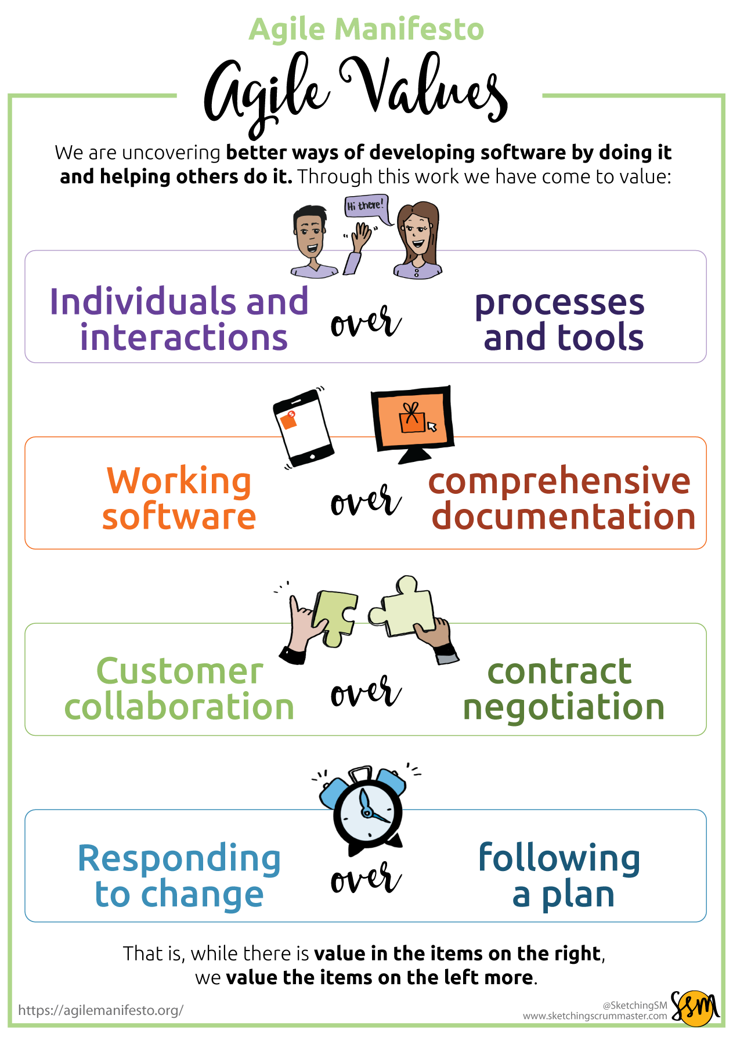
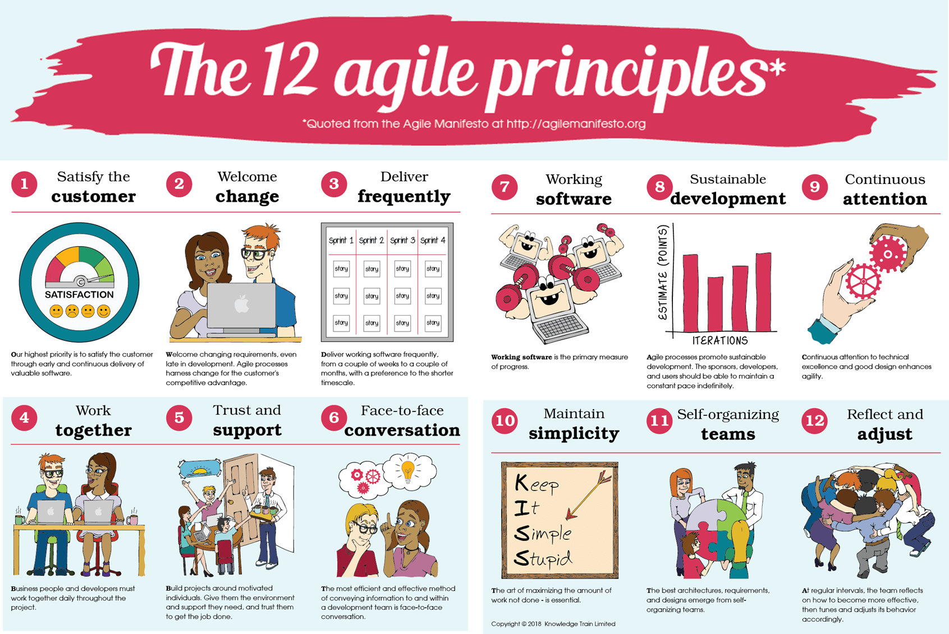
The 4 VALUES and 12 PRINCIPLES of AGILE

Slide 12
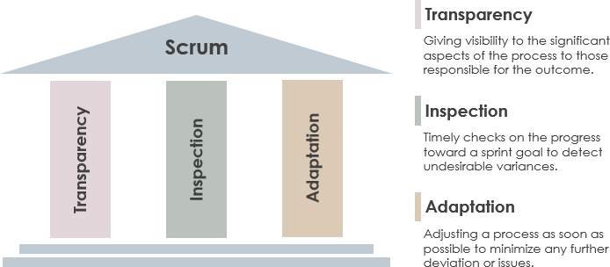
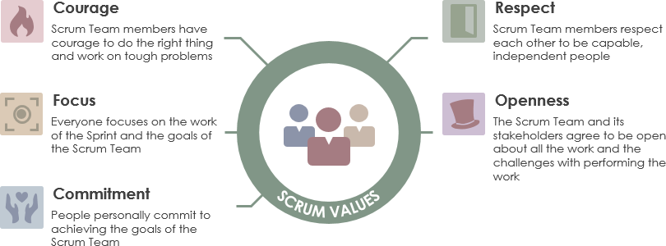
SCRUM is one of the AGILE Implementations
PILARS
&
VALUES

Slide 13
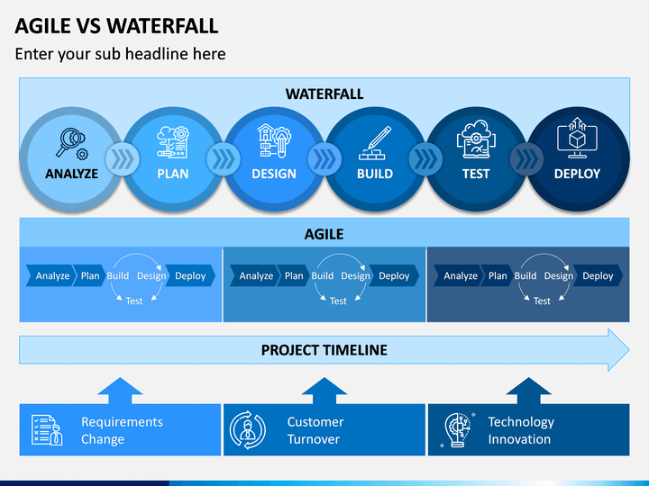
From WATERFALL to AGILE
REQUIREMENTS
From Defined upfront to Co-created w/ Customers
COST PROFILE
From Committed @start to Pay-as-you-GO
RISK PROFILE
From Large, long-term, managed risks to Short term, controlled risks
TIME-2-VALUE
From Potential large value after several months to Value increments every few weeks
CHANGE TOLLERANCE
From Prevent change or Reset plan to Welcome and continuously integrate change
ACCOUNTABILITY
From Strict hieratical structure to Empowered team of equals
LEADERSHIP ROLE
From Directive to Supportive

Slide 14
AGILE & LEAN… Marriage made in heaven!
AGILE helps with HOW and LEAN STARTUP guides the WHAT.
The essence of both is captured in well written USER STORES
AGILE
BUSN. |USER | FUNCTIONAL | NON-FUNCT. REQ
LEAN
DEFINITION OF READY
DEFINITION OF DONE
Individuals and interactions over processes and tools
Customer collaboration
over contract negotiation
Working solution
over comprehensive documentation
Responding to change
over following a plan
Reduce /eliminate waste
by
“Seeing yourself”
first what customer needs,
Work in small batches to easily adapt to changes/issues and
React proportional to impact of the issue
USER STORY
Business Requirements define the business value and success criteria
User Requirements defines WHO and HOW is going to use the solution
Functional Requirements defines WHAT the system does
Non-Functional Requirements defines HOW WELL the system performs

Slide 15
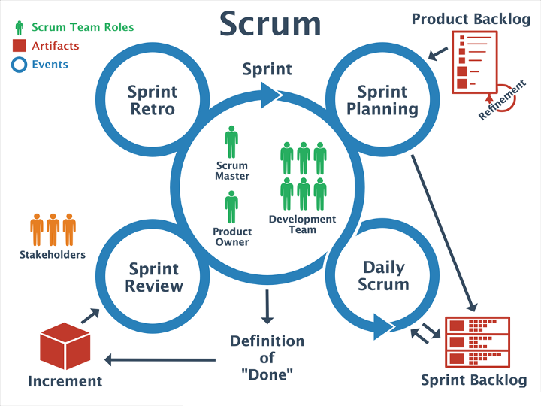
AGILE SCRUM Process
ROLES
STAKEHOLDER / BUSINESS OWNER
Main ROI Responsible, responsible for overall governance, compliance and business processes
PRODUCT OWNER
Customer Representative in the team. Good PO create user stories with clear why, acceptance criteria and provide clear priority and estimation of value
SCRUM MASTER
Team Coach and Process Facilitator. Good SM protect the team from external interruptions and allow focused execution of the Sprint Backlog.
EVENTS
Daily STAND-UP
Done via specific TEAMS channel; What did you do yesterday, what are you working on today, where do you need help; Participation of all team members
SPRINT PLANNING
1 hour, every 2 weeks meetings; Estimate effort and agree on focus for next 2 weeks; Participation of all team members
SPRINT DEMO
½..1 hour; Show the incremental value achieved in the past period and collect stakeholder feedback; Team members and all interested stakeholder; Walk-in encouraged
SPRINT RETROSPECTIVE
½..1 hour; Looking on what went well, what can be improved and what went wrong; Team members ONLY
BACKLOG PRIO
½ hour meeting preceding the Sprint Planning, aiming to organize all user stories in right priority order. Story creation should happen on continuous basis. Participation of all team members.
Sprint Goal
Improvements
Sprint
Definition
Of
“READY”
Feedback
Plan
Definition
Of
“DONE”

Slide 16
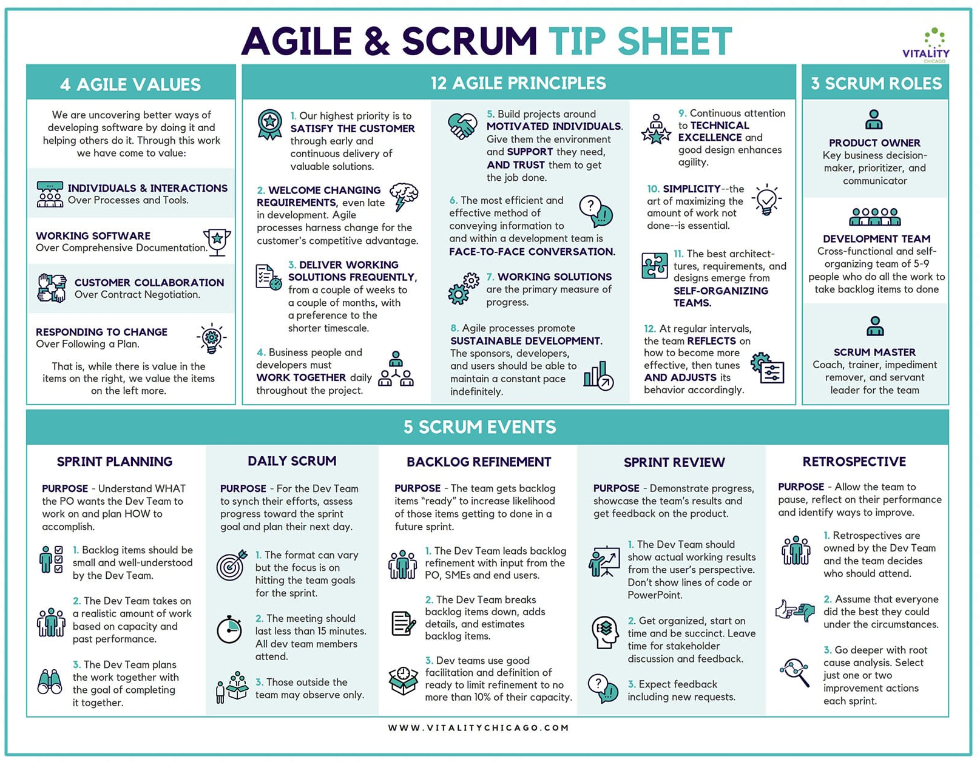

Slide 17
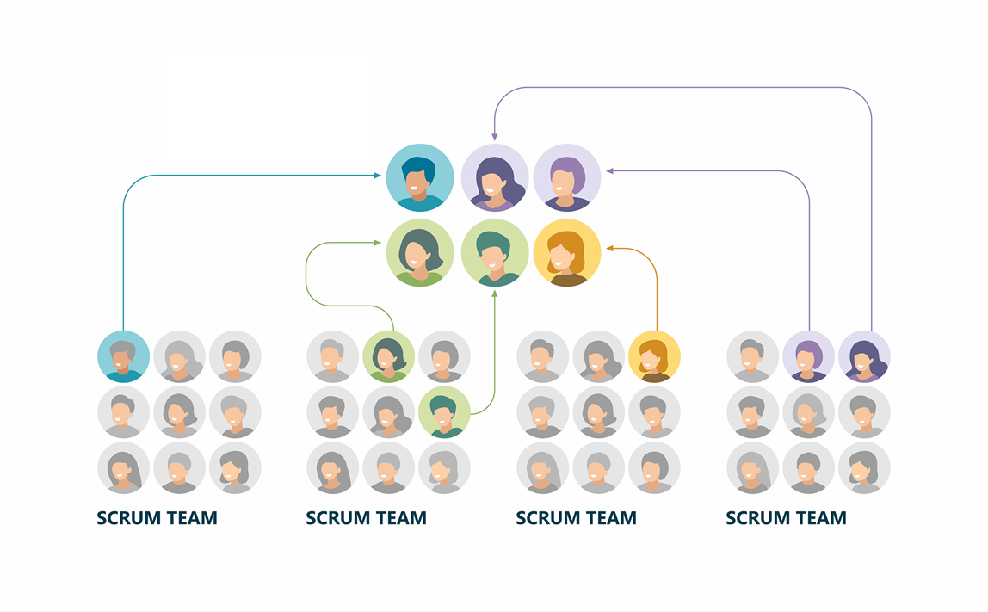
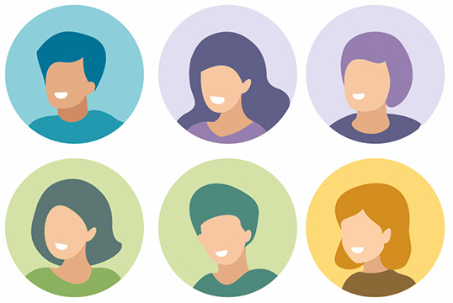
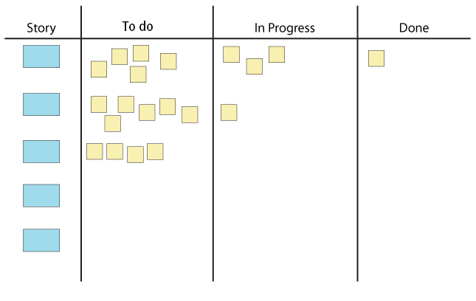
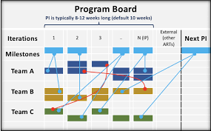
Scaling AGILE: SCRUM of SCRUMs
SCRUM TEAM
SCRUM of SCRUMS

