Slide 1
Type I vs Type II innovation programs
Success considerations for two quite distinct innovation missions
December 10th, 2025
InnoLead webinar

Slide 2


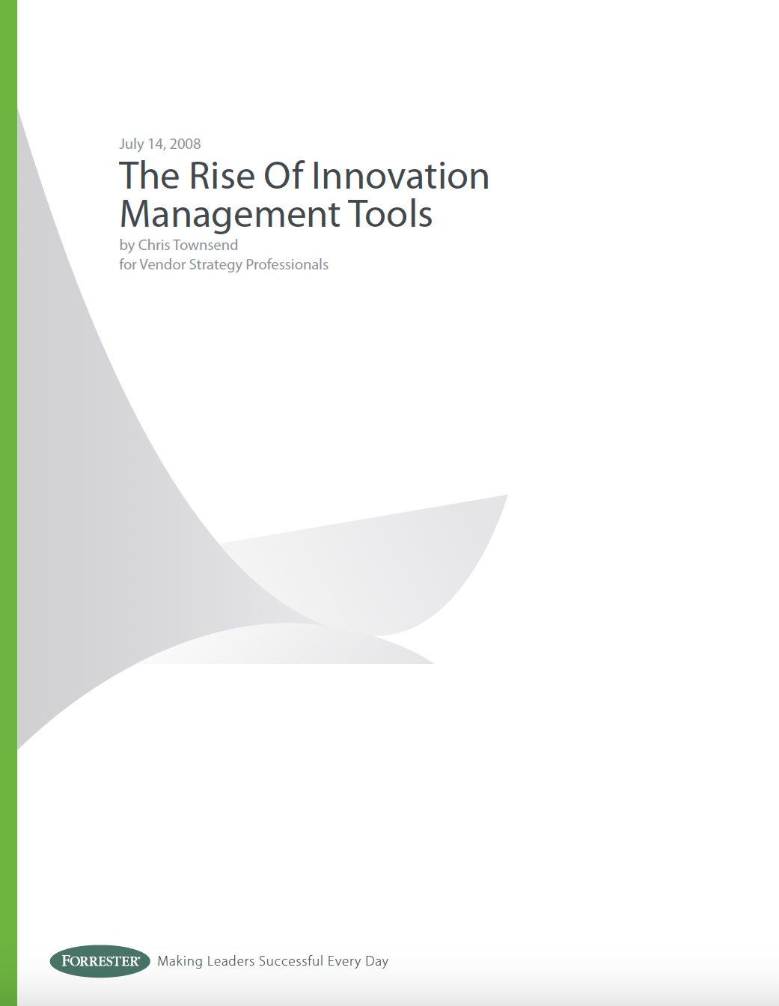
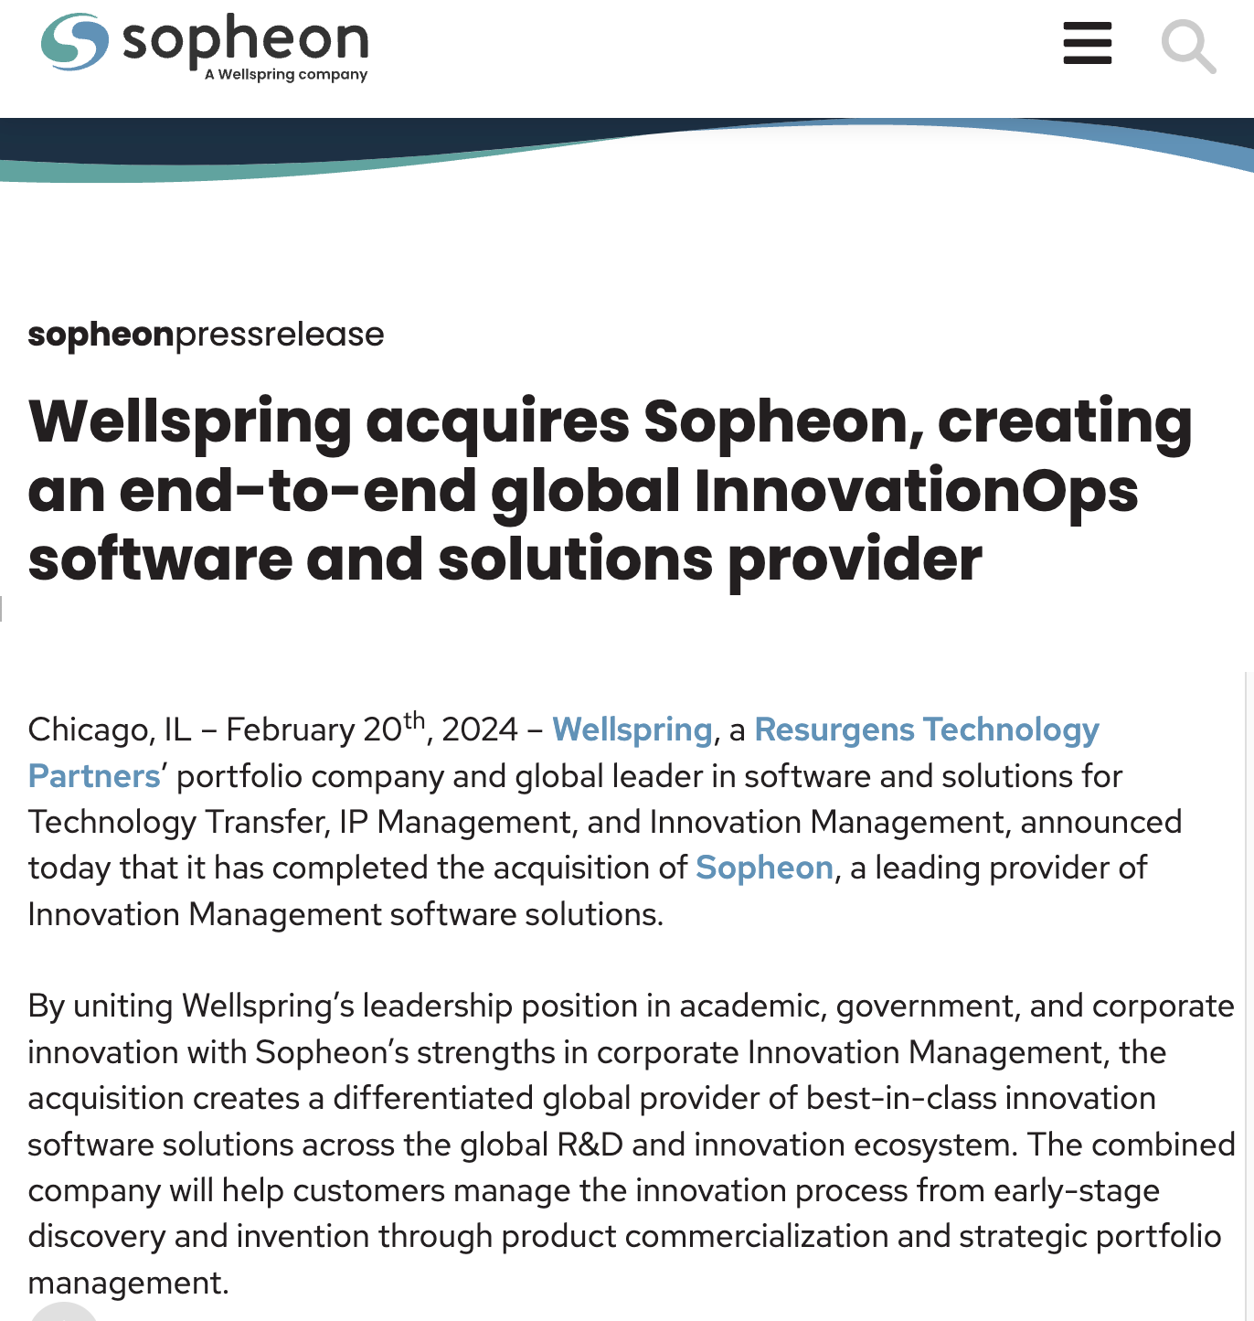


An 18-year love affair with Innovation Management
2007-2009
Forrester Research
2018-2024
2024-present
2010-2018
2009-2010

Slide 3
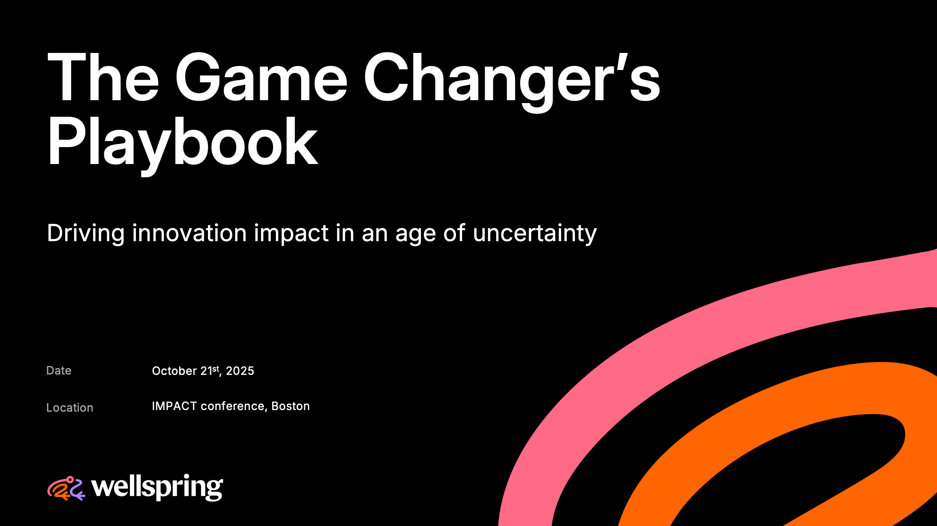
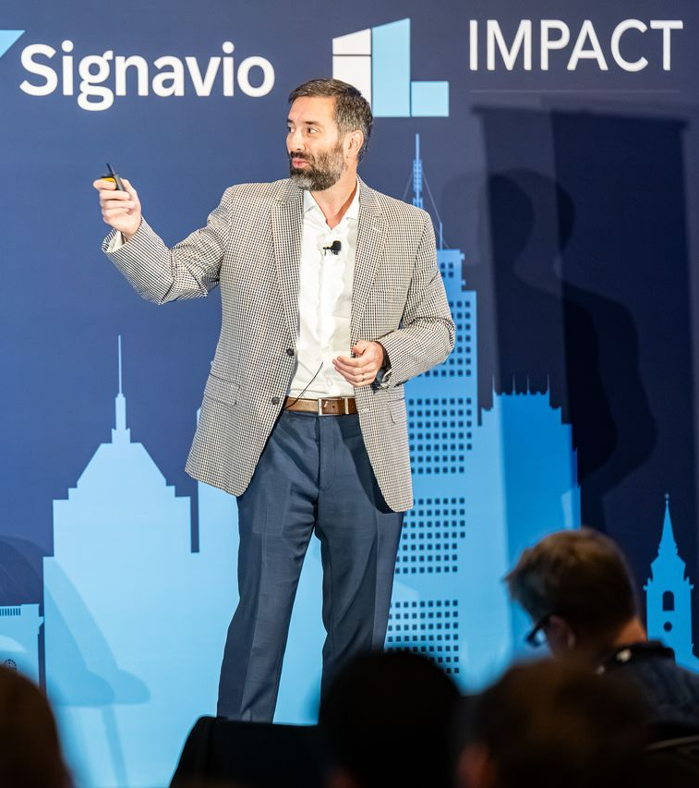

@ IMPACT 2025

Slide 4



Where have all the (previous) innovation teams gone?

Slide 5

The best way to do innovation is…
Our approach to innovation is…

Slide 6
Type I vs Type II innovation programs
Type I innovation programs
Type II innovation programs
Innovation programs motivated by a specific business challenge or opportunity (e.g., an energy company exploring the next-gen power grid).
Generalized innovation functions that drive business value across various parts of the company in perpetuity (e.g., New Product Development).

Slide 7
01
Type I innovation programs

Slide 8
Hallmarks of a Type I innovation program
Viewed as strategically important now; based on front-burner business issue.
Often created to bypass Type II programs that are deemed too slow / too cautious.
Often dependent on vision and/or charisma from one or more senior leader(s).
Usually fairly young; typically founded within the past few years.
In 5 years, I’m doubtful this program will still exist.

Slide 9
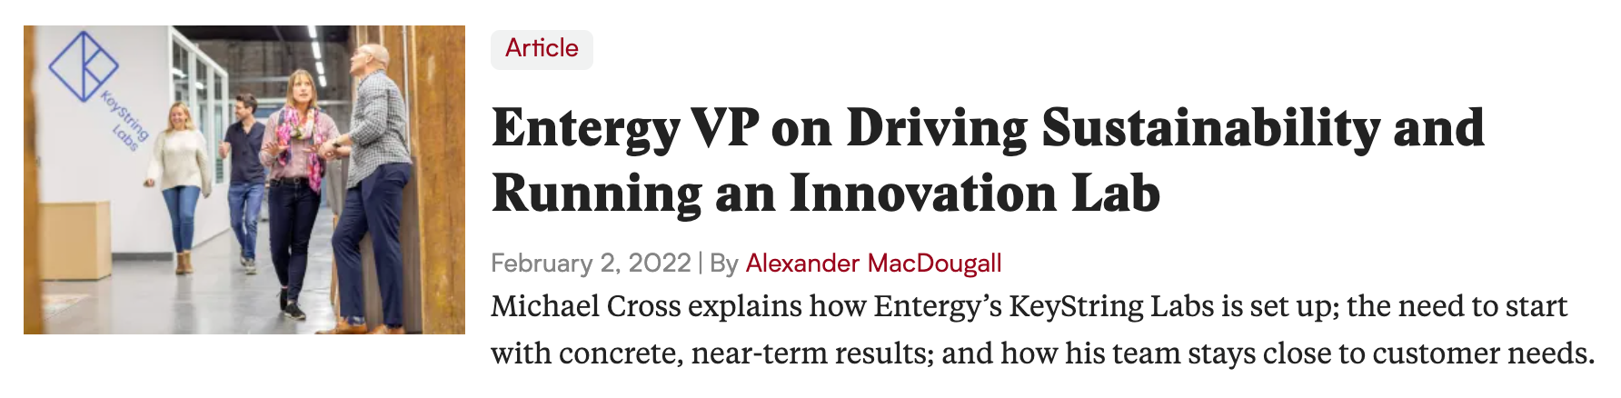
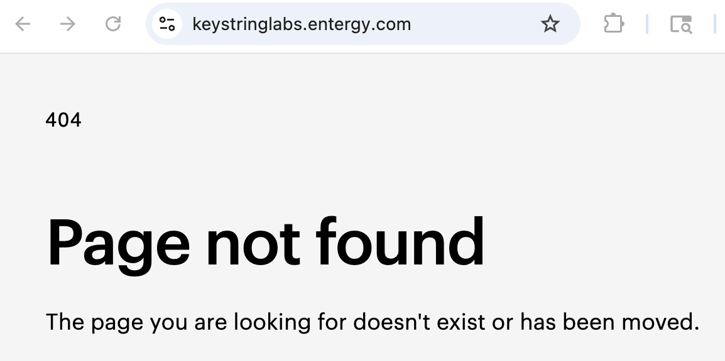
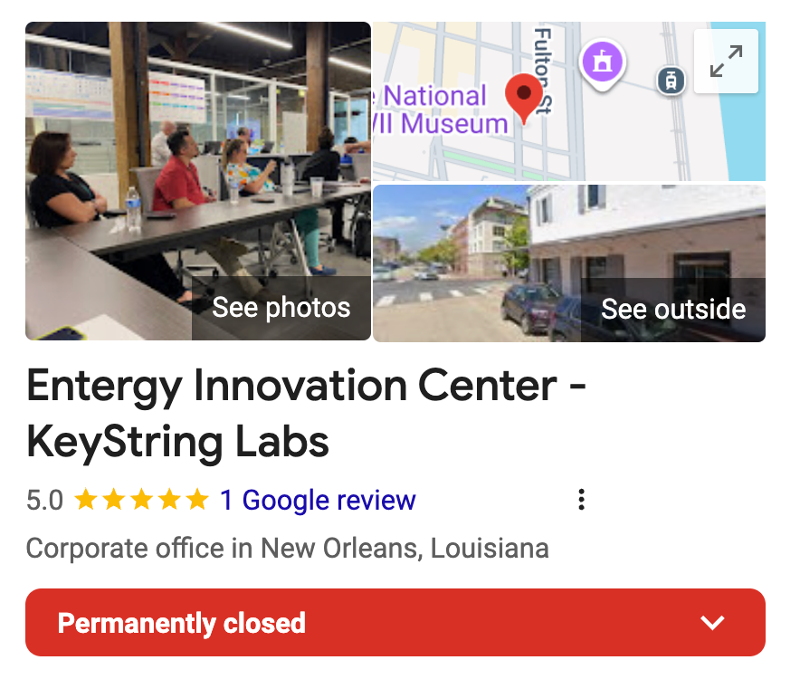
Type I program: exploring the next-gen energy grid
Entergy VP on Driving Sustainability and Running an Innovation Lab, InnoLead article, Feb 2nd, 2022

Slide 10

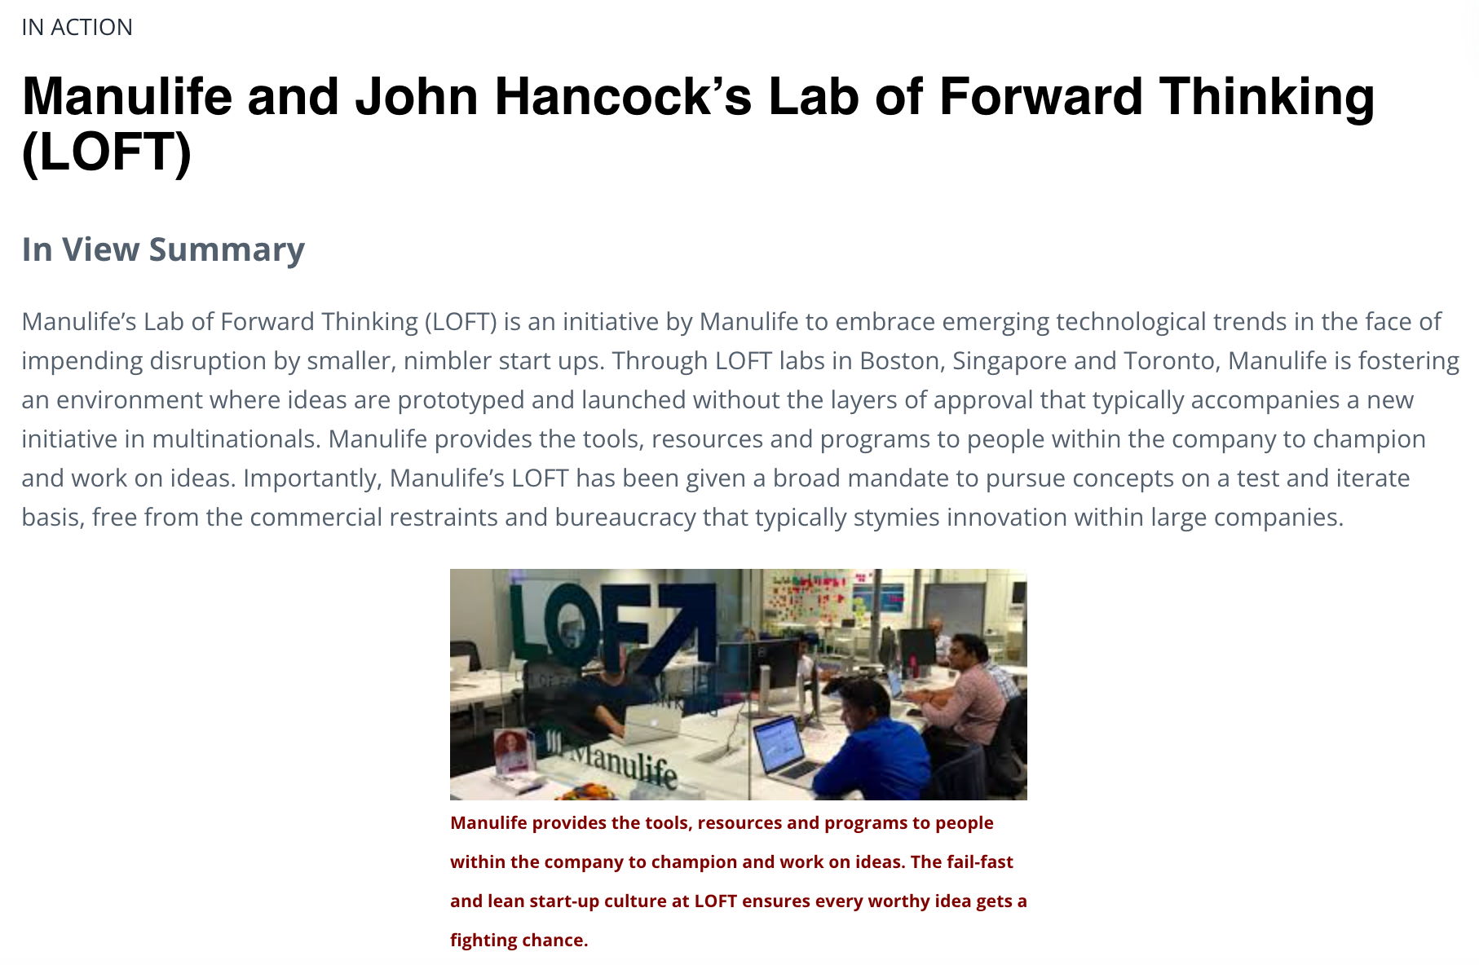
Type I program: Manulife / John Hancock LOFT
Manulife/John Hancock on How COVID Accelerated Digitization, InnoLead article, Aug 6th, 2020

Slide 11
The Type I endgame: three pathways
Dismemberment
Planned obsolescence
Evolution into Type II
Eliminated due to internal cost cutting
Eliminated as a casualty of re-org
Wrong model / not working
Original champion changes role / leaves company
Company strategy changes / no longer needed
Sabotaged / killed by another function or group
Disbanded once strategic mission is complete
Folded back into the business (as planned)
Time-boxed from inception
Rolled into an existing business function (Marketing, Product, Strategy, etc.) as an innovation subfunction.
Formally attached to one or more existing Type II programs.
Becomes a new Type II program of its own.

Slide 12
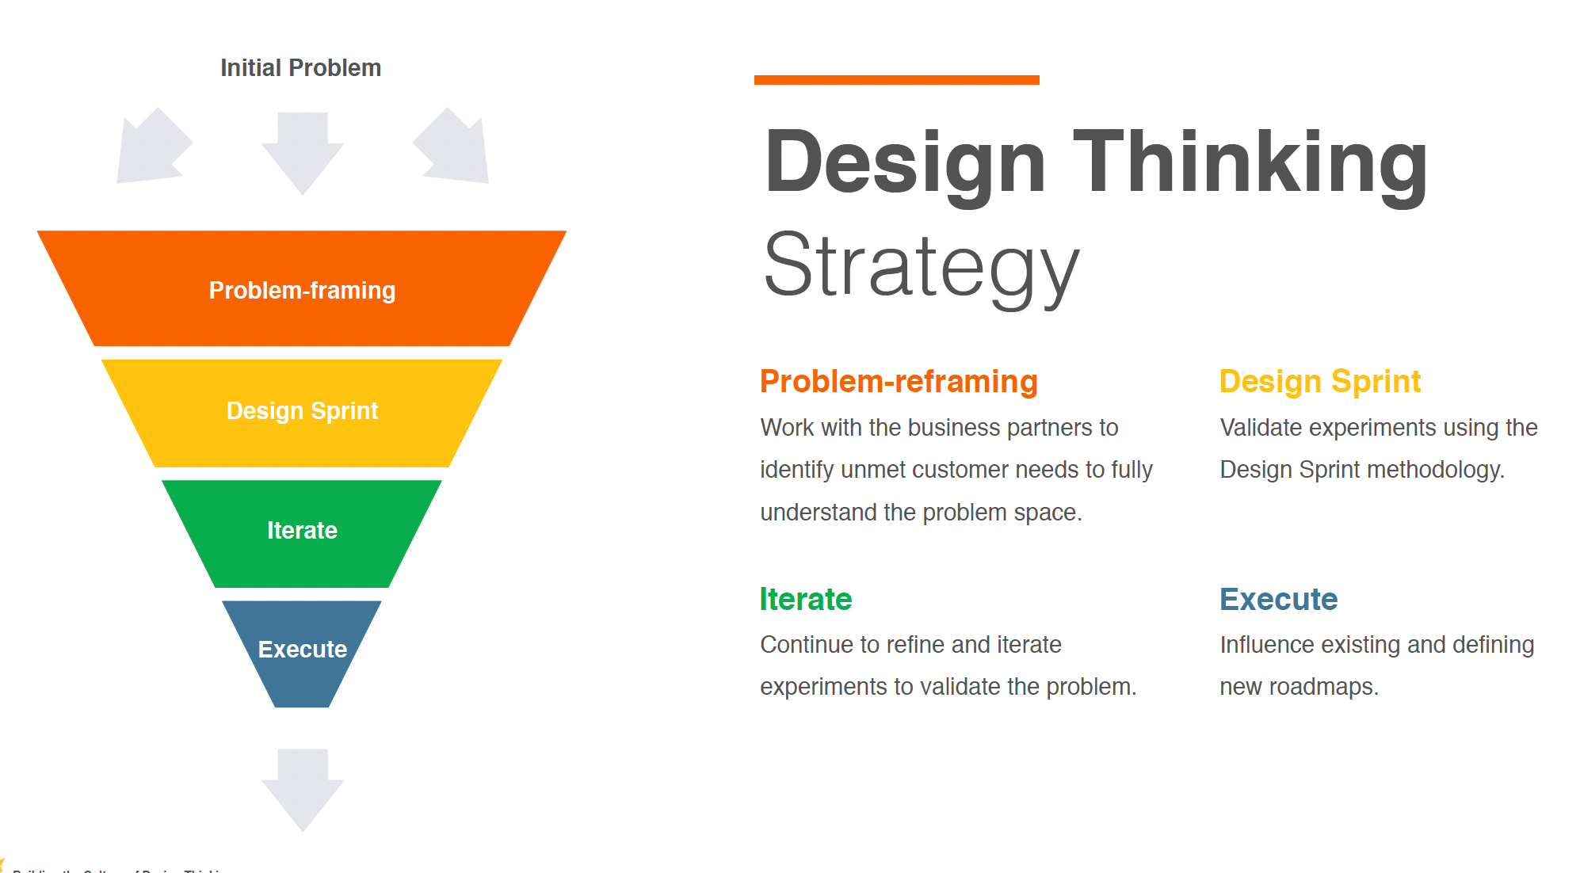
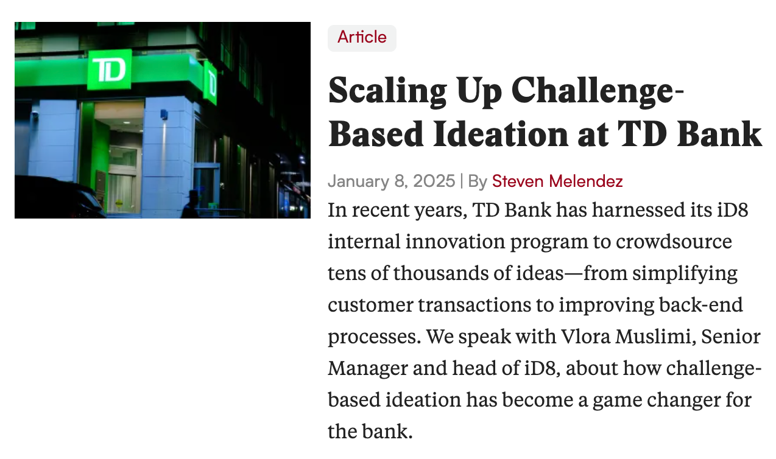
What about “shared service” innovation programs?
Design Thinking programs
Ideation programs
Home Depot: Building the Culture of Design Thinking, InnoLead resource, Dec 10th, 2018
Scaling Up Challenge-Based Ideation at TD Bank, InnoLead article, Jan 8th, 2025

Slide 13
02
Type II innovation programs

Slide 14
Hallmarks of a Type II innovation program
Viewed as mission critical to the enterprise.
Direct connection to a key part of the global operation.
Not dependent on a charismatic leader / internal founder.
Usually has been around for a long time already.
In 5 years, I’m confident this program will still exist.

Slide 15
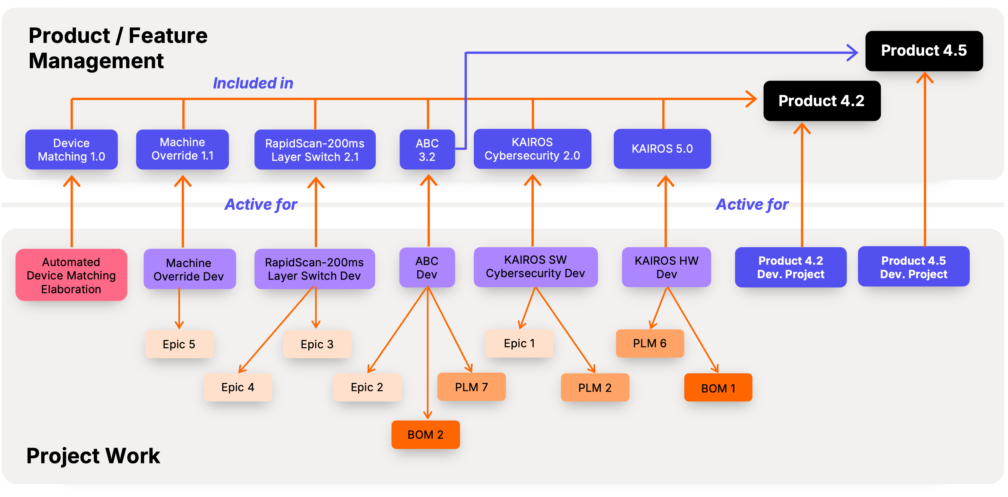
New Product Development (NPD): Classic Type II Program
Innovation Portfolio 1
NPD Program #1
NPD Program #2
New Product A
Product Extension B
NPV
NPV

Slide 16
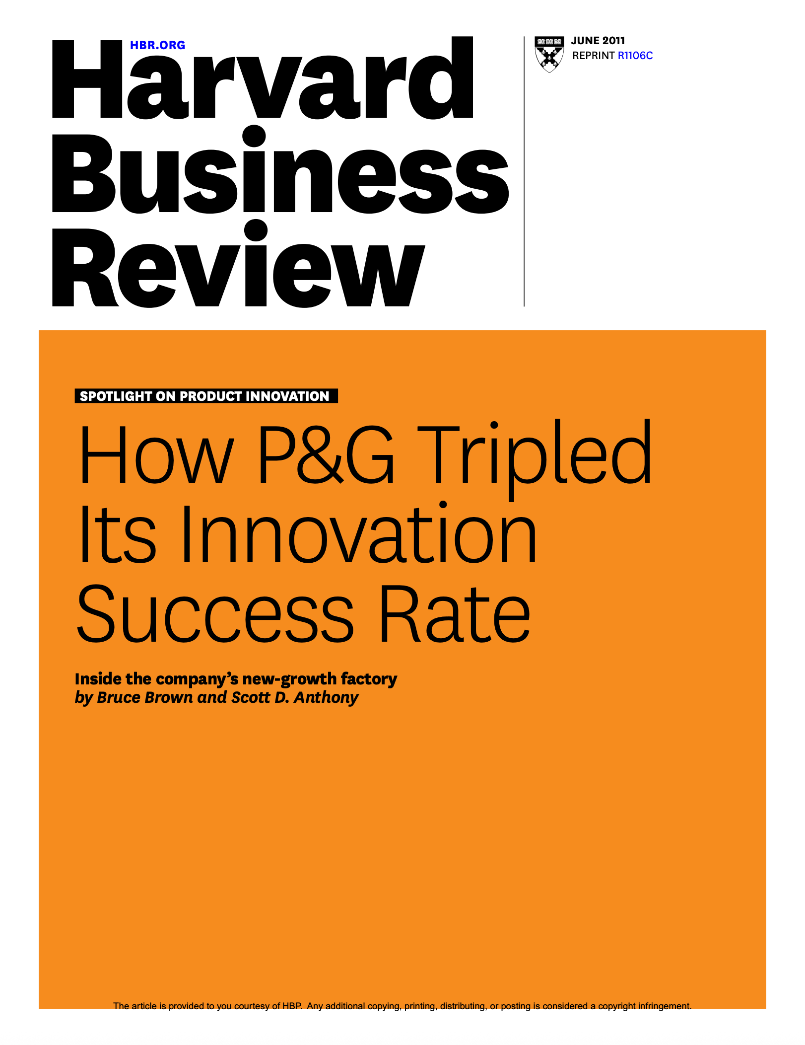
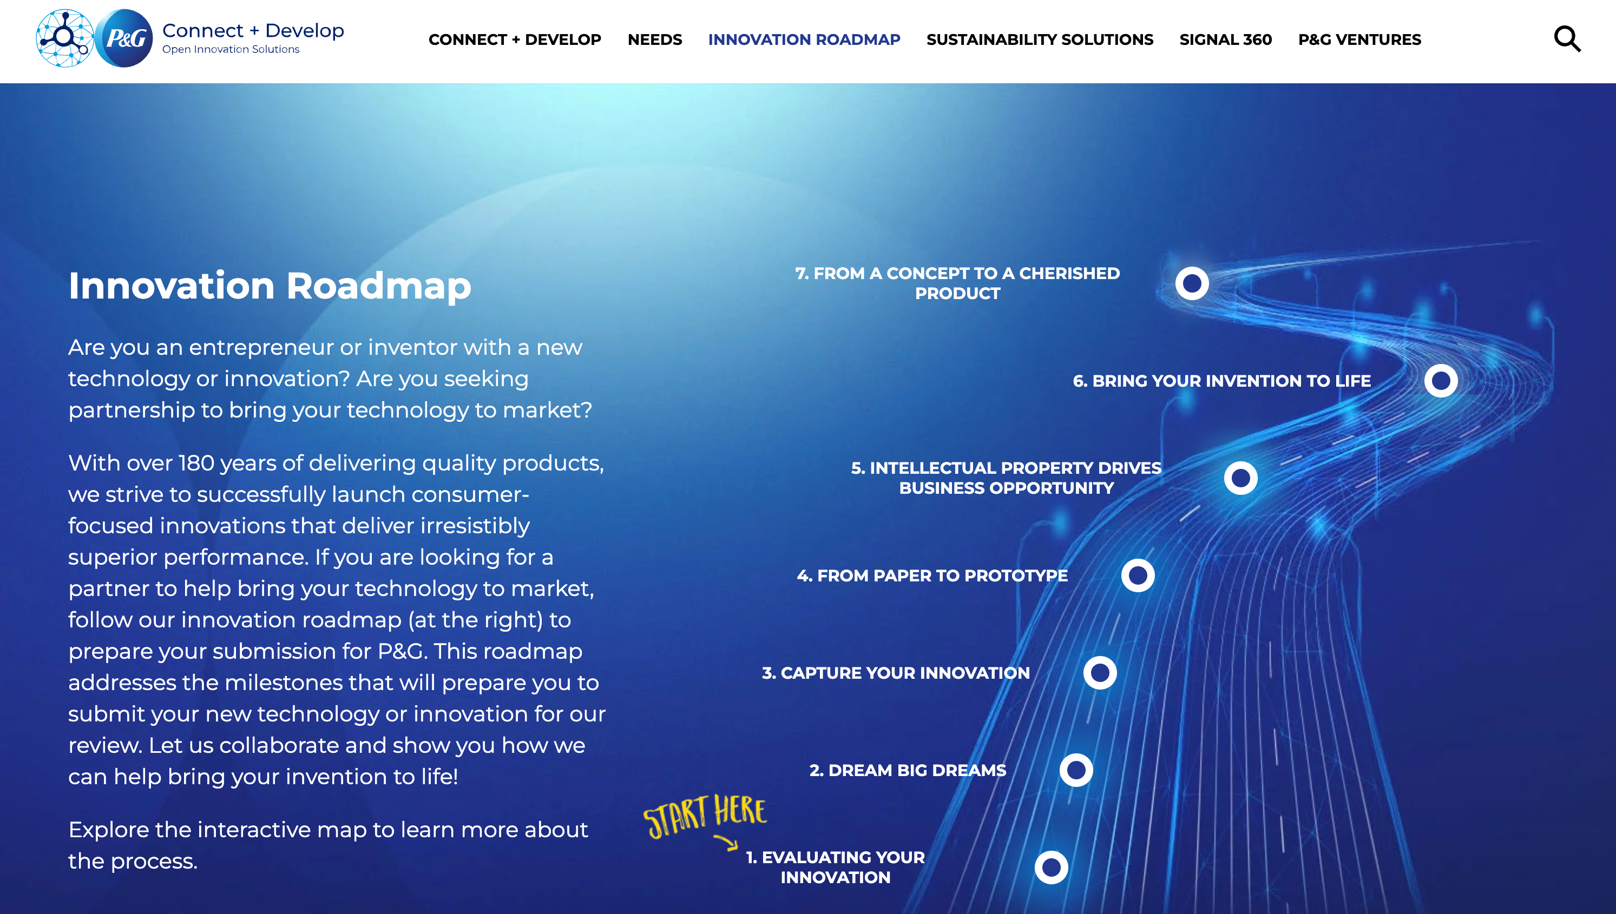
P&G Connect + Develop: from Type I → Type II

Slide 17
What does Type II success look like?
Delivering on your team’s KPIs / OKRs (because of course).
Not screwing up / not creating problems / staying under the radar.
Weathering re-orgs; avoiding staff and budget cuts.
Delivering “move the needle” enterprise value.
Playing a true 3-horizon innovation game.

Slide 18
Type II programs thrive when they scale together
R&D
NPD
Manufacturing
Mktg/Sales
R&D Program #1
NPD Program #1
GTM Program #1
Factory innovation programs
R&D Program #1
NPD Program #2
GTM Program #2

Slide 19
03
Putting it all together

Slide 20
Which type of innovation program are you?
Most Type I innovation programs
Market Growth
GDP
Most Type II innovation programs
Time

Slide 21
Why Type I and Type II need each other
Provides relevance, exec attention, fresh energy, investment options
Type I innovation programs
Type II innovation programs
Trendy
Top-of-mind
Fleeting
Localized
Boring
Overlooked
Stable
Scalable
Provides stability, longevity, scalability, operational grounding

Slide 22
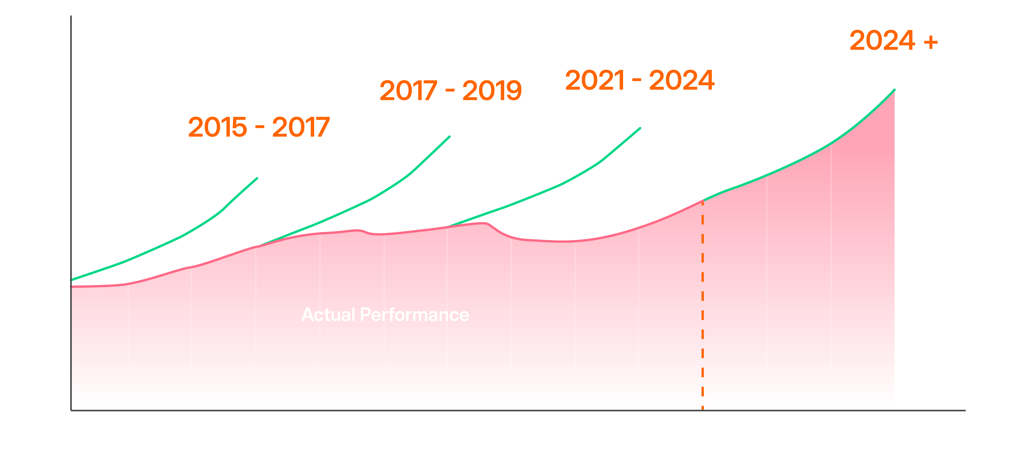
”Our innovation investments must move the needle”
Strategic growth plans consistently fall short

Slide 23
The #1 business priority has changed
Which of the following initiatives are likely to be among your organization’s top business priorities over the next two years? (select up to three)
2021
2022
2023
2024
2025
Digital Business Transformation
(49%)
Digital Business Transformation
(51%)
Digital Business Transformation
(49%)
New Sources of Revenue Growth
(43%)
New Sources of Revenue Growth
(45%)
Source: Wellspring, 2025 Innovation Outlook, March 2025

Slide 24
Most companies: (at least) two different growth systems
Finance, Mktg, Sales
R&D, Product, Innovation
(nominal high-level leadership coordination)
Top-down revenue planning and GTM execution
Flows directly from corporate growth & profitability targets
Bottom-up project proposals and stepwise investments
Notionally connected to business goals, but operates in a different universe
??
(absent or under-developed mid-level coordination)

Slide 25
The “Growth Innovation” structure that unites both Types
SparkSurge (product family)
Type: New Product Introduction (2028 launch)
Revenue Stream (proj.): year 1: $50-100M; year 5: $300-$800M
R&D
NPD
Manuf.
Mktg/Sales
(option for 2027 / 2028)
associated innovation programs (active in 2025)
AirConnect Plus 3G
Type: Product Extension (2026 launch)
5-year NPV: $242M
R&D
NPD
Manuf.
Mktg/Sales
associated innovation programs (active in 2025)

